Slide 1
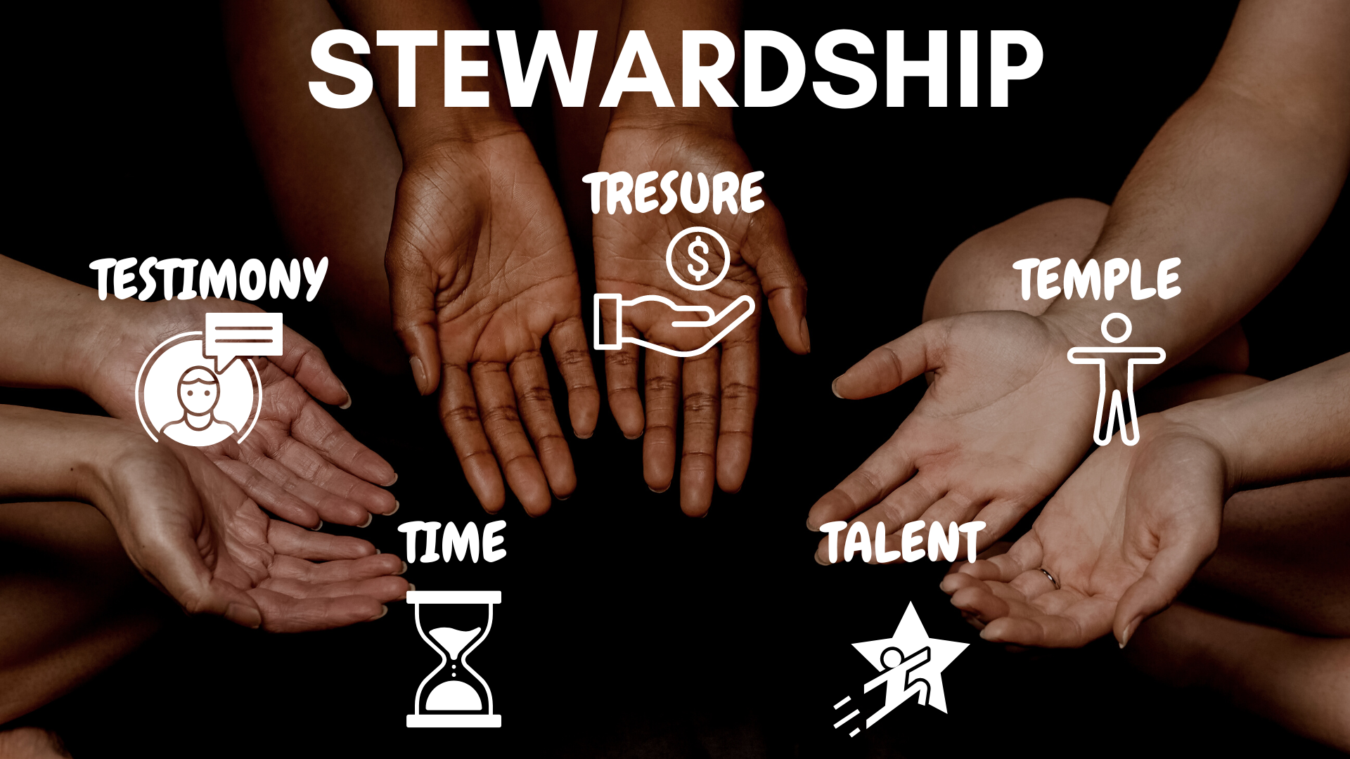


Role of the Stewardship Director in the Local Church
By Dr Jacob Mahlangu
NCSA Stewardship/AMO Director
2022-2025

Slide 2
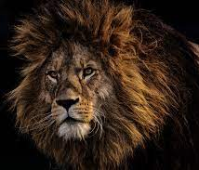
Deuteronomy 31:7 says:
Then Moses called Joshua and said to him in the sight of all Israel, “Be strong and of good courage, for you must go with this people to the land which the LORD has sworn to their fathers to give them, and you shall cause them to inherit it.

Slide 3
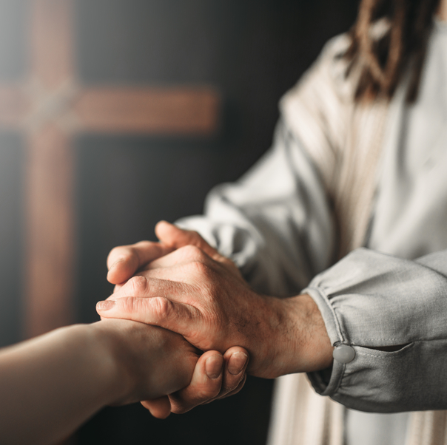
Meaning of Steward:
In Old French:
A Seneschal or a Steward is a highly trusted appointed officer of extraordinary dignity and reliable dependability.
He or she has been appointed under judiciary terms in order to oversee that the interests and possessions of his Master are managed and protected.

Slide 4
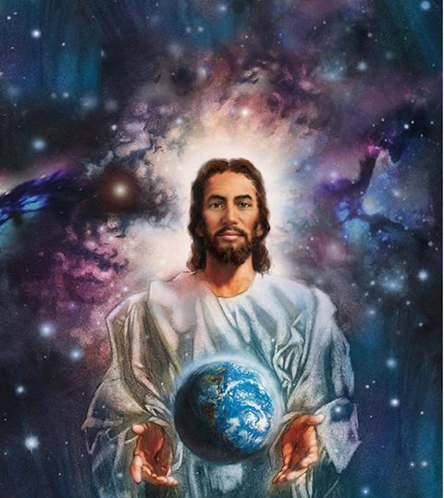
A Stewardship Director is an ecclesiastical leader whose primary calling is to influence and guide the whole church unto God’s Agenda /His Mission

Slide 5

God’s Agenda is Leaning & doing His will!

Slide 6
The first port of call of a Stewardship Director is to be a Christian model practitioner.
He must model Godly confidence before the church.
He must model sacrificial living.
He must be willing to be a player coach… modelling team ministry.
The Lord said to Abram “ Walk before me faithfully and be blameless”
Genesis 17:1

Slide 7

A Stewardship Director is called to move the Church unto God’s Agenda
[A] Spiritual Renewal:
While God’s church is both a Prophetic Movement and a Movement of Destiney; its survival and Mission progression is entirely dependent upon the leadership of the Holy Spirit who alone transforms and renews every member’s commitment to the lordship of Jesus.
Romans 12:1-2

Slide 8
Suggested tips to go around this venture:
Keep this following advice at the top of your mind:
“ Remain in me, as I remain in you. No branch can bear fruit by itself; it must remain in the vine. Neither can you bear fruit unless you remain in me”
-John 15:4

Slide 9
Begin by prayerfully surveying the spiritual topography of your church.
Do this by simply conducting an assessment exercise that will show the spiritual tempo of your church.
The exercise must engage the members on their knowability upon the subject of vertical connectivity with Christ, and their call to a life of faithful partnership with God as stewards.

Slide 10
After undertaking the above exercise; as a Stewardship Director respond by engaging your church into a Spiritual Renewal exercise.
Develop a curriculum that will guide your church to connect with its Maker.
Position your church like a satellite dish to connect with the biddings of the Holy Spirit so that members can experience renewal messages.
-Acts 13:2

Slide 11
Establish small Prayer groups that will pray towards the Renewal Exercise.
Share Reviving messages that are directed at their hearts and not at their pockets

Slide 12

(B). Do Strategic Engagement with your church.
Understand the age groups that you are dealing with.
Seek to understand the Gender Structure of your church.
Understand the carrier landscape of your church. This will assist you in understanding their giving patterns.

Slide 13
Deliberately check their level of participation in spiritual programs.
Check their level of participation in tithes and offerings beginning with church board members.
NB: This is meant to encourage your leaders to lead by good example.

Slide 14
Seek to understand principles that motivate them to give.
Seek to understand challenges that demotivate and cause them not to participate adequately.
Ask them to suggests areas that need your intervention.
Develop a curriculum that responds and addresses their felt needs.

Slide 15
Form Stewardship Counsels in your church.
The functions of a council are encompassed in the slides below

Slide 16
How Departments work?
Departments work through Counsels and Counsels serve on an Advisory Role.

Slide 17
Structure of all Councils:
Elder is the chairperson
Director is the secretary
Plus two or three members approved by the board
The Pastor is an Ex-Officio member

Slide 18
Seating of the Council
The Council should have one full seating at least once a quarter.
And further have sub seating times as agreed upon by members and as needs arise.

Slide 19
Function of the Council:
1.Goals are the function of the Conference Executive Committee.
2. Objectives are the function of the Conference Departmental Directors.
3. Activities are the function of a Local church

Slide 20
1. Pray and fast for the Departmental programs, seeking the Holy Spirit’s guidance in making an impact on God’s people.

Slide 21
2. To come up with Strategic projects and programs that must carry your Thematic needs as demanded by your Strategic Plan for implementation.

Slide 22
3. To identify, recruit and train personnel (TOT’s) that is going to be involved in the running of the department.

Slide 23
4. Plan and work out a departmental budget in light of the work that must be done in the ensuing year and submit it to the church board for consideration and possible approval.
EG: WHEREAS the church needs to buy a black dog for efficient security for the Pastor’s house.
NOTED policy allows local churches to own black dogs (CM page 99)
NOTED a black dog costs R750.
NOTED three quotations have been provided for consideration from three different companies that provide black dogs.
NOTED the department has further checked with the treasurer to find out the Church’s cash flow and the response is positive.
Voted to recommend to the church board to buy a black dog at Spar Menlyn for R750 on the first of April 2021 for the Pastor’s security.

Slide 24
5. To identify and recommend the right personnel that are in good and regular standing that the department would be able to use as facilitators for their programs and seek for their clearance for use on time with the Elders and the Church board.

Slide 25
6. The Stewardship Director should come up with a Strategic Instrument for doing departmental follow ups in terms of program impact assessments.
Come up with continuous training programs within the department.
On the job training or refresher courses.

Slide 26
7. The Stewardship Director should prepare a departmental report to be present to the church board and the Church Business meeting.

Slide 27
8. The Stewardship Director should recommend Departmental policy changes to the Higher organization through the church board and business meetings.

Slide 28
Stewardship Visiting Committee in your church.
Each church must have Visitation committees
Below is a simple example of what a visitation committee does.

Slide 29
After a while Paul said to Barnabas, “ Let us now revisit the brethren in various towns in which we have made known the Lord’s message- to see whether they are prospering.”
Acts 15: 36

Slide 30
The word for visit or visitation as indicated in the following verses Genesis 21:1, Genesis 50:24, Exodus 3:16, Exodus 4:31 and Ephesians 6:4 is Paqad in Hebrew and Paideia in Greek and Erudio in Latin.

Slide 31
The inter changeable usage of these words in the three languages compoundly suggest that the word to Visit subsequently means:

Slide 32
[a] To be concerned about someone’s well being.
[b] To attend to someone who is losing their bearings in life for the purpose of providing immediate support.

Slide 33
[c] To render assistance to a friend after noticing a need in their life.
[d] To throw a lifeline to a person who is helplessly drowning in a pool.

Slide 34
[d] To disciple a person.
[e] To train, equip and empower a person with life skills

Slide 35
[f] To observe with care and practical interest.

Slide 36
A wise English saying goes “a bird in hand is worth two in the bush.”
The implication of the above statement suggests that while it is imperative for the church to go out and conquer new lands for the Lord on a daily basis and bring new fresh souls into the fold, it should remain cardinal in its life to value and preserve those that have been won for Christ already.

Slide 37
Trends have clearly proved beyond reasonable doubt that taking a casual approach as a church in showing practical concern towards our fellow believers' has cost us a lot in many ways than one and has in turn compromised the quality of our church growth.

Slide 38
We now appear to be more caught up in a disease called numberitis [the concern of statistics than the concern about real people].

Slide 39
The church should be God’s eyes to see for him the needs around its membership in a holistic ways. 1.There are those who slide away into spiritual cold rooms and freeze their spirituality into the bottomless pit. 2.There are those also who freeze from inside out but without showing any signs of withering immediately but you can through their level of non involvement or less involvement in their tithe returns and their giving of offerings tell that they are carrying heavy blocks of ice in their faith. 3. Yet at the same time in each church you shall find those who have put their lives into Auto piloting[ Isaiah 30:21; Revelation 2:10], they do right because it is right and then leave results with God. They totally trust God with their lives and everything they have. Unquestioning obedience is always the buzz word in their lives.
NB: All these three categories need to be attended to conscientiously and be nurtured adequately according to their levels of need.

Slide 40
As a body of believers, the church of Christ should always find as its primary interest the need to deliberately develop spiritual muscles in every church member by way of investing a lot of time equipping and empowering as well as nurturing them through the word of God that alone can provide nutrients enough to produce a faithful steward.
NB: Churches of our generation are known of producing church goers rather than disciples. Disciples price the interests of their Master high above theirs and their lives.
Church goers are loyal only as they feel that their personal interests are met.

Slide 41
Visiting Committees:
Depending on the size of the church and the needs thereof a church should establish stewardship visitation groups through the stewardship council and the church board.

Slide 42
Each visiting group must not have more than three people and not less than three as well. This is to avoid overwhelming the person who shall receive this special visitation. Numbers themselves speak volumes regarding this nature of visitation and may impose fear and a sense of guilty to the one being visited.

Slide 43
Stewardship Council composition:
1.Stewardship Director (Council Secretary).
2. Chairperson (Elder/s).
3. Church Treasurer
4. Head Deacon
5.Head Deaconess
6. Two members that are voted by the board
7. Pastor (Ex officio)

Slide 44
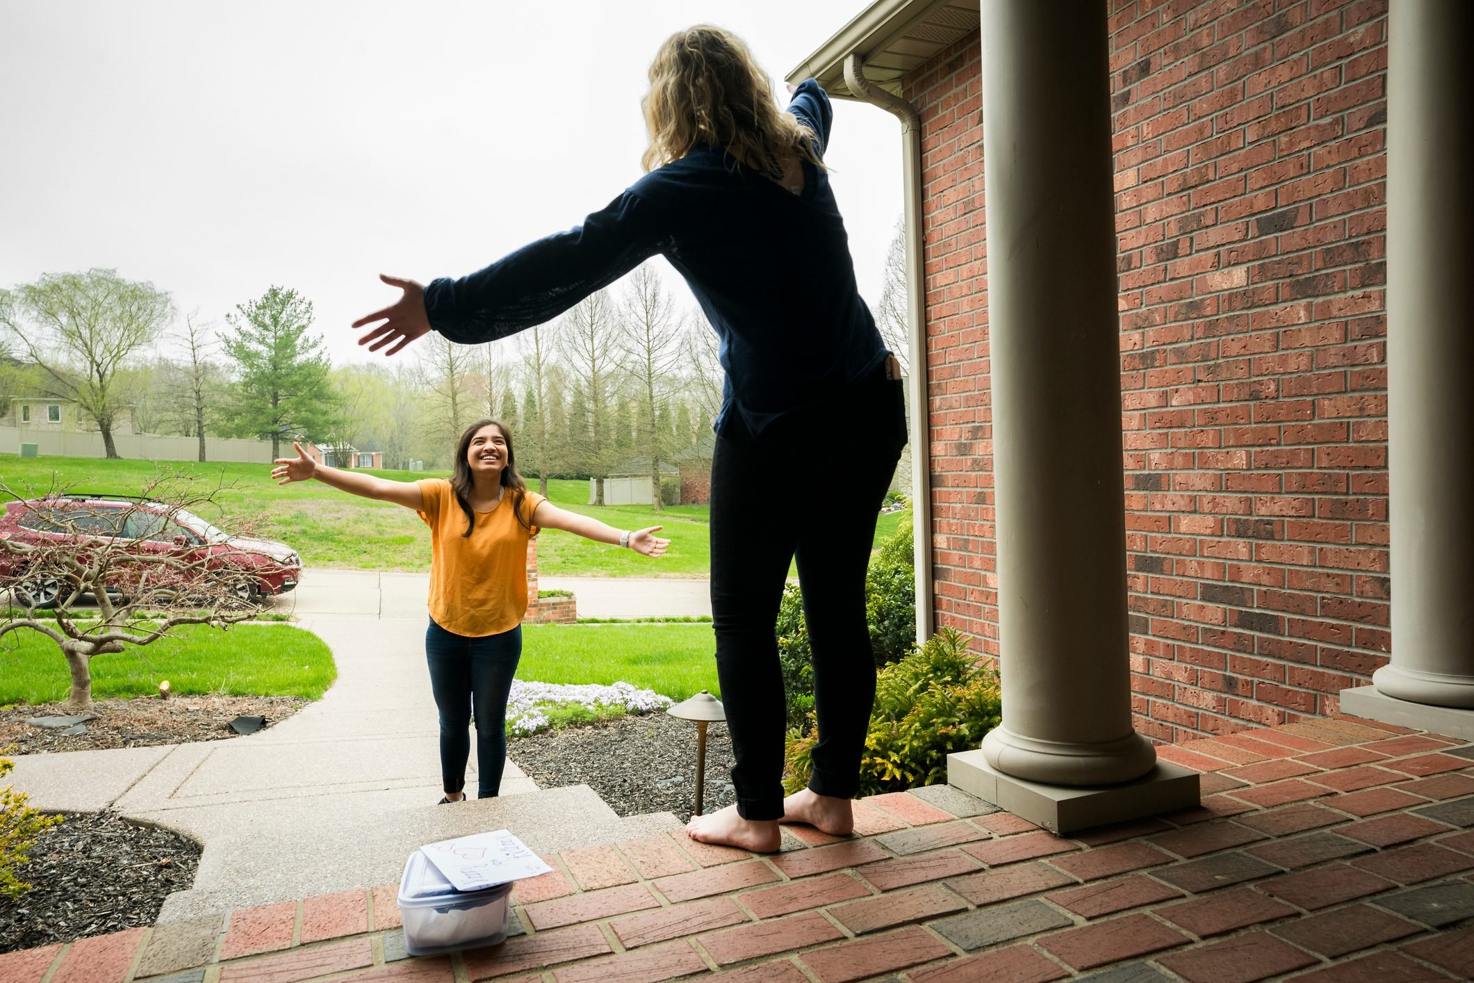
GROUPS OF PEOPLE TO BE VISITED:

Slide 45
Group 1:
Faithfull Practitioners
Regular in attendance and in returning tithes and offerings
Visit for 15-20 minutes
Step 1:
Friendship and casual questions about the family or work to establish report.

Slide 46
Step 2:
Affirmation
“ We are very happy to see that you are regular in attendance and in giving. We would like to encourage you to continue to grow in your relationship with God.
Bible text[ Matt 25:31] “ Well done good and faithful servant. You have been faithful with a few things; I will put you in charge of many things. Come and share your Master’s happiness.”

Slide 47
Step 3:
Testimony
Ask: “Would you like to share with us something about your experience with God”?

Slide 48
Step 4:
Prayer:
Ask for prayer requests the member may have.
Prayer by member and one of the visiting team members.
Step 5:
Good bye

Slide 49
Group 2
Random Practitioners
[Are those who are erratic in giving and in attendance]
Visit for 20-30 minutes

Slide 50
Step 1:
Friendship and casual questions about the family or work to establish report.

Slide 51
Step 2
Evaluation of spiritual needs
Avoid being judgmental and confrontational
This year as a church, we are reviewing the principles of stewardship in relationship to our commitment to God. Our desire is to visit and pray with each member as a way of enhancing our relationship with God. We would like to hear from you if you have any questions or concerns about stewardship and total commitment to God.
If the church records are correct, it seems that you have not been able to participate in returning your tithe for a while but it may also be true that you are probably using a different name.
We are here to provide support and encouragement to you as a child of God.

Slide 52
Step 3:
Bible Study
If the response from the person indicates that he has little knowledge on the subject of tithe and offerings…you may want to prepare a full study at a later date that you should arrange with them before you live.

Slide 53
Step 4:
Affirmations:
Do Affirmation and provide word of encouragement
We are very happy for your decision and we know that God is happy too.
Step 5:
Prayer
Ask for specific prayer requests and pray for those requests.
Step 6 – Good bye.

Slide 54
GROUP 3:
Non- Adherent Practitioners
Those not regular in attendance or giving.
Visit for 30 – 45 minutes.
Step 1 – Friendship – Ask questions about family and work to establish a rapport.
Step 2 – Evaluation of Spiritual Needs – Avoid being judgmental and condemnatory.
This year, as a church, we are reviewing the principles of stewardship. Do you have any questions or concerns about the stewardship program?
Listen carefully to the answer of the member.

Slide 55
Step 3 – Politely find out from them where they are stuck and let them suggest the kind of help they may need.
Step 4 – If they are frank and open, move ahead and respond to their need. If they are evasive and doggy , politely probe a little more to show you where they are stuck…. Don’t suggest where you think they are stuck.
Step 5 – Call for a commitment, a consecration to God and to being faithful in giving.

Slide 56
Step 6 – Affirmation. 1. ‘We are very happy for your decision and we know that God is happy too.’ 2. ‘You will need our spiritual support to keep your commitment. Let’s pray together.’
Step 7 – Prayer of Consecration: Prayer by the member, then prayer by the visitor.
Step 8 – Good-bye

Slide 57
Assist your churches in drawing up annual budgets and provide guidance on the budget formulation and budget management processes.

Slide 58
Develop a tithe and Offering check list through ACMS for your church beginning with your church board.
Appraise your board members during the Treasurer’s financial presentation for the church board.
Take a minute or two of this time and make your observations and then end by providing motivation and encouragement.
NB: Do not mention names but figures alone for both participating and non participating members.
Develop a Tithe and Offering check list for all members.
Appraise them during the Business meeting session.
Put up a Bar or Pie chat to explain your figures.

Slide 59

(C) Educational Engagement with the church teaching - approach
A Stewardship Director needs to teach wholistic Stewardship Education that is informed by Scriptures, powered by the Holy Spirit and centred on a saving living relationship with Christ.

Slide 60
In essence, Biblical stewardship is all about our Individual and corporate Response to God’s grace and redeeming love towards us, and this is factored by how we choose to relate to him through the management of all resources that he has entrusted in our hands to manage on his behalf.

Slide 61
Encompassed on the list of Management categorizations are central facets such as:
1. Time 2. Body Temple 3. Treasure (Various Possessions) 4. Talents
5. Testimony

Slide 62
Time:
Our Time belongs to God.
(Psalm 34:1, Psalm 89:47)
Ecclesiastes 3:1-8
Isaiah 33:6
“Every moment is his, and we are under solemn obligation to improve it to his glory.
Of no talent he has given will he require more strict account than of our time.”
COL page 342

Slide 63
Body Temple: 1 Corinthians 12:27
1 Corinthians 6:19
1 Corinthians 3:9,16
By allowing ourselves to form wrong habits, by keeping late hours, by gratifying appetite at the expense of health, we lay the foundation for feebleness.
By neglecting physical exercise, by overworking mind or body, we unbalance the nervous system.
Those who thus shorten their lives and unfit themselves for service by disregarding nature laws, are guilty of robbery towards God.
And they are robbing their fellow men also.
COL page 346

Slide 64
Treasure (Possessions):
Psalm 50:10-12 Deuteronomy 8:18
Proverbs 10:22
Zechariah 14:14
Ecclesiastes 5:19
It is no sin to acquire and control property as stewards for God, holding it only until he shall require it for the necessities of his work.
OHC page 194

Slide 65
Talents:
Titus 3:14
Matthew 25:14-30
1 Corinthians 12:4-11
1Corinthians 14:12
Ephesians 4:8,11-12
The talents of speech, memory, influence, property, are to accumulate for the glory of God and for the Advancement of his kingdom.
CS page 116

Slide 66
Testimony:
Our personal encounter with the person of Christ will always result in a testimony. “ But sanctify the Lord God in your hearts, and always be ready to give a defense to everyone who asks you a reason for the hope that is in you, with meekness and fear”
1Peter 3:15
Any iniquity and spiritual frailty disappears upon allowing Christ to dwell in the inner sanctuary of our souls
“ And they overcame him by the blood of the Lamb and by the word of their testimony, and they did not love their lives to the death.”
Revelation 12:11

Slide 67
Educate the church on the use of tithe and Offerings.
Teach them on what the Bible says it should be used for and what it can not be used for.
Show them the following chart on Tithe and Offerings distribution from local church to the General Conference in support of the Mission.

Slide 68
Tithe sharing percentages with higher Organizations
 | Percentages | Remarks
Retirement Fund | 6.25%
SID | 7.0%
SAU | 0.50%
Helderberg College | 5.0%
Publishing | 3.25%
Tithe of Tithe | 10.0%
VOP | 1.5%
Total Percentage Remitted to Higher Organizations Local Conference share | 33.5% 66.5%
NCSA Percentage Share | 66.5%

Slide 69
Schedule of Offerings Sharing
 | Percentage Share
Local Conference | 20%
World Mission: GC | 20%
Union Conference SID | 5% 5%
Total Share | 50%
Local church | 50%

Slide 70
Provide visible support to your local church members and the council as a whole.

Slide 71
Promote the Stewardship Calendar as provided by the General Conference through your Local Conference and lead your teams into implementing them accordingly.

Slide 72
Conduct Stewardship evaluations with your local church at least once a year.
Have a Remittance Diary for your church.
NB: This is for the purpose of assisting your church to remit Trust Funds every month without fail.
Be in close consultation with your Local church Treasurer, they must send you a copy every month before sending their copies to the Conference.
NB: Mind the Conference cut off dates.

Slide 73

Let the church appoint pastors or elders who are devoted to the Lord Jesus, and let these men see that officers are chosen who will attend faithfully to the work of gathering in the tithe. If the pastors show that they are not fitted for their charge, if they fail to set before the church the importance of returning to God His own, if they do not see to it that the officers under them are faithful, and that the tithe is brought in, they are in peril. They are neglecting a matter which involves a blessing or a curse to the church. They should be relieved of their responsibility, and other men should be tested and tried.
Counsels on Stewardship page 106:1

