Slide 1
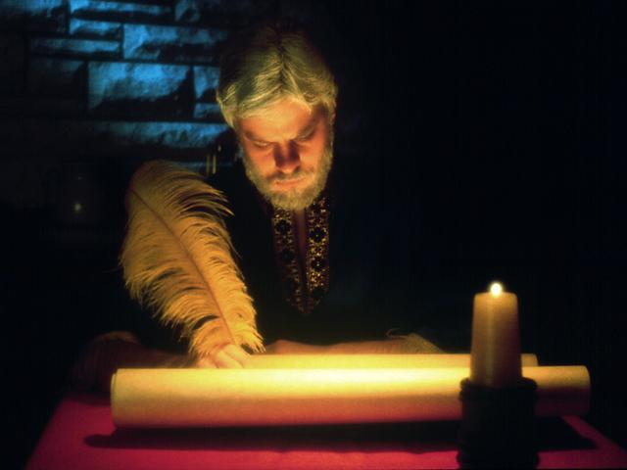
Your Will,
Your
Crowning Act as
God’s Steward!

Slide 2
With acknowledgement and honour to our Heavenly Father for the wisdom and insight granted to G. Edward Reid, former Stewardship Ministries Director, North-American Division, whose series “Your Finances in Changing Times” as well as “It’s Your Money, Isn’t It?” laid the foundation for the “Money, Money, Money…!” seminar.

Slide 3
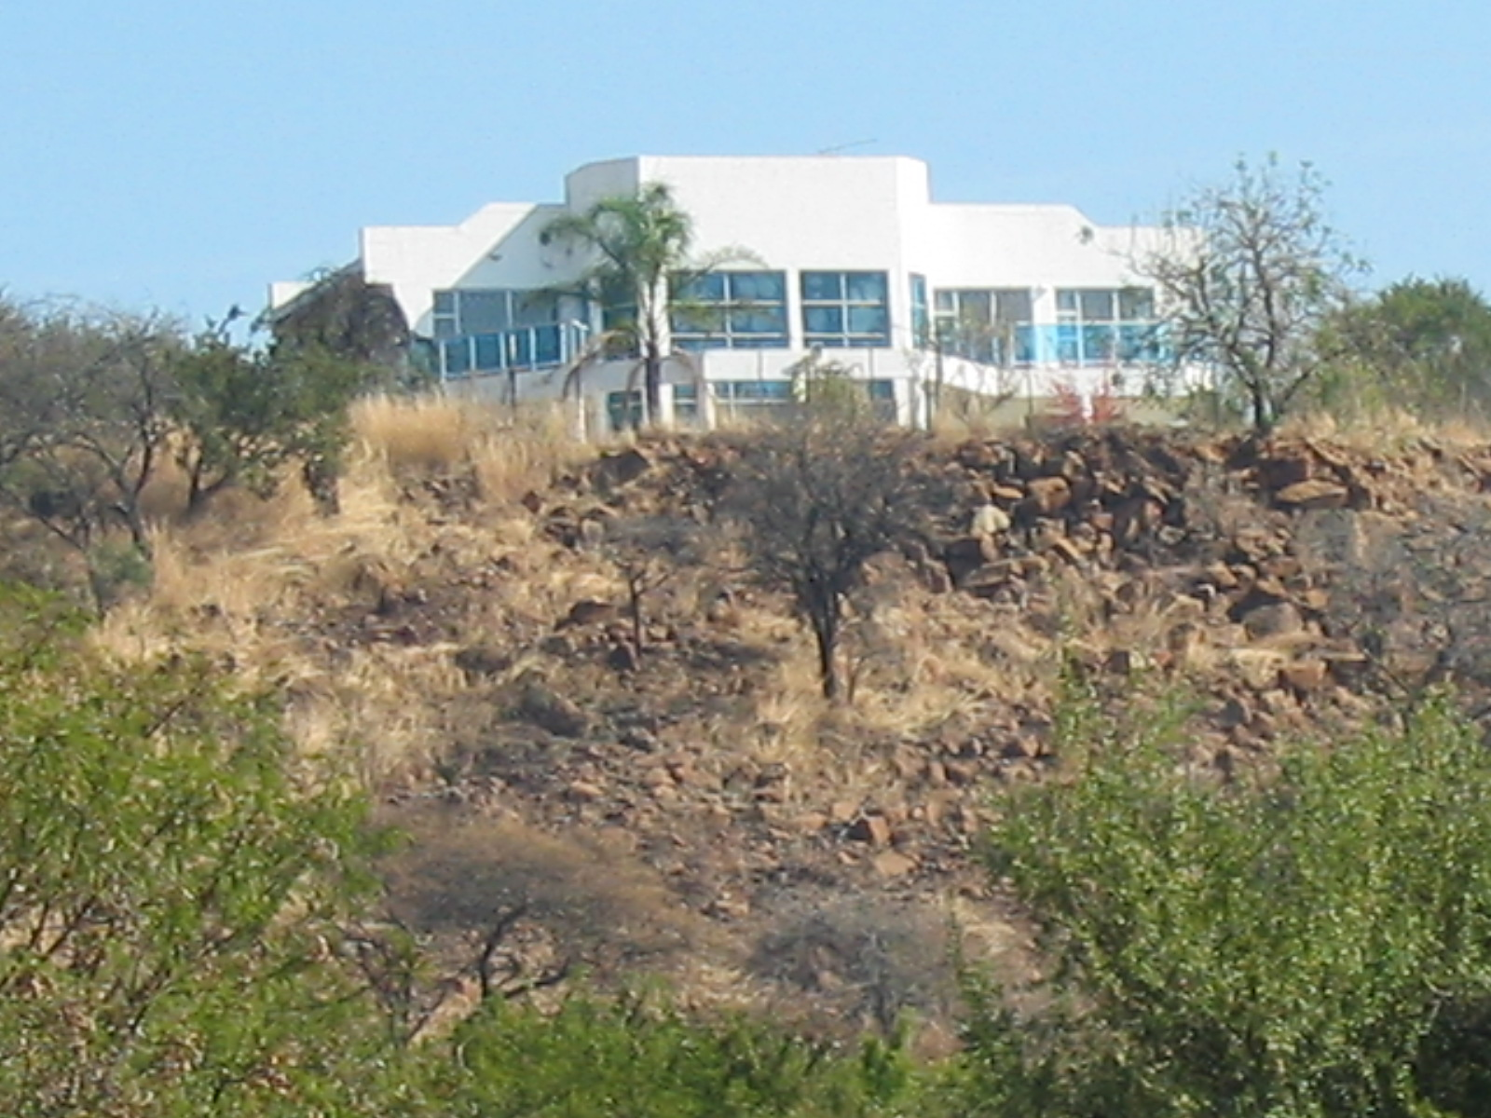
Text
In Memoriam
Reggie Pillay

Slide 4
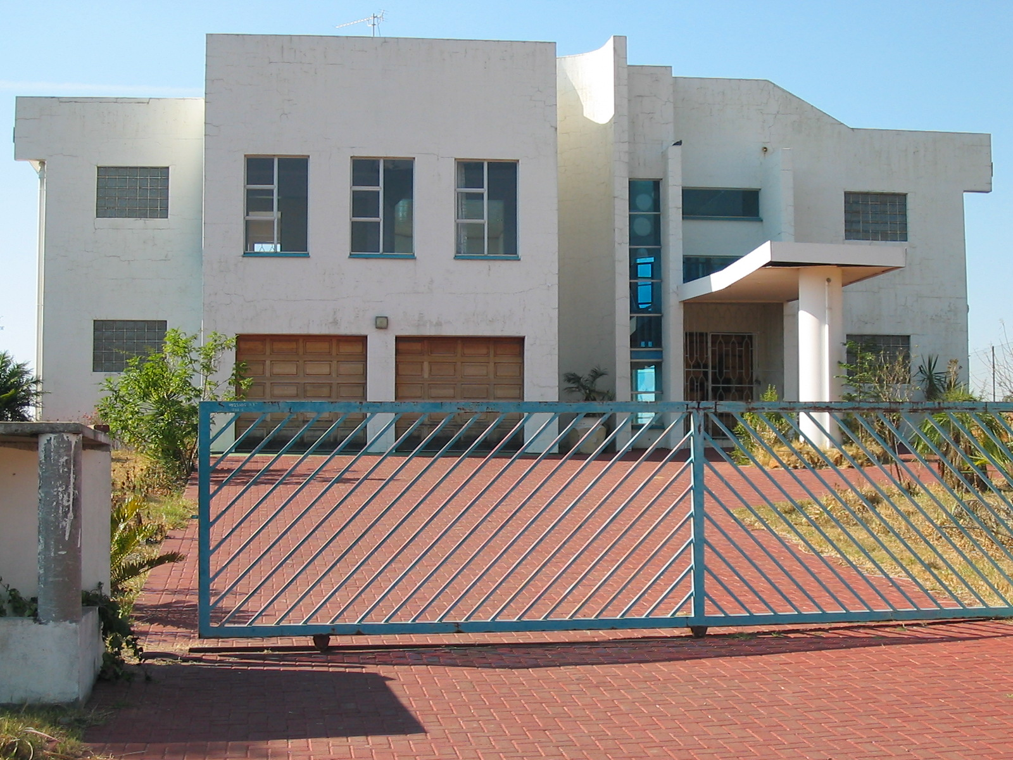
Text

Slide 5
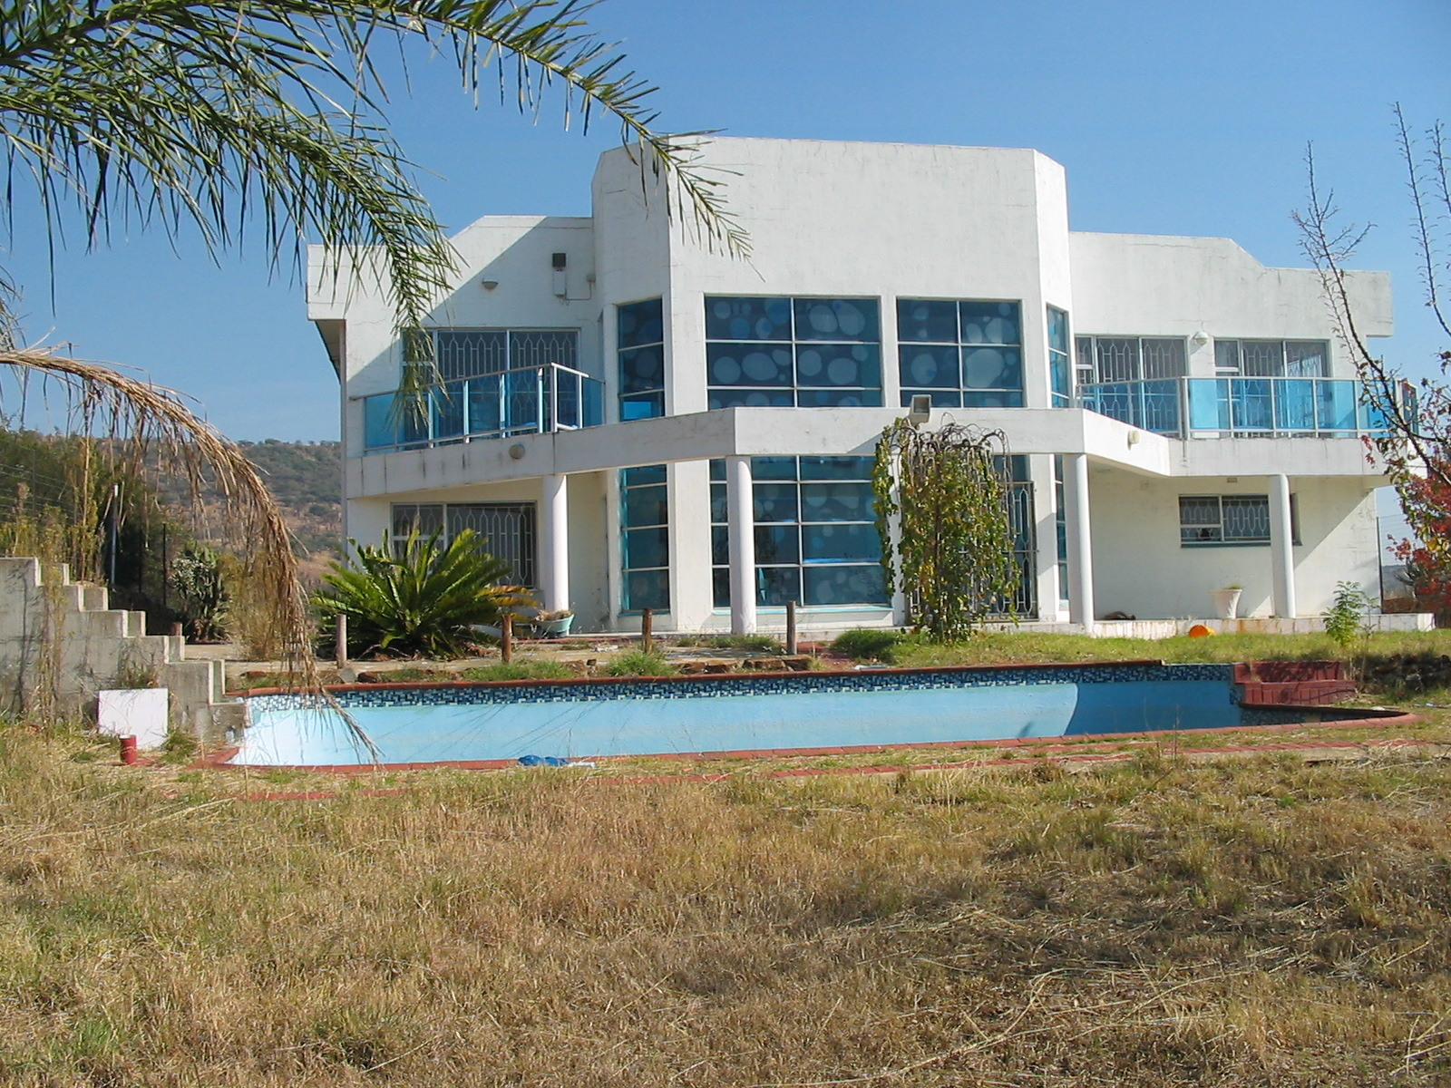

Slide 6
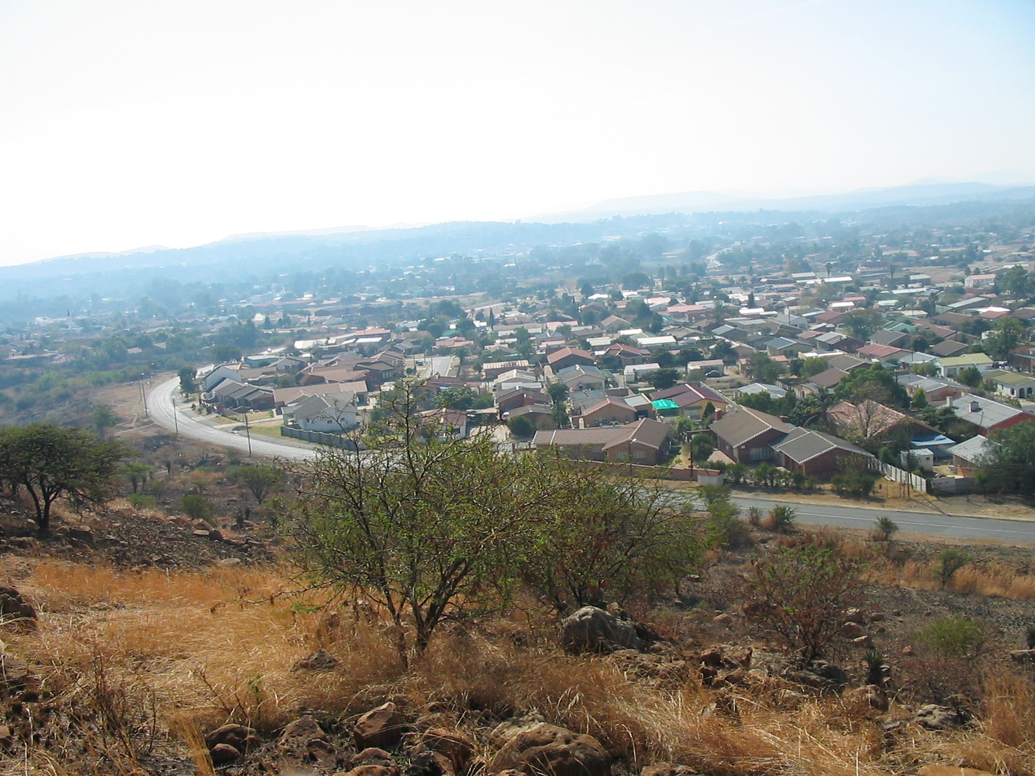
Text

Slide 7
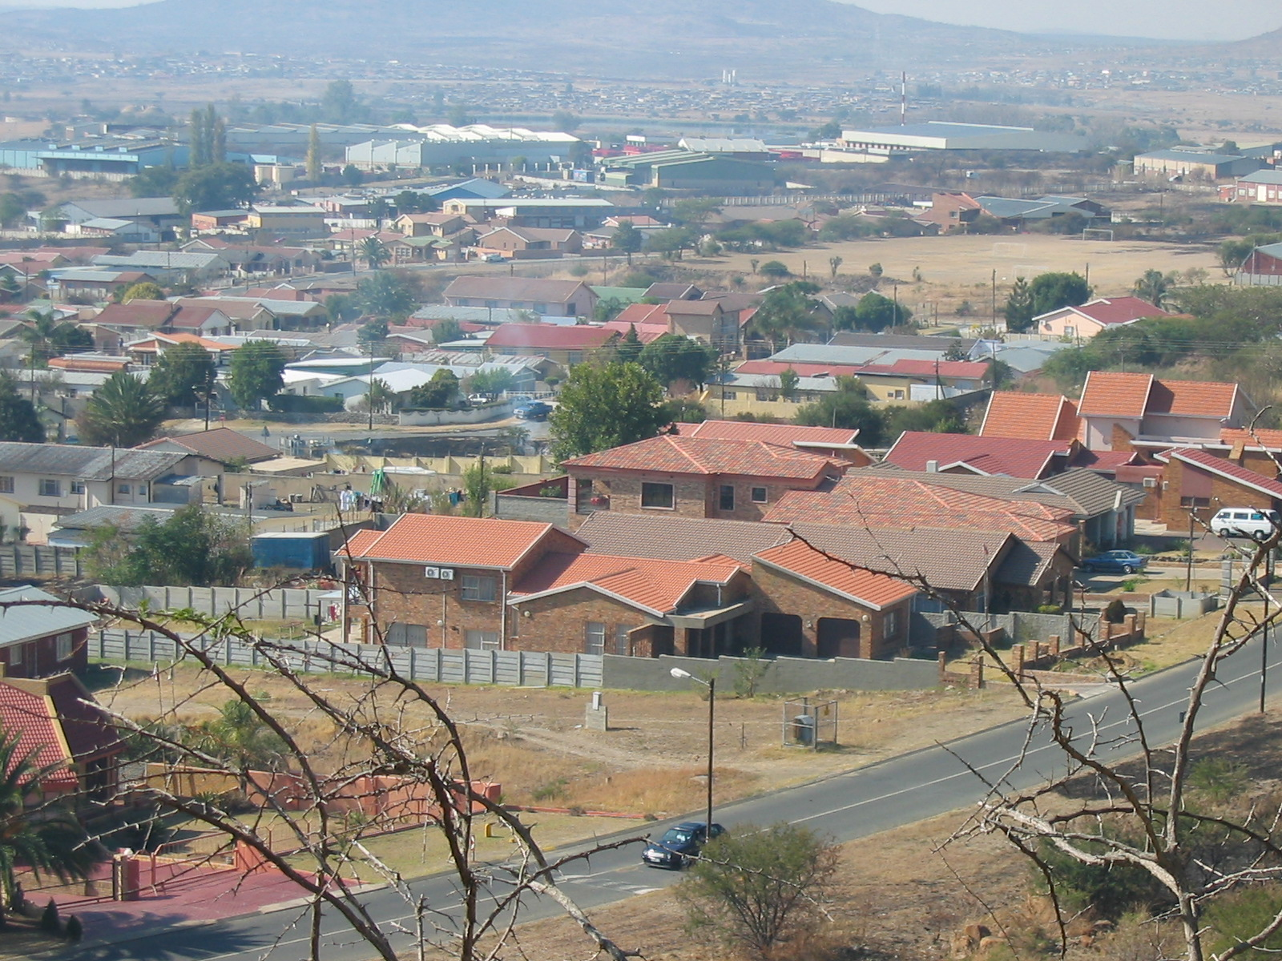

Slide 8
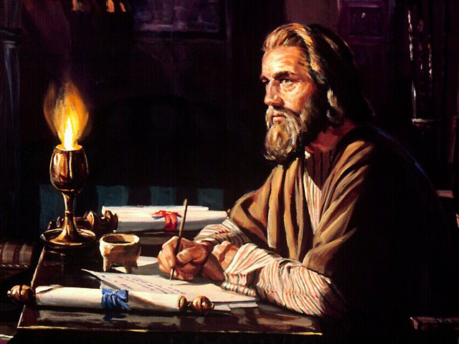
FACT ! (Pg.18-M) If you die without a will, the state assumes that you are an atheist. In no case would any of your assets be returned to God through a church or charity.

Slide 9
Really everyone has a will. Either one they make or one the state makes for them.
Which kind do you have?
Your will is the crowning act of your stewardship.

Slide 10
Your Will,
Your
Crowning Act
as
God's Steward!
Matthew 25:14-30
(The Parable of the Talents)

Slide 11
Testimonies, vol 1, pg.197 (Pg.4-M) “I was shown that the parable of the talents has not been fully understood. This important lesson was given to the disciples for the benefit of Christians living in the last days. The parable applies to the temporal means which God has entrusted to His people.”

Slide 12
Testimonies vol.7 pg 295 (Pg.18-M) “To the aged, who are losing their hold on this life, I appeal to make a right disposition of your Lord’s goods before you fall asleep in Jesus. Remember that you are God’s stewards. Do not fail of attending to this while you have your reason…

Slide 13
7T 295 (continue)
…As age comes upon us, it is our duty to make a disposition of our means to the instrumentalities that God has established.”

Slide 14
Role players & Endtime Application
V14 The Owner : | Jesus
Servants : | Church members
Possessions : | Temporal means
V15 Long Journey : | Ascension into heaven
V16-18 Character : | Labour vs Laziness
V19 Return : | Second coming
To give account : | Investigative Judgment

Slide 15
Role players & Endtime Application
V21,23 Well done, enter: | Reward (righteous)
V24,25 Scared servant : | Unfaithful members
V26,27 Wicked servant : | Attitude of wicked
V28,29 Take away : | Judgment (wicked)
V30 Darkness : | Reward of wicked

Slide 16
Your Will,
Your
Crowning Act
as
God's Steward!
“Testimonies for the Church”
(Volume 4, Page 476 – 485)
Chapter 42
“Wills and Legacies”

Slide 17
4T476.3
Selfishness is a soul-destroying sin. Under this head comes covetousness, which is idolatry. All things belong to God. All the prosperity we enjoy is the result of divine beneficence. God is the great and bountiful giver…

Slide 18
4T 476.3 (continued)
…I (God) am the rightful owner of the universe; therefore consecrate to Me thy first fruits, bring a tribute of loyalty, surrender to Me My own, thus acknowledging My sovereignty, and you shall be free to retain and enjoy My bounties, and My blessing shall be with you.

Slide 19
4T 477.2
He has given them property to be wisely used, not selfishly hoarded or extravagantly expended in luxury and selfish gratification either in dress or in the embellishment of their houses…

Slide 20
4T 477.2 (continued)
…Indeed, some seem ready to exceed their duty, as though fearful that they will lose an opportunity of investing their portion in the bank of heaven…

Slide 21
4T 477.2 (continued)
…There are others who will do as little as possible. They hoard their treasure, or lavish means upon themselves, grudgingly doling out a mere pittance to sustain the cause of God.

Slide 22
4T 478.1
There are aged ones among us who are nearing the close of their probation; but for the want of wide-awake men to secure to the cause of God the means in their possession, it passes into the hands of those who are serving Satan…

Slide 23
4T 478.1 (continued)
…This means was only lent them of God to be returned to Him; but in nine cases out of ten these brethren, when passing from the stage of action, appropriate God's property in a way that cannot glorify Him, for not one dollar of it will ever flow into the Lord's treasury…

Slide 24
4T 478.1
…Property is often bequeathed to children and grandchildren only to their injury. They have no love for God or for the truth, and therefore this means, all of which is the Lord's, passes into Satan's ranks, to be controlled by him…
Ecclesiastes 2:21
Ecclesiastes 2:21
For their is a man whose labour is with wisdom, knowledge and skill; yet he must leave his heritage to a man who has not laboured for it. This also is vanity and a great evil.

Slide 25
4T 478.1
…Satan is much more vigilant, keen-sighted, and skillful in devising ways to secure means to himself than our brethren are to secure the Lord's own to His cause…

Slide 26
4T 478.1 (continued)
…Our brethren should feel that a responsibility rests upon them, as faithful servants in the cause of God, to exercise their intellect in regard to this matter, and secure to the Lord His own.

Slide 27
4T 479.1
But this duty is just as sacred as the duty to preach the word to save souls. Here is a man with God's money or property in his hands. He is about to change his stewardship. Will he place the means which God has lent him to be used in His cause, in the hands of wicked men, just because they are his relatives?...

Slide 28
4T 479.1 (continued)
…Should not Christian men feel interested and anxious for that man's future good as well as for the interest of God's cause, that he shall make a right disposition of his Lord's money, the talents lent him for wise improvement?...

Slide 29
4T 479.1
…Will his brethren stand by and see him losing his hold on this life and at the same time robbing the treasury of God? This would be a fearful loss to himself and to the cause; for, by placing his talent of means in the hands of those who have no regard for the truth of God, he would, to all intents and purposes, be wrapping it in a napkin and hiding it in the earth.

Slide 30
4T 479.2
We must acknowledge that our possessions are absolutely His, by using of them freely whenever means is needed to advance His cause. Some close their ears to the calls made for money…

Slide 31
4T 479.2 (continued)
…Therefore they live a life of avarice, robbing God in tithes and in offerings, and in their wills return to God but a small portion of that which He has lent them, while a very large proportion is appropriated to relatives who have no interest in the truth. This is the worst kind of robbery. They rob God of His just dues, not only all through life, but also at death.

Slide 32
4T 480.1
It is utter folly to defer to make a preparation for the future life until nearly the last hour of the present life. It is also a great mistake to defer to answer the claims of God for liberality to His cause until the time comes when you are to shift your stewardship upon others…

Slide 33
4T 480.2 (continued)
…Those who wait till death before they make a disposition of their property, surrender it to death rather than to God. In so doing many are acting directly contrary to the plan of God plainly stated in His word.

Slide 34
4T 480.2
Those who neglect known duty by not answering to God's claims upon them in this life, and who soothe their consciences by calculating on making their bequests at death, will receive no words of commendation from the Master, nor will they receive a reward…

Slide 35
4T 480.2 (continued)
…By becoming their own executors, they could meet the claims of God themselves, instead of shifting the responsibility upon others. We should regard ourselves as stewards of the Lord's property and God as the supreme proprietor, to whom we are to render His own when He shall require it…

Slide 36
4T 480.2 (continued)
…When He shall come to receive His own with usury, the covetous will see that instead of multiplying the talents entrusted to them, they have brought upon themselves the doom pronounced upon the unprofitable servant.

Slide 37
4T 481.1
Dying legacies are a miserable substitute for living benevolence. The servants of God should be making their wills every day in good works and liberal offerings to God…

Slide 38
4T 481.1 (continued)
…But many professed Christians put off the claims of Jesus in life and insult Him by giving Him a mere pittance at death. Let all of this class remember that this robbery of God is not an impulsive action, but a well-considered plan which they preface by saying: "Being in sound mind…"

Slide 39
4T 481.1 (continued)
…After having defrauded the cause of God through life they perpetuate the fraud after death. And this is with the full consent of all the powers of the mind. Such a will many are content to cherish for a dying pillow.

Slide 40
4T 481.2
Many names are enrolled on the church book that have robbery recorded against them in the Ledger of Heaven. And unless these repent and work for the Master with disinterested benevolence, they will certainly share in the doom of the unfaithful steward.

Slide 41
4T 482.1
It often happens that an active businessman is cut down without a moment's warning and on examination his business is found to be in a most perplexing condition. In the effort to settle his estate the lawyers' fees eat up a large share, if not all, of the property, while his wife and children and the cause of Christ are robbed.

Slide 42
4T 482.2
Many are not exercised upon the subject of making their wills while they are in apparent health. But this precaution should be taken by our brethren.
(Estate planning)

Slide 43
4T 482.3
Wills should be made in a manner to stand the test of law. After they are drawn they may remain for years and do no harm, if donations continue to be made from time to time as the cause has need. Death will not come one day sooner, brethren, because you have made your will…

Slide 44
4T 482.3 (continued)
…In disposing of your property by will to your relatives, be sure that you do not forget God's cause. You are His agents, holding His property; and His claims should have your first consideration…

Slide 45
4T 482.3 (continued)
…Your wife and children, of course, should not be left destitute; provision should be made for them if they are needy. But do not, simply because it is customary, bring into your will a long line of relatives who are not needy.

Slide 46
4T 482.4
Let it ever be kept in mind that the present selfish system of disposing of property is not God's plan, but man's device. Christians should be reformers and break up this present system, giving an entirely new aspect to the formation of wills. Let the idea be ever present that it is the Lord's property which you are handling. The will of God in this matter is law.

Slide 47
4T 482.4 (continued)
…Your heavenly Friend has entrusted you with property, and given you His will as to how it should be used. If this will is studied with an unselfish heart, that which belongs to God will not be misapplied…

Slide 48
4T 482.4 (continued)
…The Lord's cause has been shamefully neglected, when He has provided men with sufficient means to meet every emergency, if they only had grateful, obedient hearts.

Slide 49
4T 483.1
Those who make their wills should not feel that when this is done they have no further duty; but they should be constantly at work, using the talents entrusted to them, for the upbuilding of the Lord's cause.

Slide 50
4T 483.1 (continued)
…God has devised plans that all may work intelligently in the distribution of their means. He does not propose to sustain His work by miracles. He has a few faithful stewards, who are economizing and using their means to advance His cause...

Slide 51
4T 483.1 (continued)
Instead of self-denial and benevolence being an exception, they should be the rule. The growing necessities of the cause of God require means.

Slide 52
4T 483.2
If the eyes of all could be opened to see how prevailing covetousness has hindered the advancement of the work of God, and how much more might have been done had all acted up to God's plan in tithes and offerings, there would be a decided reform on the part of many;…

Slide 53
4T 483.2 (continued)
The church is asleep as to the work it might do if it would give up all for Christ.

Slide 54
4T 483.2 (continued)
…A true spirit of self-sacrifice would be an argument for the reality and power of the gospel which the world could not misunderstand or gainsay, and abundant blessings would be poured upon the church.

Slide 55
4T 484.1
I call upon our brethren to cease their robbery of God. Some are so situated that wills must be made. But in doing this, care should be taken not to give to sons and daughters means which should flow into the treasury of God. These wills often become the subject of quarrels and dissensions.

Slide 56
4T 484.2
The Lord sometimes opens the eyes blinded by selfishness by simply reducing their income to the amount they are willing to give. Horses are found dead in the field or stable, houses or barns are destroyed by fire, or crops fail…

Slide 57
4T 484.2 (continued)
…By the mercies of Christ and the riches of His goodness, and for the honor of truth and religion, we beseech you who are followers of Christ to dedicate yourselves and your property anew to God…

Slide 58
4T 484.2 (continued)
…In view of the love and compassion of Christ, which brought Him from the royal courts to suffer self-denial, humiliation, and death, let each ask himself the question, "How much do I owe my Lord?"

Slide 59
4T 485.1
In determining the proportion to be given to the cause of God, be sure to exceed, rather than fall short, of the requirements of duty.

Slide 60
4T 485.1
…Christians must look upon themselves only as channels through which mercies and blessings are to flow from the Fountain of all goodness to their fellow men, by whose conversion they may send to heaven waves of glory in praise and offerings from those who thus become partakers with them of the heavenly gift.”
(The End)

Slide 61
NOTED ACTION:
Study the whole document.
Have a meeting with your spouse.
Seek godly counsel.
Prioritize your responsibilities.
Remember your spouse.
Remember dependant children.
Remember God’s cause.
Be a faithful steward.
(The End)

Slide 62
With acknowledgement and honour to our Heavenly Father for the wisdom and insight granted to G. Edward Reid Stewardship Director, General Conference of SDA Church, whose series “Your Finances in Changing Times” as well as “It’s Your Money, Isn’t It?” laid the foundation for the “Money, Money, Money…!” seminar.

Slide 63
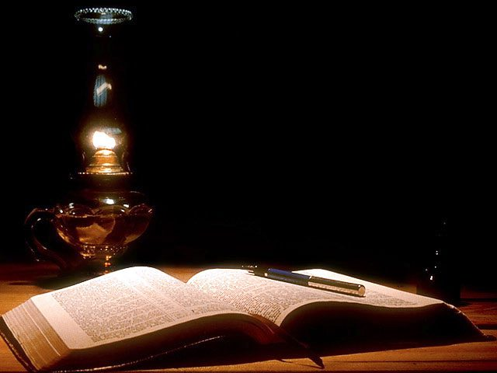
Matthew 25:14-30
“The parable of the Talents”
V14 For the kingdom of heaven is like a man traveling to a far country, who called his own servants and delivered his goods to them.
V15 And to one he gave five talents, to another two, and to another one, to each according to his own ability;

Slide 64
“The parable of the Talents” (Continued)
V16 Then he who had received the five talents went and traded with them, and made another five talents.
V17 And likewise he who had receive two gained two more also.

Slide 65
“The parable of the Talents” (Continued)
V18 But he who had received one went and dug in the ground, and hid his lord’s money.
V19 After a long time the lord of those servants came and settled accounts with them.

Slide 66
“The parable of the Talents” (Continued)
V20 So he who had received five talents came and brought five other talents, saying, ‘lord, you delivered to me five talents; look I have gained five more talents besides them.’

Slide 67
“The parable of the Talents” (Continued)
V21 His lord said to him, ‘Well done, good and faithful servant; you were faithful over a few things, I will make you ruler over many things. Enter into the joy of your lord.’

Slide 68
“The parable of the Talents” (Continued)
V22 He also who had received two talents came and said, ‘Lord you delivered to me two talents; look, I have gained two more talents besides them.’

Slide 69
“The parable of the Talents” (Continued)
V23 His lord said to him, ‘Well done, good and faithful servant; you have been faithful over a few things, I will make you ruler over many things. Enter into the joy of your lord.’

Slide 70
“The parable of the Talents” (Continued)
V24 Then he who had received the one talent came and said, ‘Lord, I knew you to be a hard man, reaping where you have not sown, and gathering where you have not scattered seed.

Slide 71
“The parable of the Talents” (Continued)
V25 And I was afraid, and went and hid your talent in the ground. Look, there you have what is yours.’

Slide 72
“The parable of the Talents” (Continued)
V26 But his lord answered and said to him, ‘You wicked and lazy servant, you knew that I reap where I have not sown, and gathered where I have not scattered seed.

Slide 73
“The parable of the Talents” (Continued)
V27 So you ought to have deposited my money with the bankers, and at my coming I would have received back my money with interest.

Slide 74
“The parable of the Talents” (Continued)
V28 Therefore take the talent from him, and give it to him who has ten talents.
V29 For to everyone who has, more will be given and he will have abundance; but from him who does not have, even what he has will be taken away.

Slide 75
“The parable of the Talents” (Continued)
V30 And cast the unprofitable servant into the outer darkness. There will be weeping and gnashing of teeth.

