Slide 1
Well done,
good and faithful
servant !

Slide 2
With acknowledgement and honour to our Heavenly Father for the wisdom and insight granted to G. Edward Reid, former Stewardship Ministries Director, North-American Division, whose series “Your Finances in Changing Times” as well as “It’s Your Money, Isn’t It?” laid the foundation for the “Money, Money, Money…!” seminar.

Slide 3

End Time Events (in the world)
(Please open your Bible at Matthew 24)
Jesus’ conversation with His disciples on end time events.

Slide 4
End time events (in the church)
Matthew 25
v 1-13 Parable of the virgins
v 14-30 Parable of the talents
v 31-46 Parable of sheep/goats

Slide 5

1 Testimonies pg.197 (Pg.4-M) “I was shown that the parable of the talents has not been fully understood. This important lesson was given to the disciples for the benefit of Christians living in the last days. The parable applies to the temporal means which God has entrusted to His people.”

Slide 6
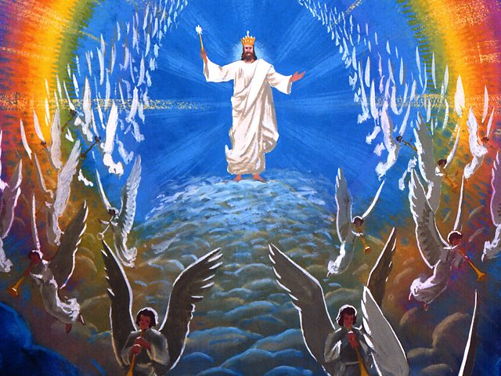
(Pg.15-M) A steward’s responsibility is to multiply the resources for the advantage of the owner.

Slide 7
(Continue) Accordingly, my one ultimate responsibility as a Christian steward is to use what God has given me and trade with it until He comes, with the perspective of bringing profit to the kingdom.

Slide 8

Disciples asks: v 3 What will be the signs?
Jesus answers:
v 4 Be not deceived (v11 + 24)
v 5 False prophets / Christ's
v 6 Wars and rumors of wars
v 15 Fall of Jerusalem
v 20 End of the world
v 30 Coming of the Son of man
v 36 Parallel to Noah’s flood

Slide 9

Matthew 25:14-30
“The parable of the Talents”
V14 For the kingdom of heaven is like a man traveling to a far country, who called his own servants and delivered his goods to them.
V15 And to one he gave five talents, to another two, and to another one, to each according to his own ability;

Slide 10
“The parable of the Talents” (Continued)
V16 Then he who had received the five talents went and traded with them, and made another five talents.
V17 And likewise he who had receive two gained two more also.

Slide 11
“The parable of the Talents” (Continued)
V18 But he who had received one went and dug in the ground, and hid his lord’s money.
V19 After a long time the lord of those servants came and settled accounts with them.

Slide 12
“The parable of the Talents” (Continued)
V20 So he who had received five talents came and brought five other talents, saying, ‘lord, you delivered to me five talents; look I have gained five more talents besides them.’

Slide 13
“The parable of the Talents” (Continued)
V21 His lord said to him, ‘Well done, good and faithful servant; you were faithful over a few things, I will make you ruler over many things. Enter into the joy of your lord.’

Slide 14
“The parable of the Talents” (Continued)
V22 He also who had received two talents came and said, ‘Lord you delivered to me two talents; look, I have gained two more talents besides them.’

Slide 15
“The parable of the Talents” (Continued)
V23 His lord said to him, ‘Well done, good and faithful servant; you have been faithful over a few things, I will make you ruler over many things. Enter into the joy of your lord.’

Slide 16
“The parable of the Talents” (Continued)
V24 Then he who had received the one talent came and said, ‘Lord, I knew you to be a hard man, reaping where you have not sown, and gathering where you have not scattered seed.

Slide 17
“The parable of the Talents” (Continued)
V25 And I was afraid, and went and hid your talent in the ground. Look, there you have what is yours.’

Slide 18
“The parable of the Talents” (Continued)
V26 But his lord answered and said to him, ‘You wicked and lazy servant, you knew that I reap where I have not sown, and gathered where I have not scattered seed.

Slide 19
“The parable of the Talents” (Continued)
V27 So you ought to have deposited my money with the bankers, and at my coming I would have received back my money with interest.

Slide 20
“The parable of the Talents” (Continued)
V28 Therefore take the talent from him, and give it to him who has ten talents.
V29 For to everyone who has, more will be given and he will have abundance; but from him who does not have, even what he has will be taken away.

Slide 21
“The parable of the Talents” (Continued)
V30 And cast the unprofitable servant into the outer darkness. There will be weeping and gnashing of teeth.

Slide 22


Role players & Endtime Application
V14 The Owner : | Jesus
Servants : | Church members
Possessions : | Temporal means
V15 Long Journey : | Ascension into heaven
V16-18 Character : | Labour vs Laziness
V19 Return : | Second coming
To give account : | Investigative Judgment

Slide 23
Role players & Endtime Application
V21,23 Well done, enter: | Reward (righteous)
V24,25 Scared servant : | Unfaithful members
V26,27 Wicked servant : | Attitude of wicked
V28,29 Take away : | Judgment (wicked)
V30 Darkness : | Reward of wicked

Slide 24
With acknowledgement and honour to our Heavenly Father for the wisdom and insight granted to G. Edward Reid Stewardship Department, General Conference of SDA Church, whose series “Your Finances in Changing Times” as well as “It’s Your Money, Isn’t It?” laid the foundation for the “Money, Money, Money…!” seminar.

Slide 25
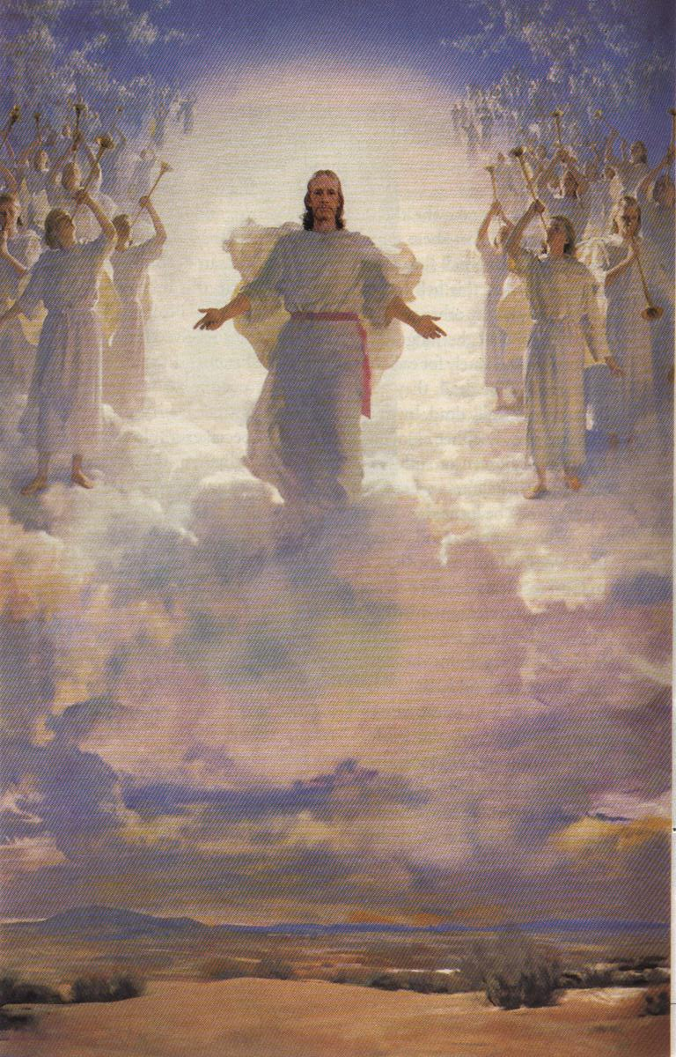
5 MR 255 “It should be our highest aim in life to get ready for heaven.”

Slide 26
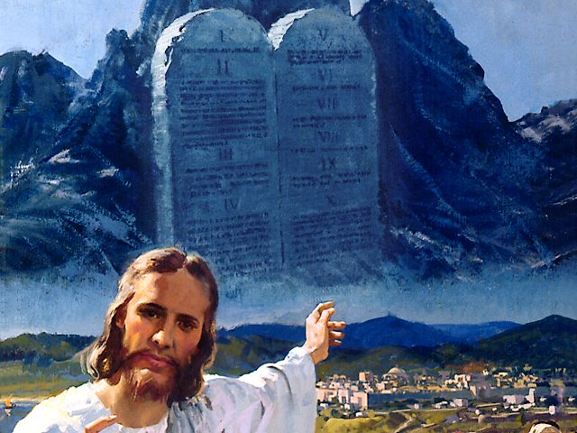
The responsible and faithful Adventist Christian
- lives in a Master / steward relationship with his Creator.

Slide 27
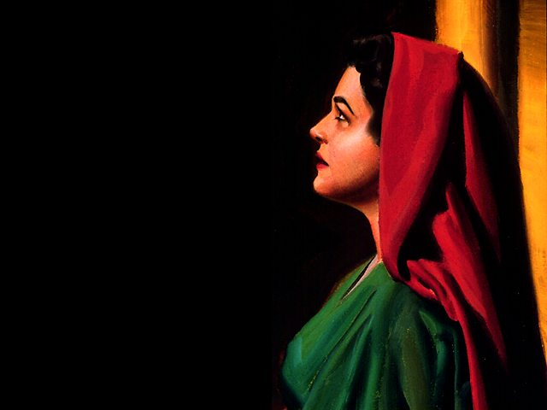
A True Steward manages: (Pg.2-M)
Time – Sabbath included.
Treasures – money / possessions.
Talents – gifts and abilities.
Temple – physical bodies.
Theology – knowledge of God.
Terrestrial – care for the earth.

Slide 28
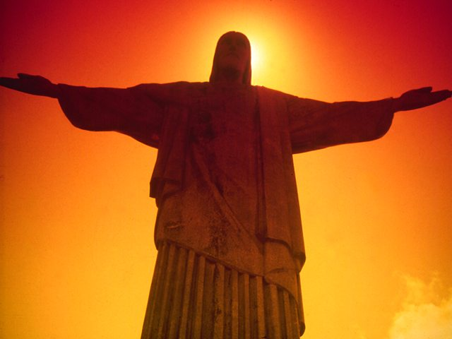
BASIC STEWARDSHIP PRINCIPLES (Pg.1-M)
1. God is the Owner of Everything. (Ps. 24:1; 50:10; Hag. 2:8)
2. Our Purpose in Life is to Glorify God.
3. The Tithe is the minimum Testimony of a
Christian Commitment.
4. Debt is bad.
5. Prosperity is having what you need
when you need it.

Slide 29
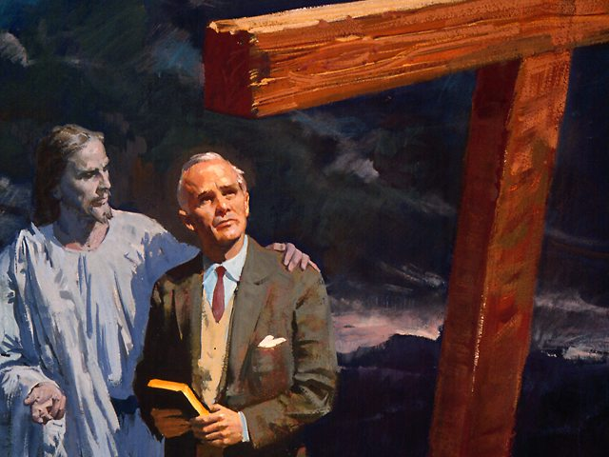
Three phases of development of a steward’s character. (Pg.15-M)
Learn
Earn
Return

Slide 30
Phase 1
LEARN
(Dedicate your life to God)

Slide 31
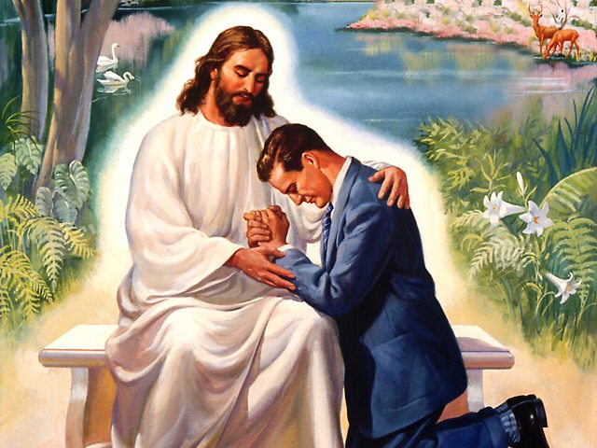
Looking for a revival ?
* Blessings and Curses - Deut.28
* An honest tithe- Mal. 3:10
* The minister’s responsibility
– Christian Stewardship p. 106

Slide 32
Educating Your Family
Proverbs 22:6,7 “Train up a child in the way he should go, and when he is old he will not depart from it…
v 7 …and the borrower is the servant to the lender.”

Slide 33
Train up a child
- Our families belong to God
- Parental assistance
- The property of God (Adventist Home, Pg.183)
- Start early (Education, Pg.88,89)
- What do we owe our children ?

Slide 34
Phase 2
EARN
(Live in partnership with God)

Slide 35


The significance of tithing
- Origin of tithing (Christian Stewardship, Pg.65)
- Our covenant relationship.
- Failure to tithe is robbery.
- An act of worship (Desire of Ages, Pg.615)

Slide 36
Christ Object Lessons p.351 (Pg.5-M)
“Some think that only a portion of their means is the Lord’s. When they have set apart a portion for religious and charitable purposes, they regard the remainder as their own, to be used as they see fit. But in this they mistake…

Slide 37
C O L p.351 (Pg.5-M)
(continue)
…All we possess is the Lord’s and we are accountable to Him for the use we make of it.”

Slide 38
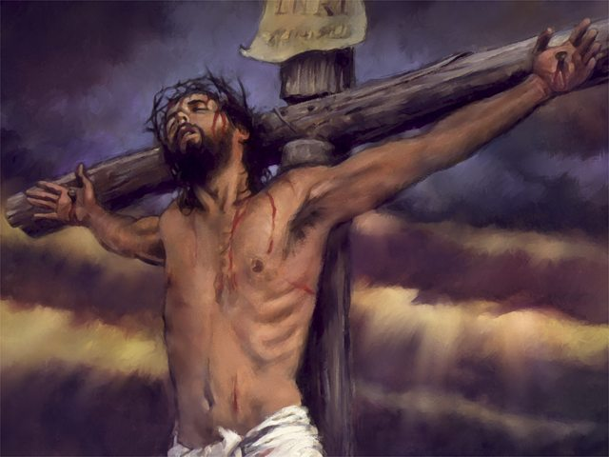
The simplicity of planned giving
1. Return God’s Tithe 10%
2. Give an offering: __%
3. Write in “Lumpsum” or divide:
50% - Local Church
20% - Conference Development
20% - World mission
10% - Union Contribution

Slide 39

Living on a budget !
(Pg.6-M)

Slide 40
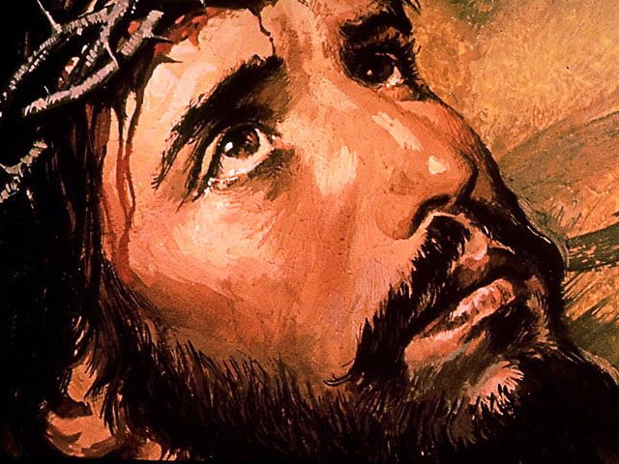
Where should I invest ?
* Do not lay up for yourselves treasures on this earth - Matt. 6:19
* … but lay up for yourselves treasures in heaven - Matt. 6: 20
* Saving VS Hoarding.

Slide 41

Dangers with hoarding
- Failing economy- 1Tim.6:17
- Holding on too long- James 5:1
- Can’t buy or sell- Rev.13:18
- Evidence of selfishness- (COL 351)

Slide 42
Some investment suggestions
- High risk / low risk.
- “Get rich quick” schemes ?
- No safe place on earth.
- Transfer your treasures.

Slide 43
Phase 3
RETURN
(Crown your partnership with God)

Slide 44

What about retirement?
Retirement in Scripture-
Num.8:25 & Luke 12:16-21
S.O.P. on retirement.
Common fears.

Slide 45
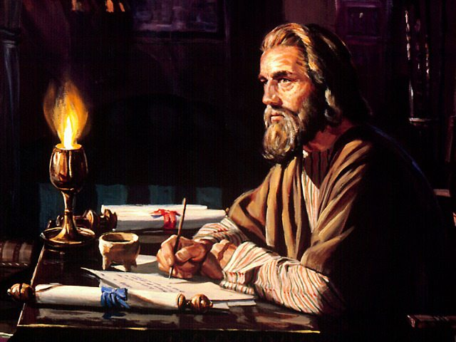
YOUR WILL:
The crowning act of your stewardship

Slide 46
Understanding Matthew 25
Ecclesiastes 2:21
For their is a man whose labour is with wisdom, knowledge and skill; yet he must leave his heritage to a man who has not laboured for it. This also is vanity and a great evil.
- Dying intestate.
- Common practice- Eccl. 2:21
- The Christian will (4 Testimonies pg 476-485)

Slide 47
Testimonies vol.7 pg 295 (Pg.18-M) “To the aged, who are losing their hold on this life, I appeal to make a right disposition of your Lord’s goods before you fall asleep in Jesus. Remember that you are God’s stewards. Do not fail of attending to this while you have your reason…

Slide 48
7T 295 (continue)
…As age comes upon us, it is our duty to make a disposition of our means to the instrumentalities that God has established.”

Slide 49
FACT ! (Pg.18-M) If you die without a will, the state assumes that you are an atheist. In no case would any of your assets be returned to God through a church or charity.

Slide 50
Really everyone has a will. Either one they make or one the state makes for them.
Which kind do you have?
Your will is the crowning act of your stewardship.

Slide 51
5 MR 255 “It should be our highest aim in life to get ready for heaven.”

Slide 52
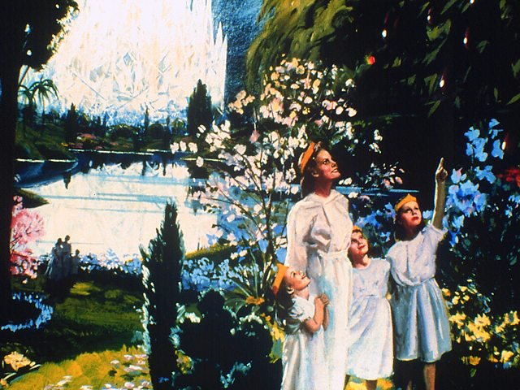
“WELL DONE, good and faithful servant; you were faithful over a few things, I will make you ruler over many things. Enter into the joy of your Lord !

Slide 53
THE END !

