Slide 1
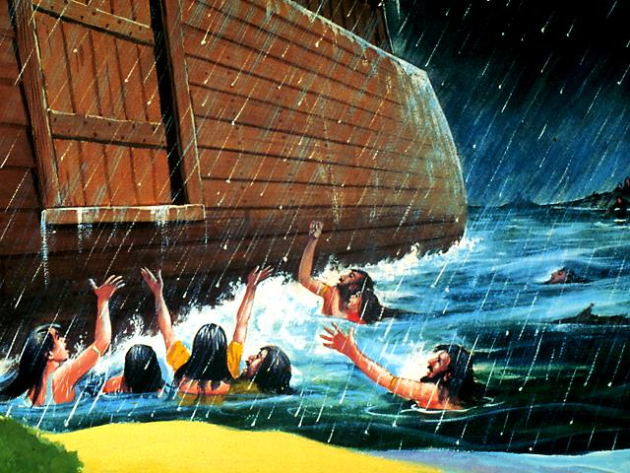
Saving up for a “Rainy Day”?
How to Prepare for the “Time of Trouble”!

Slide 2
With acknowledgement and honour to our Heavenly Father for the wisdom and insight granted to G. Edward Reid, former Stewardship Minsitries Director, North –American Division, whose series “Your Finances in Changing Times” as well as “It’s Your Money, Isn’t It?” laid the foundation for the “Money, Money, Money…!” seminar.

Slide 3
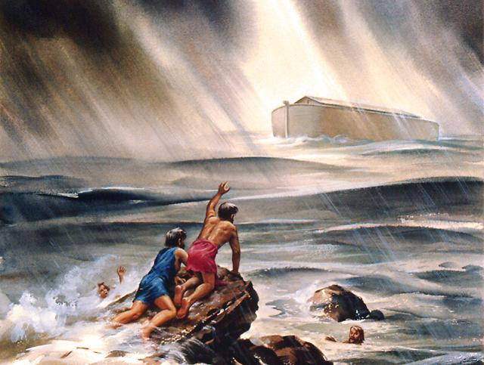
Duty in View of the Time of Trouble (EW 56.2)
The Lord has shown me repeatedly that it is contrary to the Bible to make any provision for our temporal wants in the time of trouble.

Slide 4
EW 56.2 (continued)
I saw that if the saints had food laid up by them or in the field in the time of trouble, when sword, famine, and pestilence are in the land, it would be taken from them by violent hands and strangers would reap their fields.

Slide 5
EW 56.2 (continued) …Then will be the time for us to trust wholly in God, and He will sustain us. I saw that our bread and water will be sure at that time, and that we shall not lack or suffer hunger;…

Slide 6
EW56.2 (continued) …for God is able to spread a table for us in the wilderness. If necessary He would send ravens to feed us, as He did to feed Elijah, or rain manna from heaven, as He did for the Israelites.

Slide 7
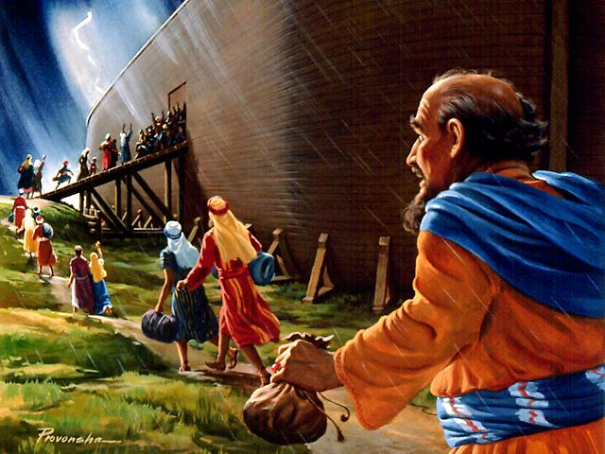
Preparation for the Time of Trouble (EW 56.3 and CS 60)
Houses and lands will be of no use to the saints in the time of trouble,…

Slide 8
EW 56.3 (continued)
…for they will then have to flee before infuriated mobs, and at that time their possessions cannot be disposed of to advance the cause of present truth.…

Slide 9
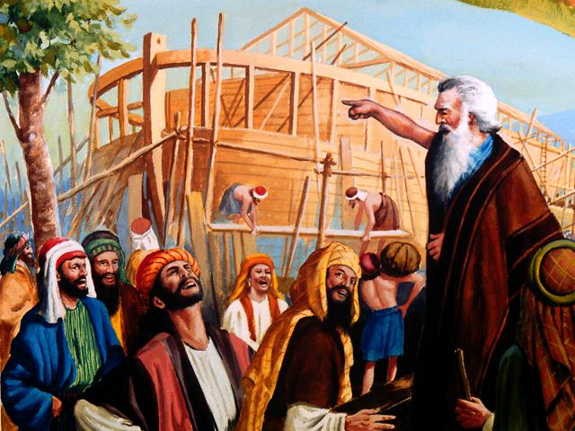
EW 56.3 (continued)
…I was shown that it is the will of God that the saints should cut loose from every encumbrance before the time of trouble comes, and make a covenant with God through sacrifice.

Slide 10
EW 56.3 (continued)
If they have their property on the altar and earnestly inquire of God for duty, He will teach them when to dispose of these things.

Slide 11
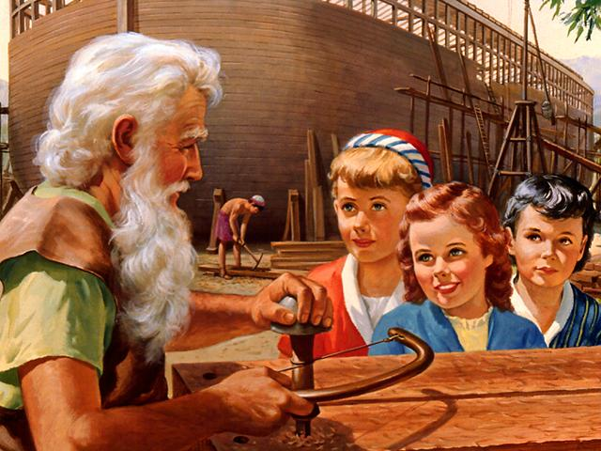
EW 56.3 (continued)
Then they will be free in the time of trouble and have no clogs to weigh them down.

Slide 12
EW 57.1
I saw that if any held on to their property and did not inquire of the Lord as to their duty, He would not make duty known…

Slide 13
EW 57.1 (continued)
...and they would be permitted to keep their property, and in the time of trouble it would come up before them like a mountain to crush them, and they would try to dispose of it, but would not be able.…

Slide 14
EW 57.1 (continued)
…I heard some mourn like this: "The cause was languishing, God's people were starving for the truth, and we made no effort to supply the lack;…

Slide 15
EW 57.1 (continued)
…now our property is useless. Oh, that we had let it go, and laid up treasure in heaven!"

Slide 16
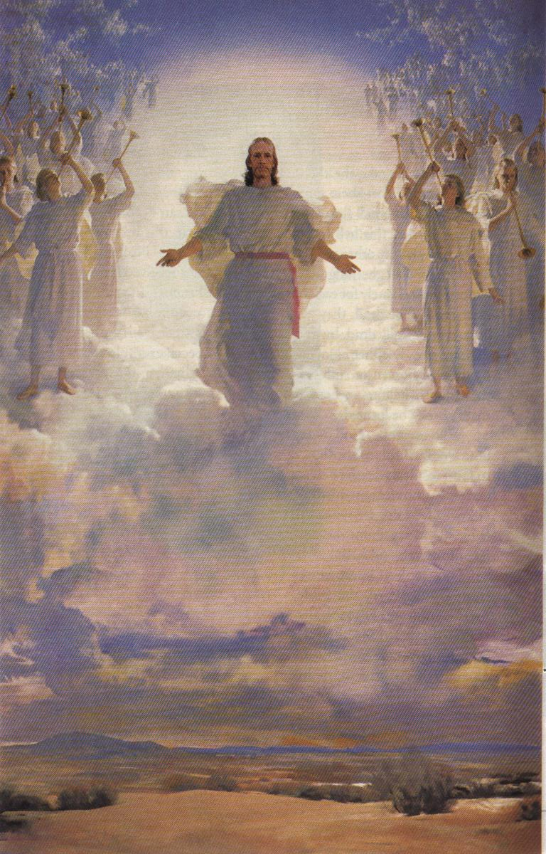
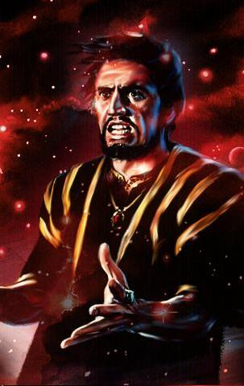
God’s Plan
Satan’s Plan
…for your life
God - Owner /
Man - Steward
Man the owner of
possessions
No debts-
Financially free
In debt–Interest
slavery
Faithful-honest tithe
No tithe - dishonest
tithe
Happy family-needs
supplied
Unhappy marriages

Slide 17
God’s Plan
Satan’s Plan
…for your life
Surplus – helping
others
Distrust God and
Church
Advancing God’s
cause
Possessions
glorify man
Total commitment –
life glorifies God
No will
Estate back to God
Estate to relatives

Slide 18
Miss Sparkling Personality
I am following Jesus’ way !
Miss Grumpy !

Slide 19
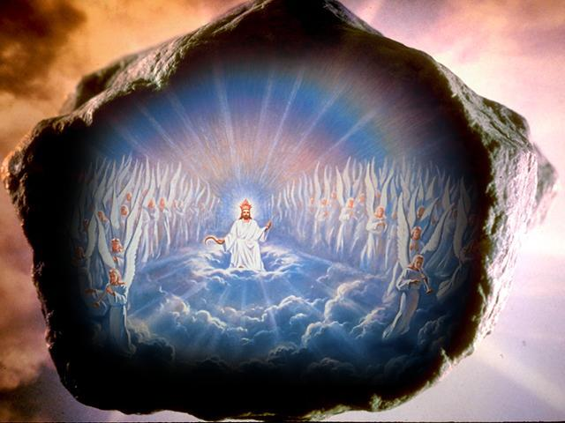
“WELL DONE, good and faithful servant; you were faithful over a few things, I will make you ruler over many things. Enter into the joy of your Lord !
THE END ? ? ?
IT’S A NEW BEGINNING !
Jesus is coming very soon !

Slide 20
…as you prepare to meet Jesus!

Slide 21
God’s Plan...
Satan’s Plan...
…for your life
God - Owner / Man – Steward Man the owner of possessions
No debts - Financially free In debt – Interest slavery
Faithful - honest tithe No tithe - dishonest tithe
Happy family - needs supplied Unhappy marriages
Surplus – helping others Distrust God and Church
Advancing God’s cause Possessions glorify man
Total commitment – life glorifies God No will
Estate back to God Estate to relatives

Slide 22
God’s Plan
Satan’s Plan
…for your life
God - Owner /
Man - Steward
Man the owner of
possessions
No debts-
Financially free
In debt–Interest
slavery
Faithful-honest tithe
No tithe - dishonest
tithe
Happy family-needs
supplied
Unhappy marriages

Slide 23
God’s Plan
Satan’s Plan
…for your life
Surplus – helping
others
Distrust God and
Church
Advancing God’s
cause
Possessions
glorify man
Total commitment –
life glorifies God
No will
Estate back to God
Estate to relatives

Slide 24
God’s Plan
Satan’s Plan
…for your life
Surplus – helping
others
Distrust God and
Church
Advancing God’s
cause
Possessions
glorify man
Total commitment –
life glorifies God
No will
Estate back to God
Estate to relatives

