Slide 1

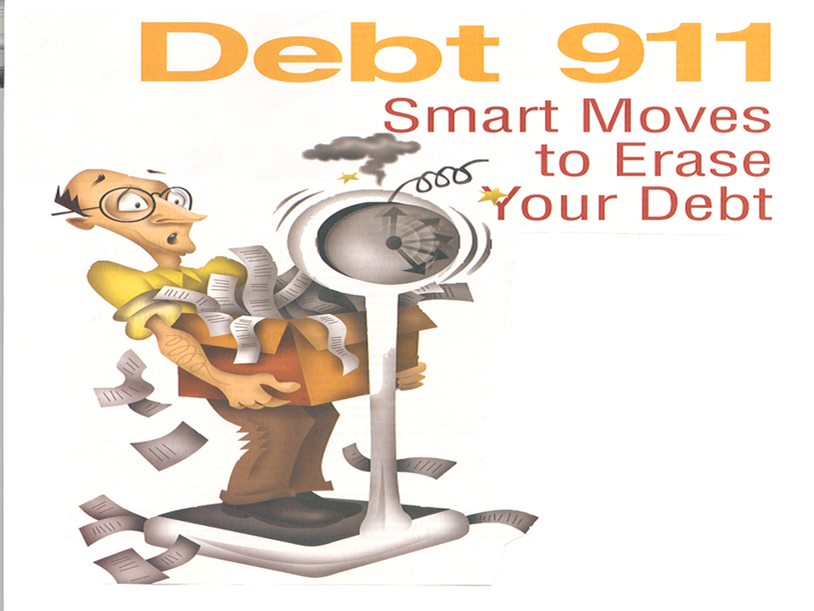
In support of
MISSION TO THE HOLY CITY

Slide 2
With acknowledgement and honour to our Heavenly Father for the wisdom and insight granted to G. Edward Reid, former Stewardship Ministries Director, North-American Division, whose series “Your Finances in Changing Times” as well as “It’s Your Money, Isn’t It?” laid the foundation for the “Money, Money, Money…!” seminar.

Slide 3
HOW TO STRETCH YOUR DOLLAR
In support of
MISSION TO THE HOLY CITY

Slide 4
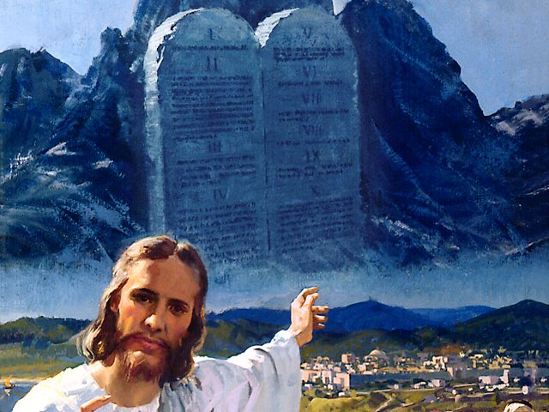
The Camp of the Israelites
and
The Camp of the Philistines

Slide 5
PURCHASE PROPERTY IN 7 YEARS ???

Slide 6
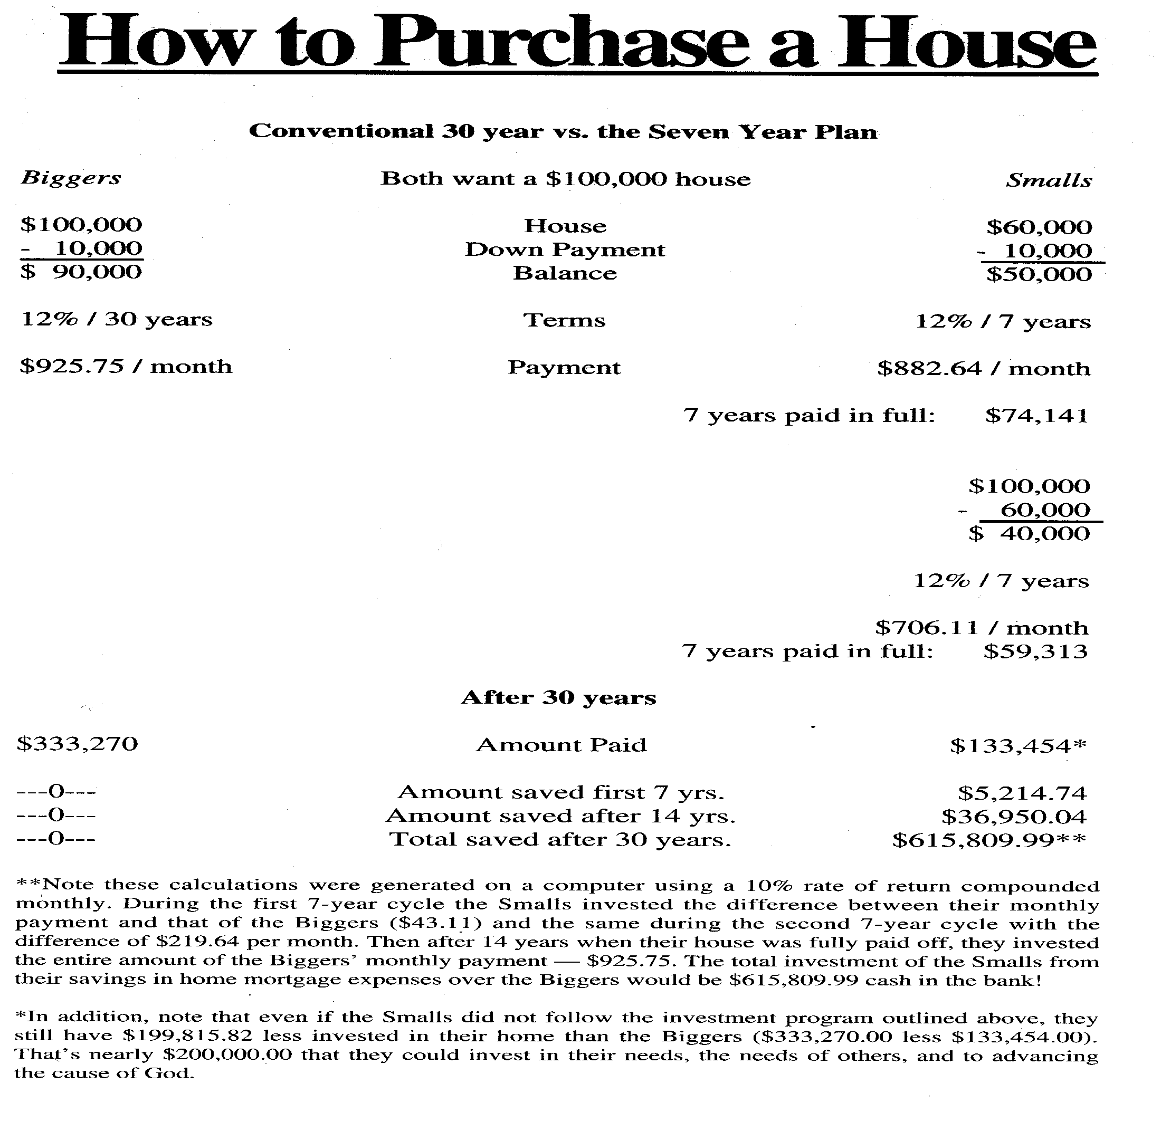

60%
1
2
1+2

Slide 7
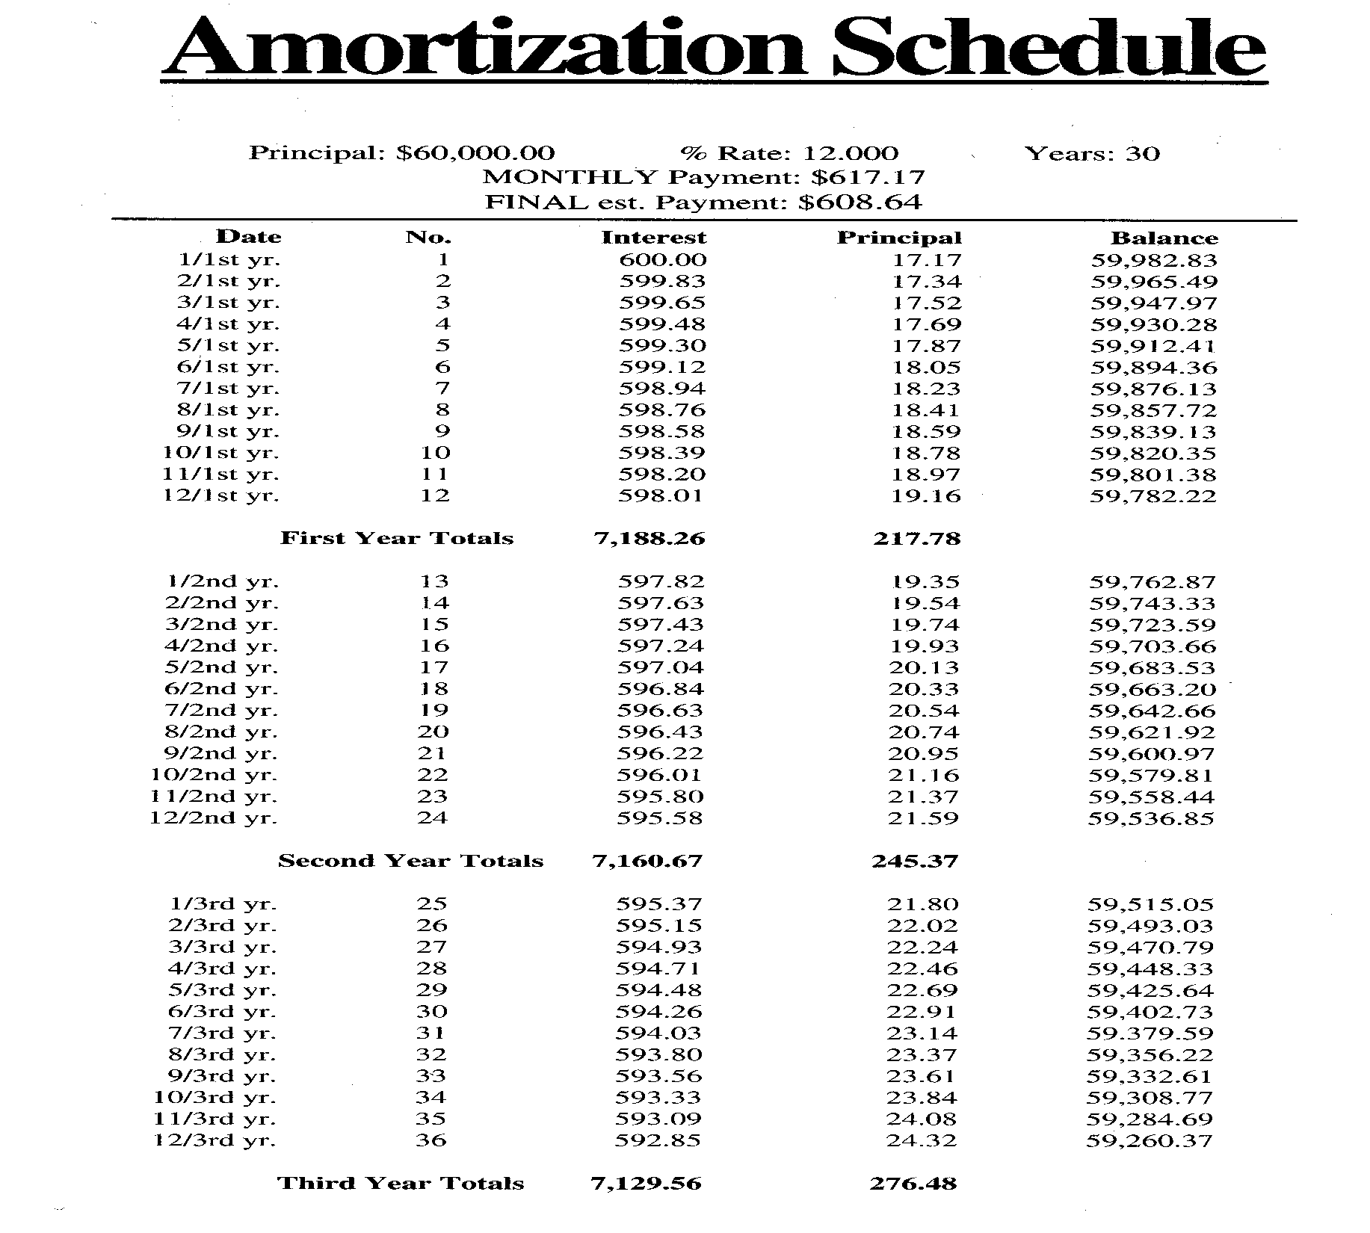
LOAN AMORTIZATION SCHEDULE
3,200%

Slide 10
R 617.17
PRINCIPLE
INSTALLMENT (R)
R 617.17
INTEREST
1 90 180 270 360
PAYMENT PERIOD (months)
How is interest calculated?

Slide 11

IMPACT OF INTEREST ON LIFE OF LOAN R60,000.00 @ 12% over ? years
30 Years
R 162,172.24
20 Years
R 98,557.26
10 Years
R 43,298.62
7 Years
R 28,969.95
What is the bottom line ?

Slide 12
When will you reach the equilibrium?
R 617.17
PRINCIPLE
(292)
R 617.17
INSTALLMENT (R)
INTEREST
1 90 180 270 360
PAYMENT PERIOD (months)
R 60,000.00 @ 12% over 30 years

Slide 13
R60,000.00 @ 12% OVER 30 YRS
Conven-tional Bi-weekl Weekly 15 Yrs Bi-week 7 Yrs | P / I (R) 617.17 308.59 154.29 720.10 360.05 1059.16 | LIFE OF LOAN 30 19.04 18.79 15 12.3 7 | INTEREST PAID [R] 162,181.20 92,752.05 90.809.33 69,618.45 54,617.36 28,969.95 | INTEREST SAVED [R] R0.00 69,429.15 71,372.20 92,562.75 107,563.84 133,211.25
Please turn to last page
“Points to Consider”

Slide 14
TIP OF THE DAY
If your bank refuses to set your mortgage up on a bi-weekly plan of repayment you can get a similar benefit in this way: Divide your current monthly payment by 12 and add that amount to each month’s regular check (mark it: “principle payment only.”)

Slide 15
For a R60,000.00 30-year loan at 12% this means adding an extra R51.43 to the normal R617.17, making a monthly check of R668.60. You would save R69,178.92 and 10 years and 11 months of payments !

Slide 16
When you think no one cares you’re alive, try missing a couple of
car payments.

Slide 17
We always pay dearly for chasing after what is cheap.
Alexander Solzhenitsyn

Slide 18
Some people go over their budgets very carefully every month… Some just go over them!

Slide 19
God demands our tithes and deserves our offerings.
Stephen Olford

Slide 20
Christ taught that tithing was a good place to start. . .
but a tragic place to stop.

Slide 21
“Make money your god and it will plague you like the devil!”
Henry Fielding

Slide 22
You can spend money
any way you want. . .
but you can only spend it once.

Slide 23
“Money talks. It says, ‘Good-bye.’”
Brian Kluth

Slide 24
THE END

Slide 25
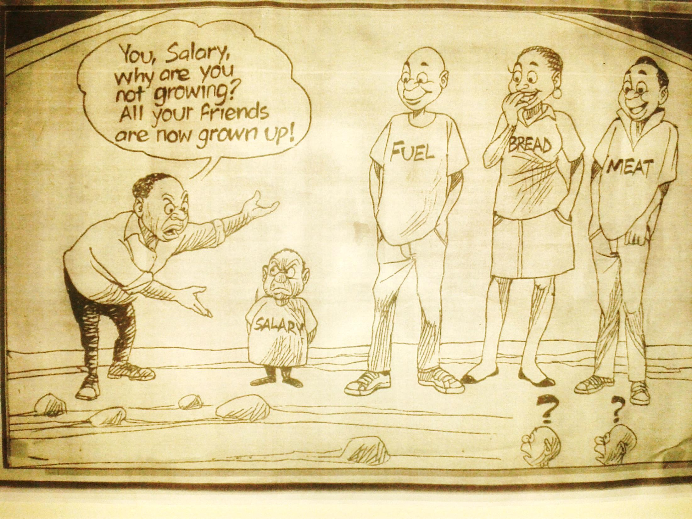

Slide 26
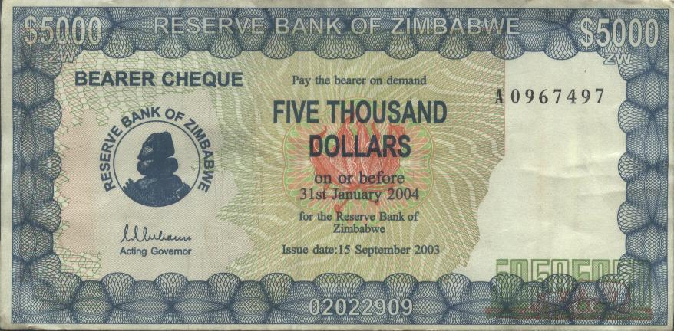
?
ZIMBABWE DECLARES BANKRUPTCY
RSG RADIO, FRIDAY 7 MARCH 2014

Slide 27
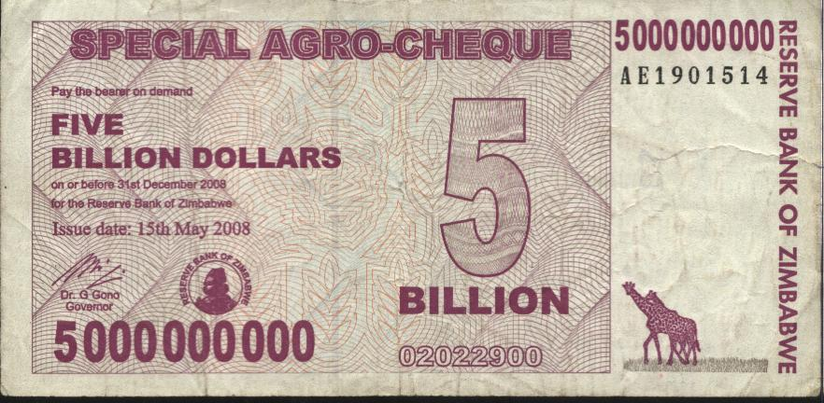
?

Slide 28
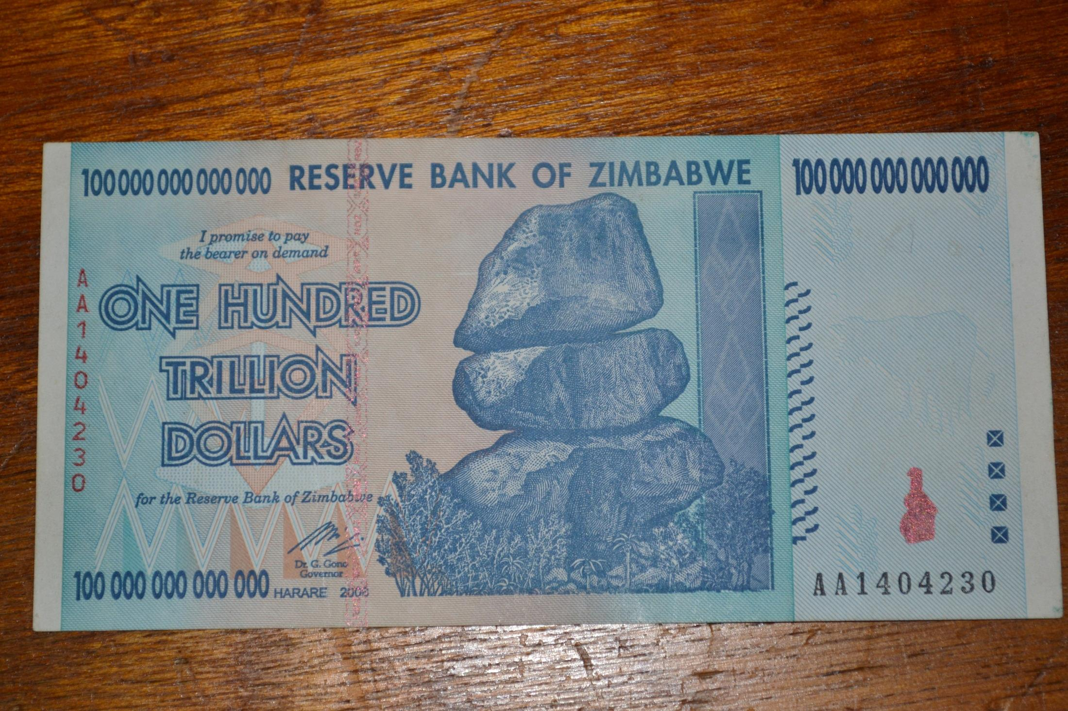

Slide 29
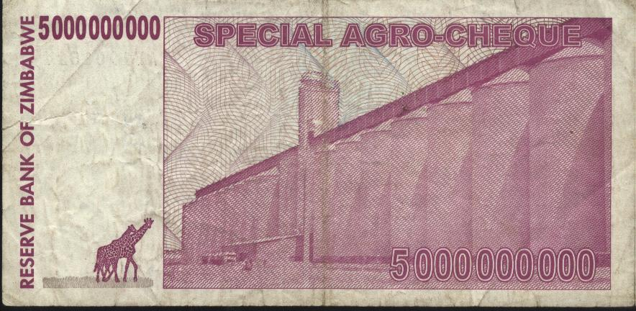
?

Slide 30


Slide 31

1 Cor 4:1,2
Let a man so consider us, as servants of Christ and stewards of the mysteries of God. Moreover it is required in stewards that one be found faithful.

Slide 32

Testimonies vol. 9 p13
“There are not many, even among educators and statesmen, who comprehend the causes that underlie the present state of society…

Slide 33
9T 13 (Continue)
…Those who hold the reins of government are not able to solve the problem of moral corruption, poverty, pauperism, and increasing crime…

Slide 34
9T 13 (Continue)
…They are struggling in vain to place business operations on a more secure basis. If men would give more heed to the teaching of God’s word, they would find a solution of the problems that perplex them.”

Slide 35
THE LIFE CYCLE OF A STEWARD
LEARN (dedicate yourself to God)
EARN (live in partnership with God)
RETURN (crown your partnership with God)

Slide 36

THE BIBLE and MONEY
- 2/3 of Jesus’ parables deals with
money / possessions
- 2000 references on money found in
the Bible
- 500 reference on faith found in the
Bible
- All 15 Kingdom parables deals with
money / possessions

Slide 37
Bible Characters and money
- Remember Lot’s wife- Gen.13
- Achan- Joshua 7
- Gehazi- 2 Kings 5
- The yuppie- Matt. 19:16-22
- Ananias & Sapphira- Acts 4,5
- Judas Iscariot- Matt. 27:3-5
- Abraham: father of the faithful Gen.12-15
- Moses: greater riches- Heb.11:24-26
- Zacchaeus: the tax collector- Luke 19

Slide 38
Testimonies Vol. 6, p.446
“There are only two places in the world where we can deposit our treasures - in God’s storehouse or in Satan’s, and all that is not devoted to Christ’s service is counted on Satan’s side and goes to strengthen his cause.”

Slide 39
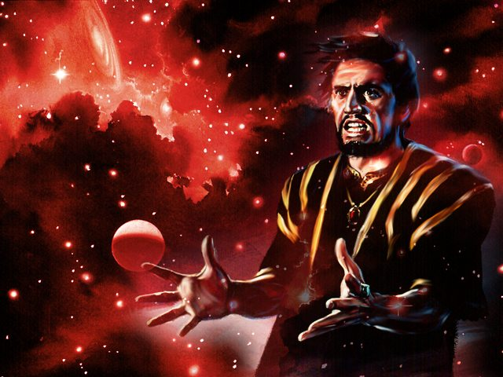
(The Devil’s Workers Meeting) Testimonies to Ministers, p 473,474
“Go make the possessors of lands and money drunk with the cares of this life. Present the world before them in its most attractive light, that they may lay up their treasure here and fix their affections upon earthly things…

Slide 40
TM.473-4 (Continued…)
…We must do our utmost to prevent those who labour in God’s cause from obtaining means to use against us. Keep the money in our ranks. The more means they obtain, the more they will injure our kingdom by taking from us our subjects…

Slide 41
TM.473-474 (Continued)
…Make them care more for money than for the up building of Christ’s kingdom and the spread of the truths we hate, and we need not fear their influence; for we know that every selfish, covetous person will fall under our power, and will finally be separated from God’s people.”

Slide 42
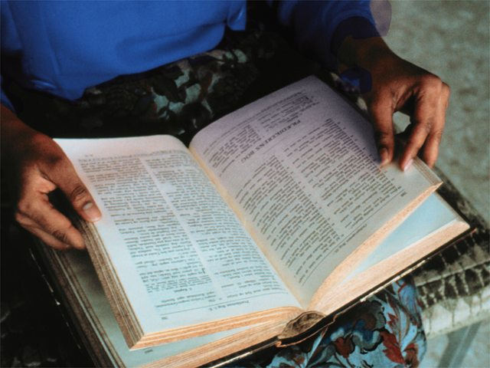
Does the Bible allow debt ? Yes / No

Slide 43
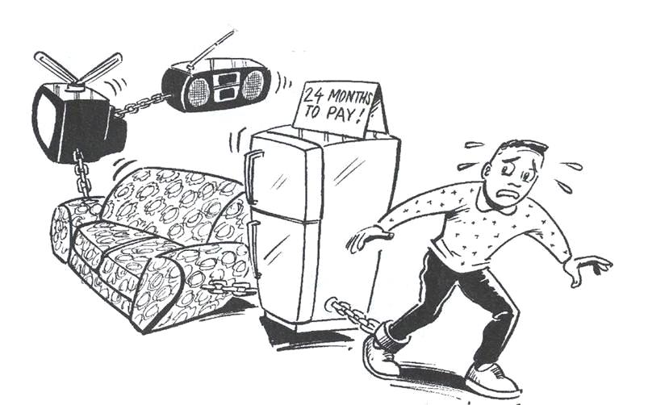
What is debt?

Slide 44
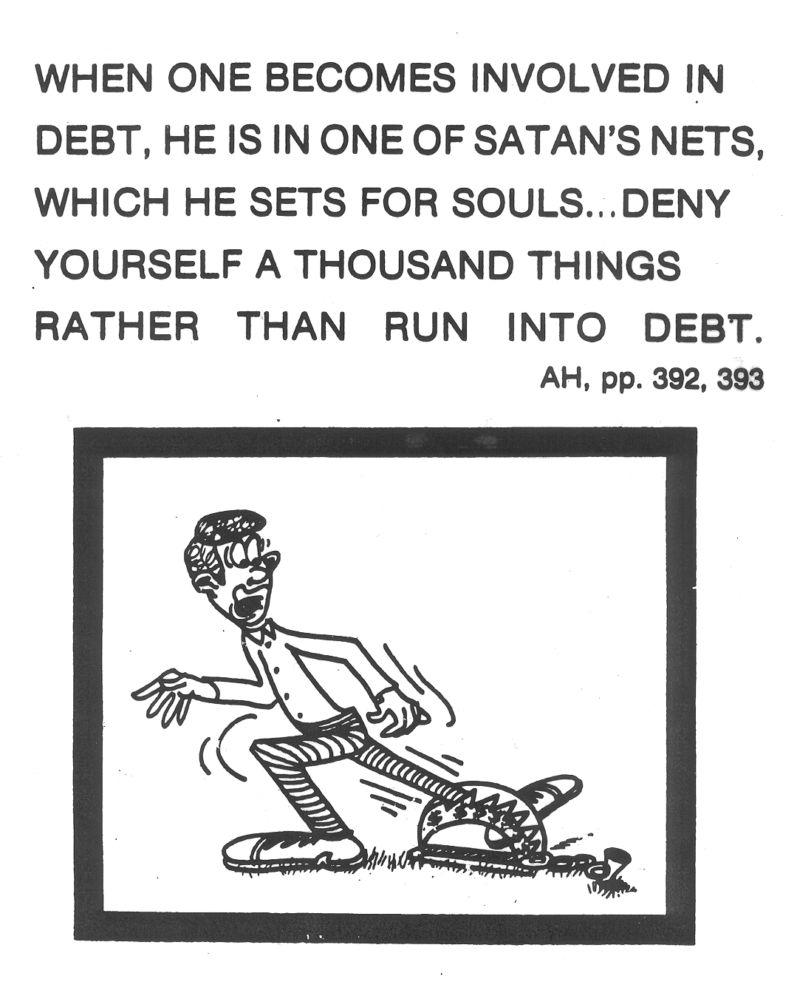

Slide 45

Deuteronomy 15:1,2
“At the end of every seven years you shall grant a release of debts. And this is the form of the release: Every creditor who has lent anything to his neighbor shall release it; he shall not require it of his neighbor or his brother, because it is called the Lord’s release.”

Slide 46
Leviticus 25:10 “And you shall consecrate the fiftieth year, and proclaim liberty throughout all the land to all its inhabitants. It shall be a Jubilee for you; and each of you shall return to his possession, and each of you shall return to his family.”

Slide 47
Leviticus 25:14,15 “And if you sell anything to your neighbor or buy from your neighbor's hand, you shall not oppress one another. According to the number of years after the Jubilee you shall buy from your neighbor, and according to the number of years of crops he shall sell to you.”

Slide 48
100
PRINCIPLE
75
50
INSTALLMENT (R)
25
INTEREST
10
1 90 180 270 360
PAYMENT PERIOD (months)
How Is Interest Calculated ?

Slide 49
MODERN LIFESTYLE - LIFELONG INDEBTEDNESS
R 4,810.69 per month!!!
ITEM CAPITAL M/I INTEREST
House-30yr R 500,000 R 5,143(360) R 1,351,500
5x Cars-5yr R 200,000(x5) R 4,450(60x5) R 66,950 x5
2x Lg/st-2yr R 15,000 (x2) R 763 (24x2) R 3,320 x2
2x Br/st-2yr R 10,000 (x2) R 509 (24x2) R 2,215 x2
4x Beds-2yr R 7,000 (x4) R 256 (24x4) R 1,550 x4
2x Fridge-2yr R 7,000 (x2) R 256 (24x2) R 1,550 x2
2x Stove-2yr R 5,000 (x2) R 255 (24x2) R 1,108 x2
2x Wash-2yr R 5,000 (x2) R 255 (24x2) R 1,107 x2
2x F/s tv-2yr R 7,000 (x2) R 256 (24x2) R 1,550 x2
10x S4/i5-2yr R 8,000 (x10) R 407 (24x10) R 1,770 x10
*TOTAL: R1,706,000 R3,418,850 R1,731,850

Slide 50
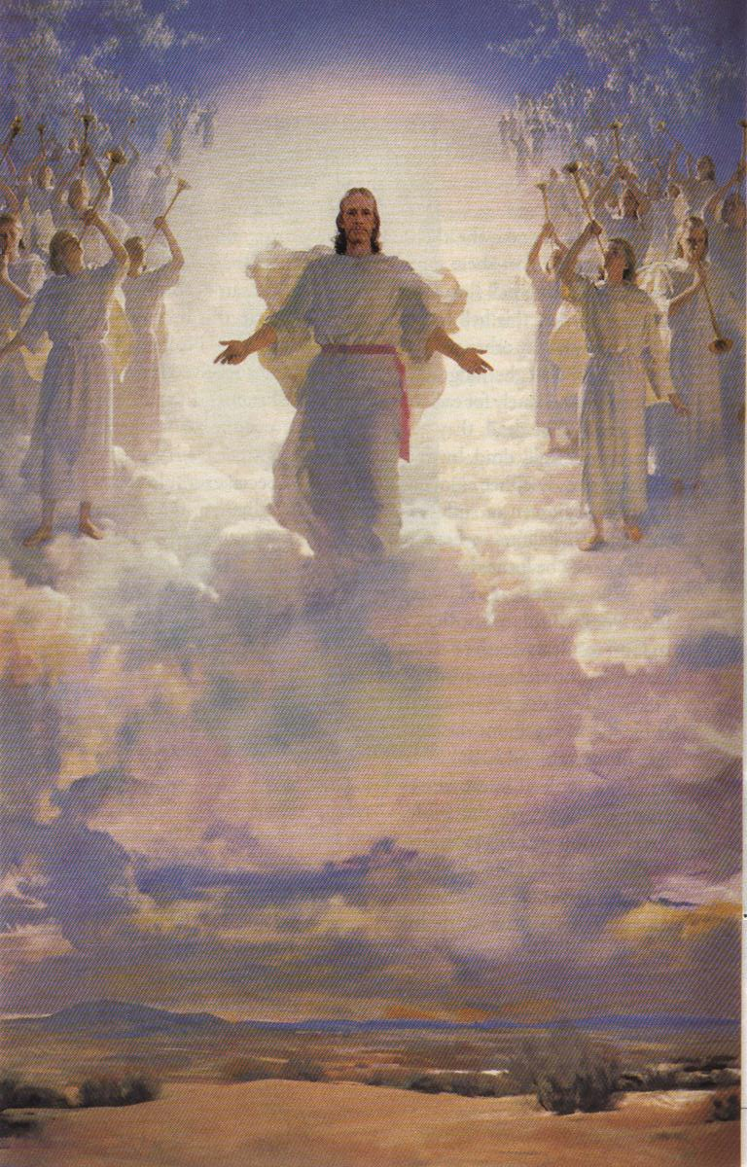
5 MR 255 “It should be our highest aim in life to get ready for heaven.”

Slide 51
The End

Slide 52
60%
1
2
1+2

Slide 53
1
2
1+2

Slide 54



THE BIBLE BOOKMARK

Slide 55
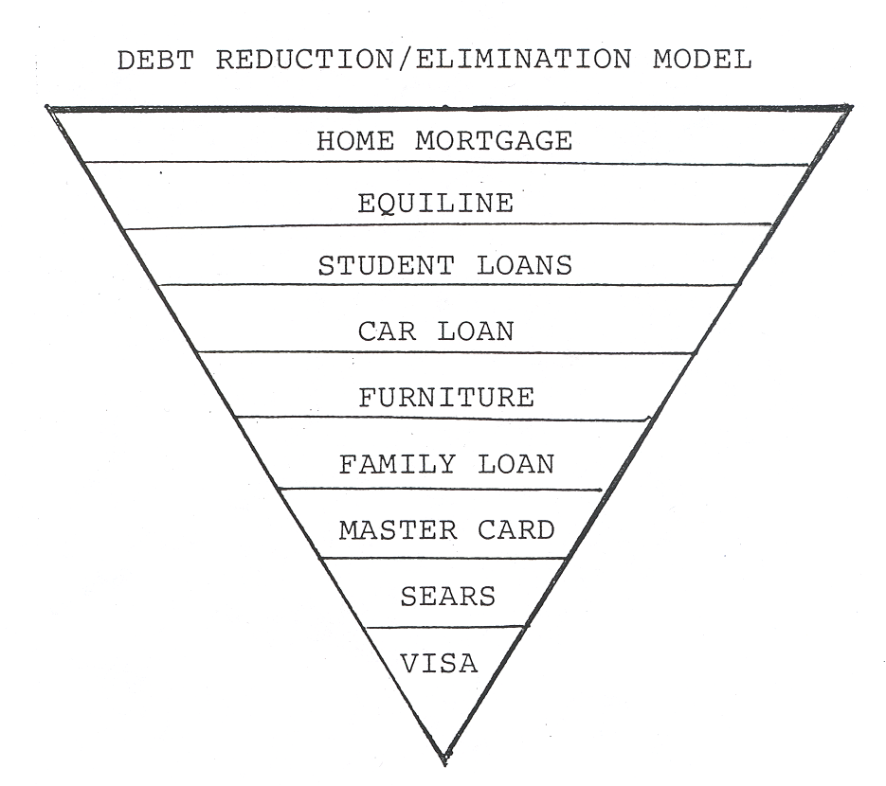
3 Practical
Steps to Debt Elimination

Slide 56
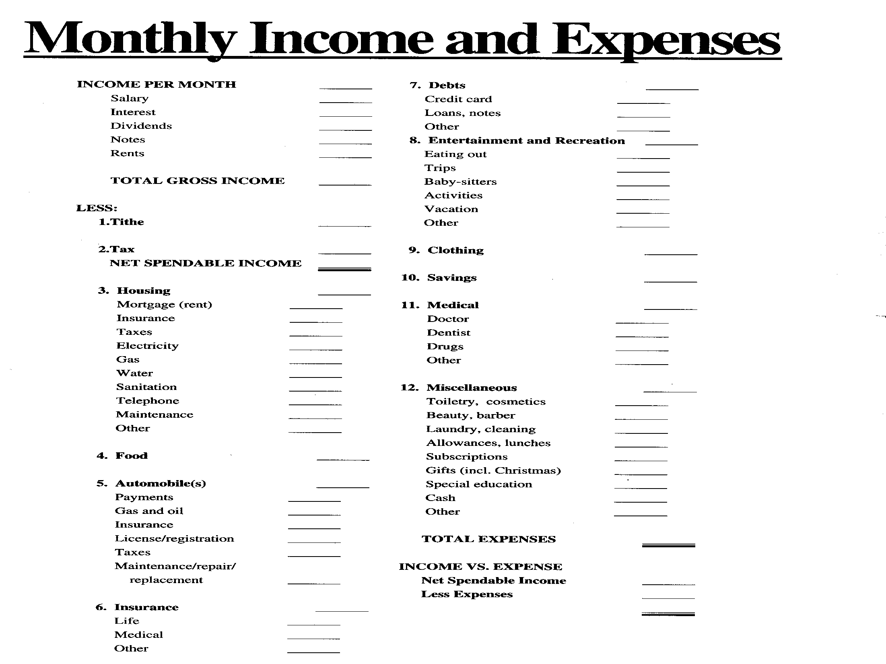

Slide 57
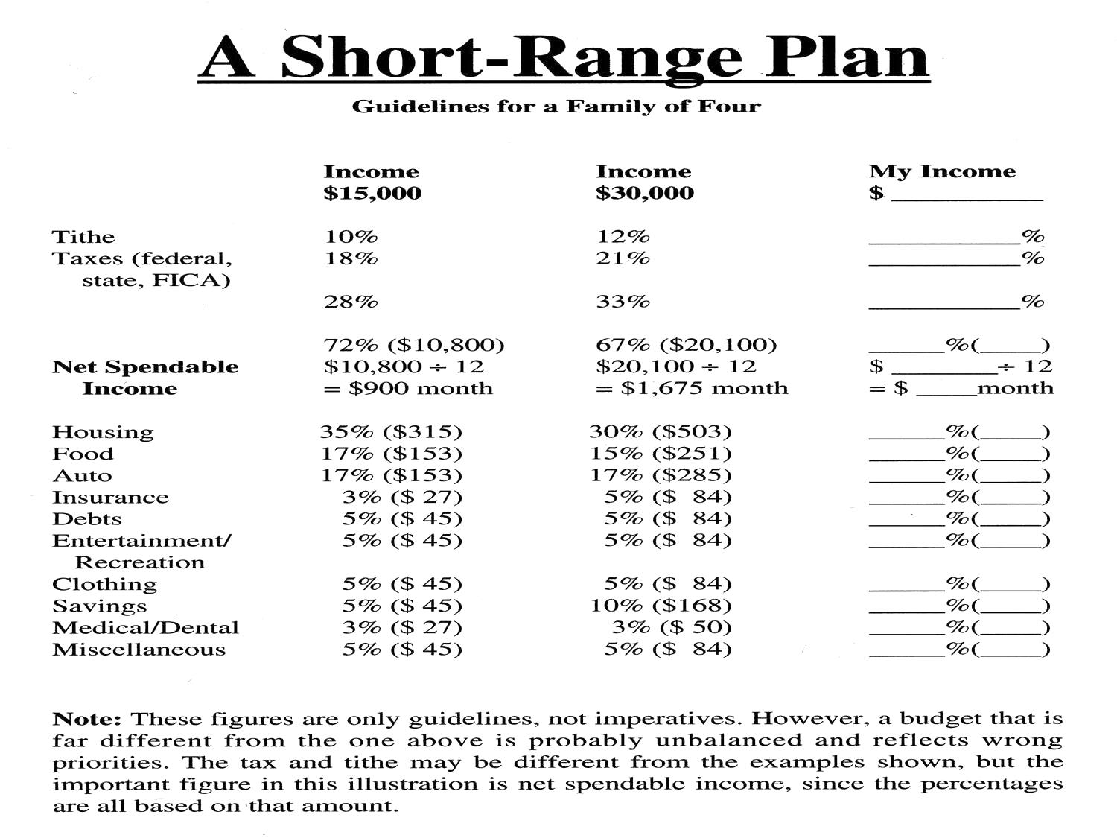

Slide 58
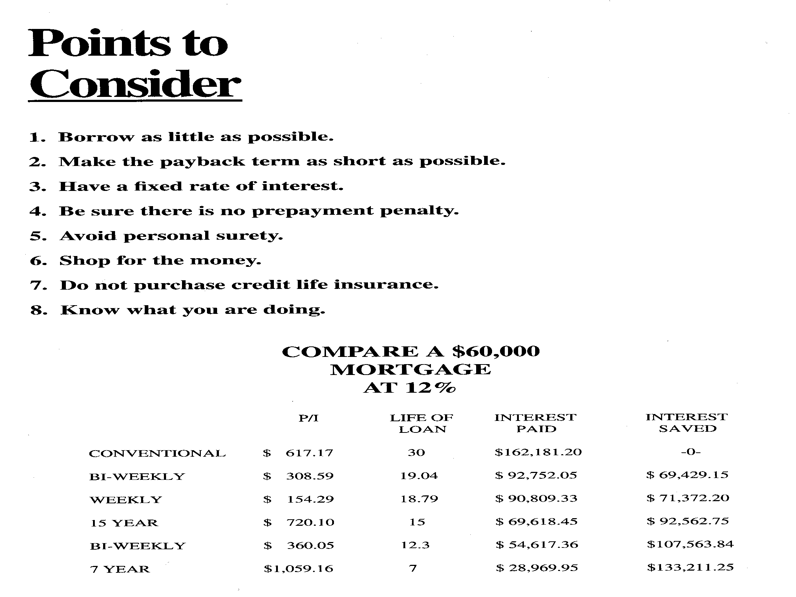

Slide 59
The End

Slide 60
The End

Slide 61
THE WORLD AND THE CHURCH IN A CRISIS

Slide 62
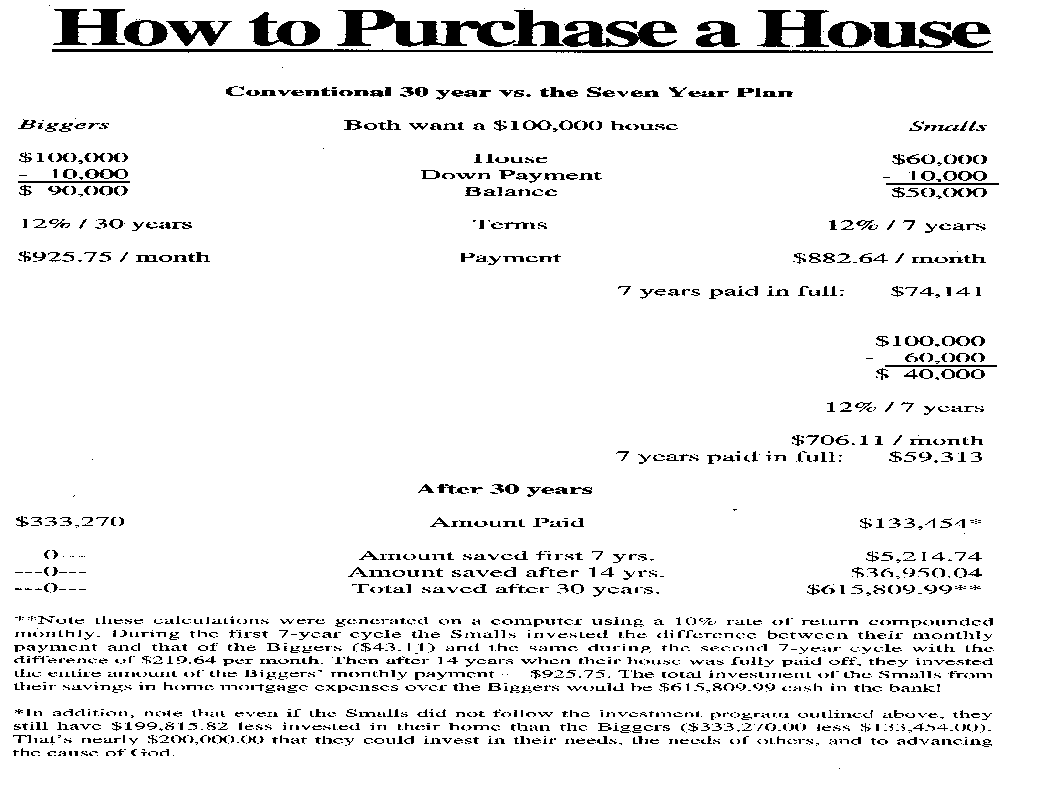

Slide 63
When will you reach the equilibrium?
R 617.17
PRINCIPLE
(292)
R 617.17
INSTALLMENT (R)
INTEREST
1 90 180 270 360
PAYMENT PERIOD (months)
R 60,000.00 @ 12% over 30 years

Slide 65

HOW TO STRETCH YOUR DOLLAR

