Slide 1
In support of
MISSION TO THE HOLY CITY

Slide 2
With acknowledgement and honour to our Heavenly Father for the wisdom and insight granted to G. Edward Reid, retired Stewardship Ministries Director, North-American Division, whose series “Your Finances in Changing Times” as well as “It’s Your Money, Isn’t It?” laid the foundation for the “Money, Money, Money…!” seminar.

Slide 3
A budget is an orderly,
time-consuming, and methodical way to discover there is not enough money to go around.

Slide 4
When your outgo exceeds your income, your upkeep will be your downfall!

Slide 5
“If you’re giving while you’re living, then you’re knowing where it’s going.”

Slide 6
“Make all you can, save all you can, give all you can.”
Wesley

Slide 7
When you think no one cares you’re alive, try missing a couple of
car payments.

Slide 8
We always pay dearly for chasing after what is cheap. Alexander Solzhenitsyn

Slide 9
Some people go over their budgets very carefully every month… Some just go over them!

Slide 10
God demands our tithes and deserves our offerings.
Stephen Olford

Slide 11
Christ taught that tithing was a good place to start. . .
but a tragic place to stop.

Slide 12
“Make money your god and it will plague you like the devil!”
Henry Fielding

Slide 13
You can spend money
any way you want. . .
but you can only spend it once.

Slide 14
“Money talks. It says, ‘Good-bye.’”
Brian Kluth

Slide 15
THE END

Slide 16
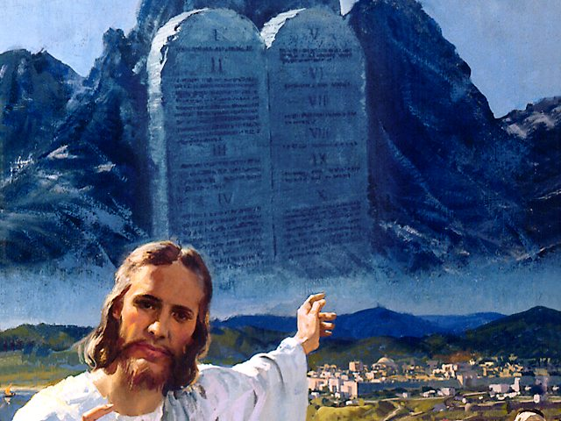
The Camp of the Israelites
and
The Camp of the Philistines

Slide 17
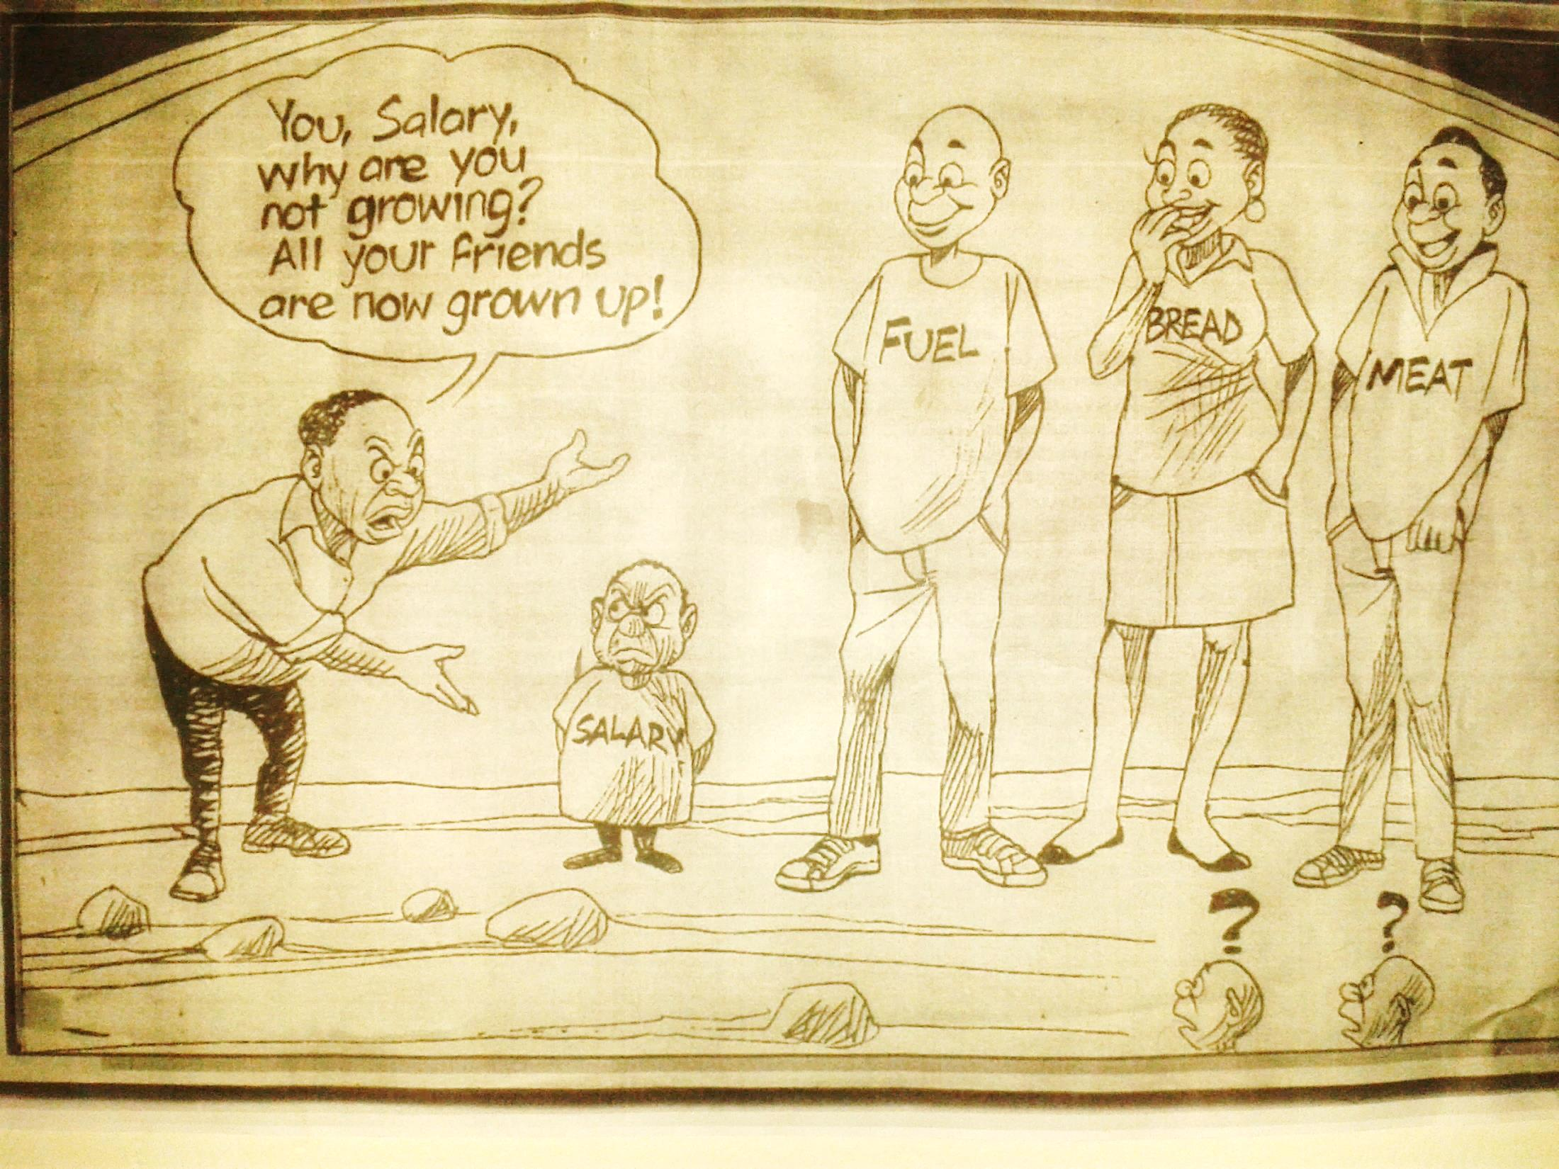

Slide 18
THE VALUE OF A FAMILY BUDGET
(CS 249.1-2)
“Many, very many, have not so educated themselves that they can keep their expenditures within the limit of their income. They do not learn to adapt themselves to circumstances, and they borrow and borrow again and again, and become overwhelmed in debt, and consequently they become discouraged and disheartened…

Slide 19
TELL YOUR MONEY WHERE TO GO BEFORE IT TELLS YOU WHERE IT WENT.

Slide 20
CS 249.1-2
(Continue)
…Many do not remember the cause of God, and carelessly expend money in holiday amusements, in dress and folly, and when there is a call made for the advancement of the work in home and foreign missions, they have nothing to give, or even have overdrawn their account. Thus they rob God in tithes and offerings, and through their selfish indulgence they lay the soul open to fierce temptations and fall into the wiles of Satan.”

Slide 21
CS 249.1-2
(Continue)
…Many do not remember the cause of God, and carelessly expend money in holiday amusements, in dress and folly, and when there is a call made for the advancement of the work in home and foreign missions, they have nothing to give, or even have overdrawn their account. Thus they rob God in tithes and offerings, and through their selfish indulgence they lay the soul open to fierce temptations and fall into the wiles of Satan.”

Slide 22
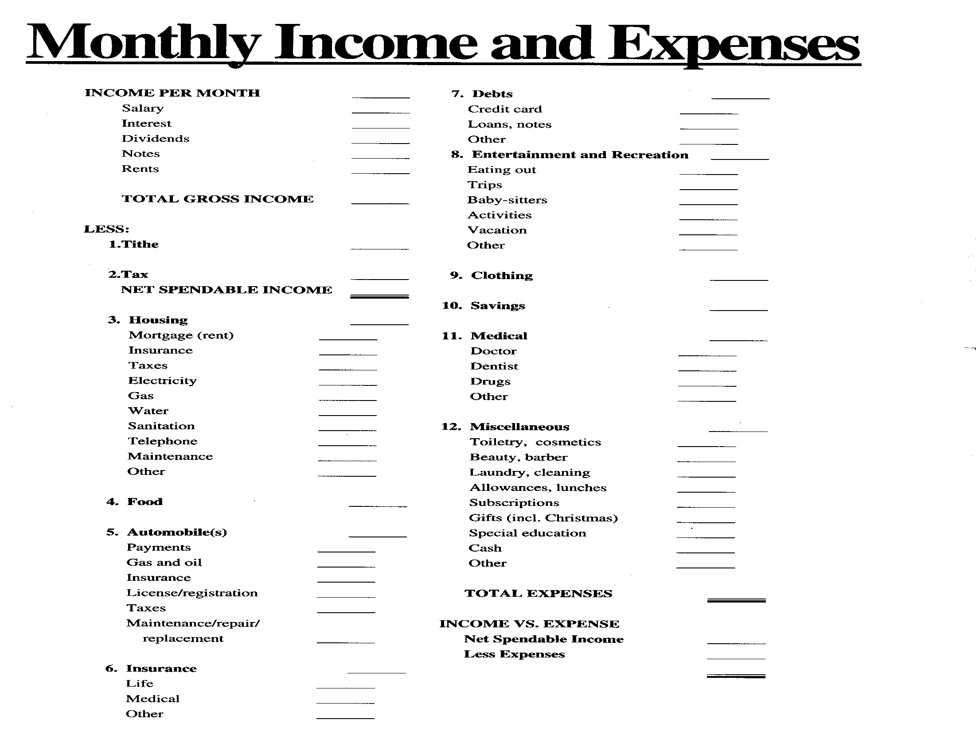

Slide 26
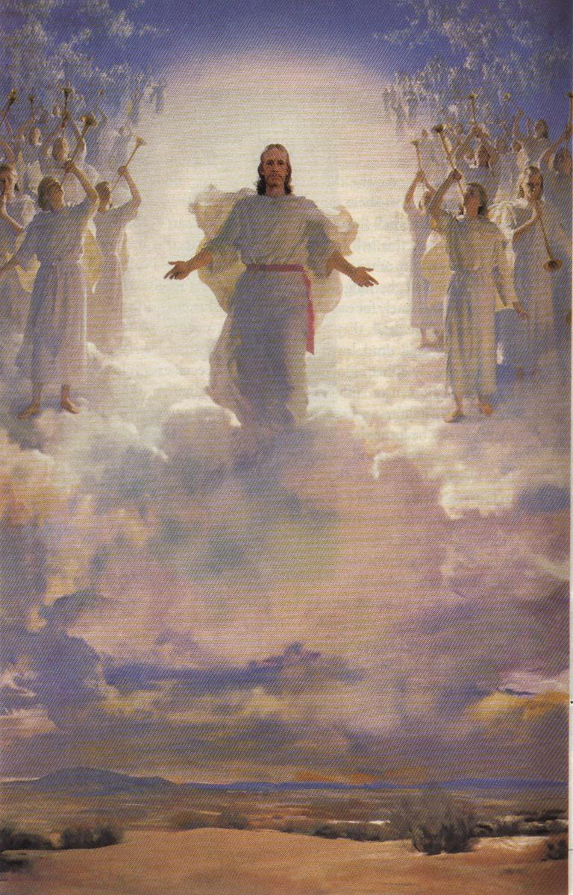
5 MR 255 “It should be our highest aim in life to get ready for heaven.”

Slide 27
The End

Slide 28
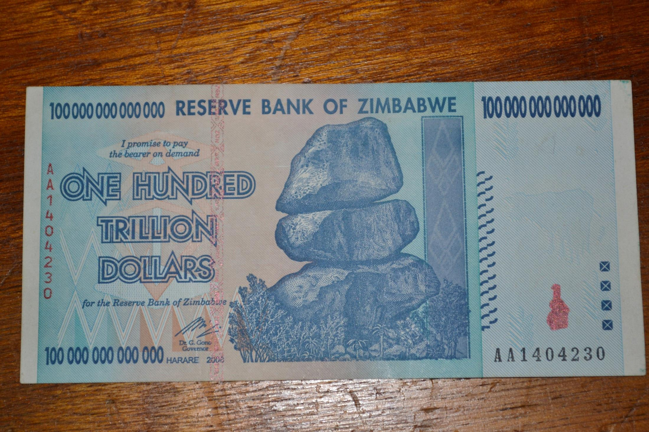

Slide 29
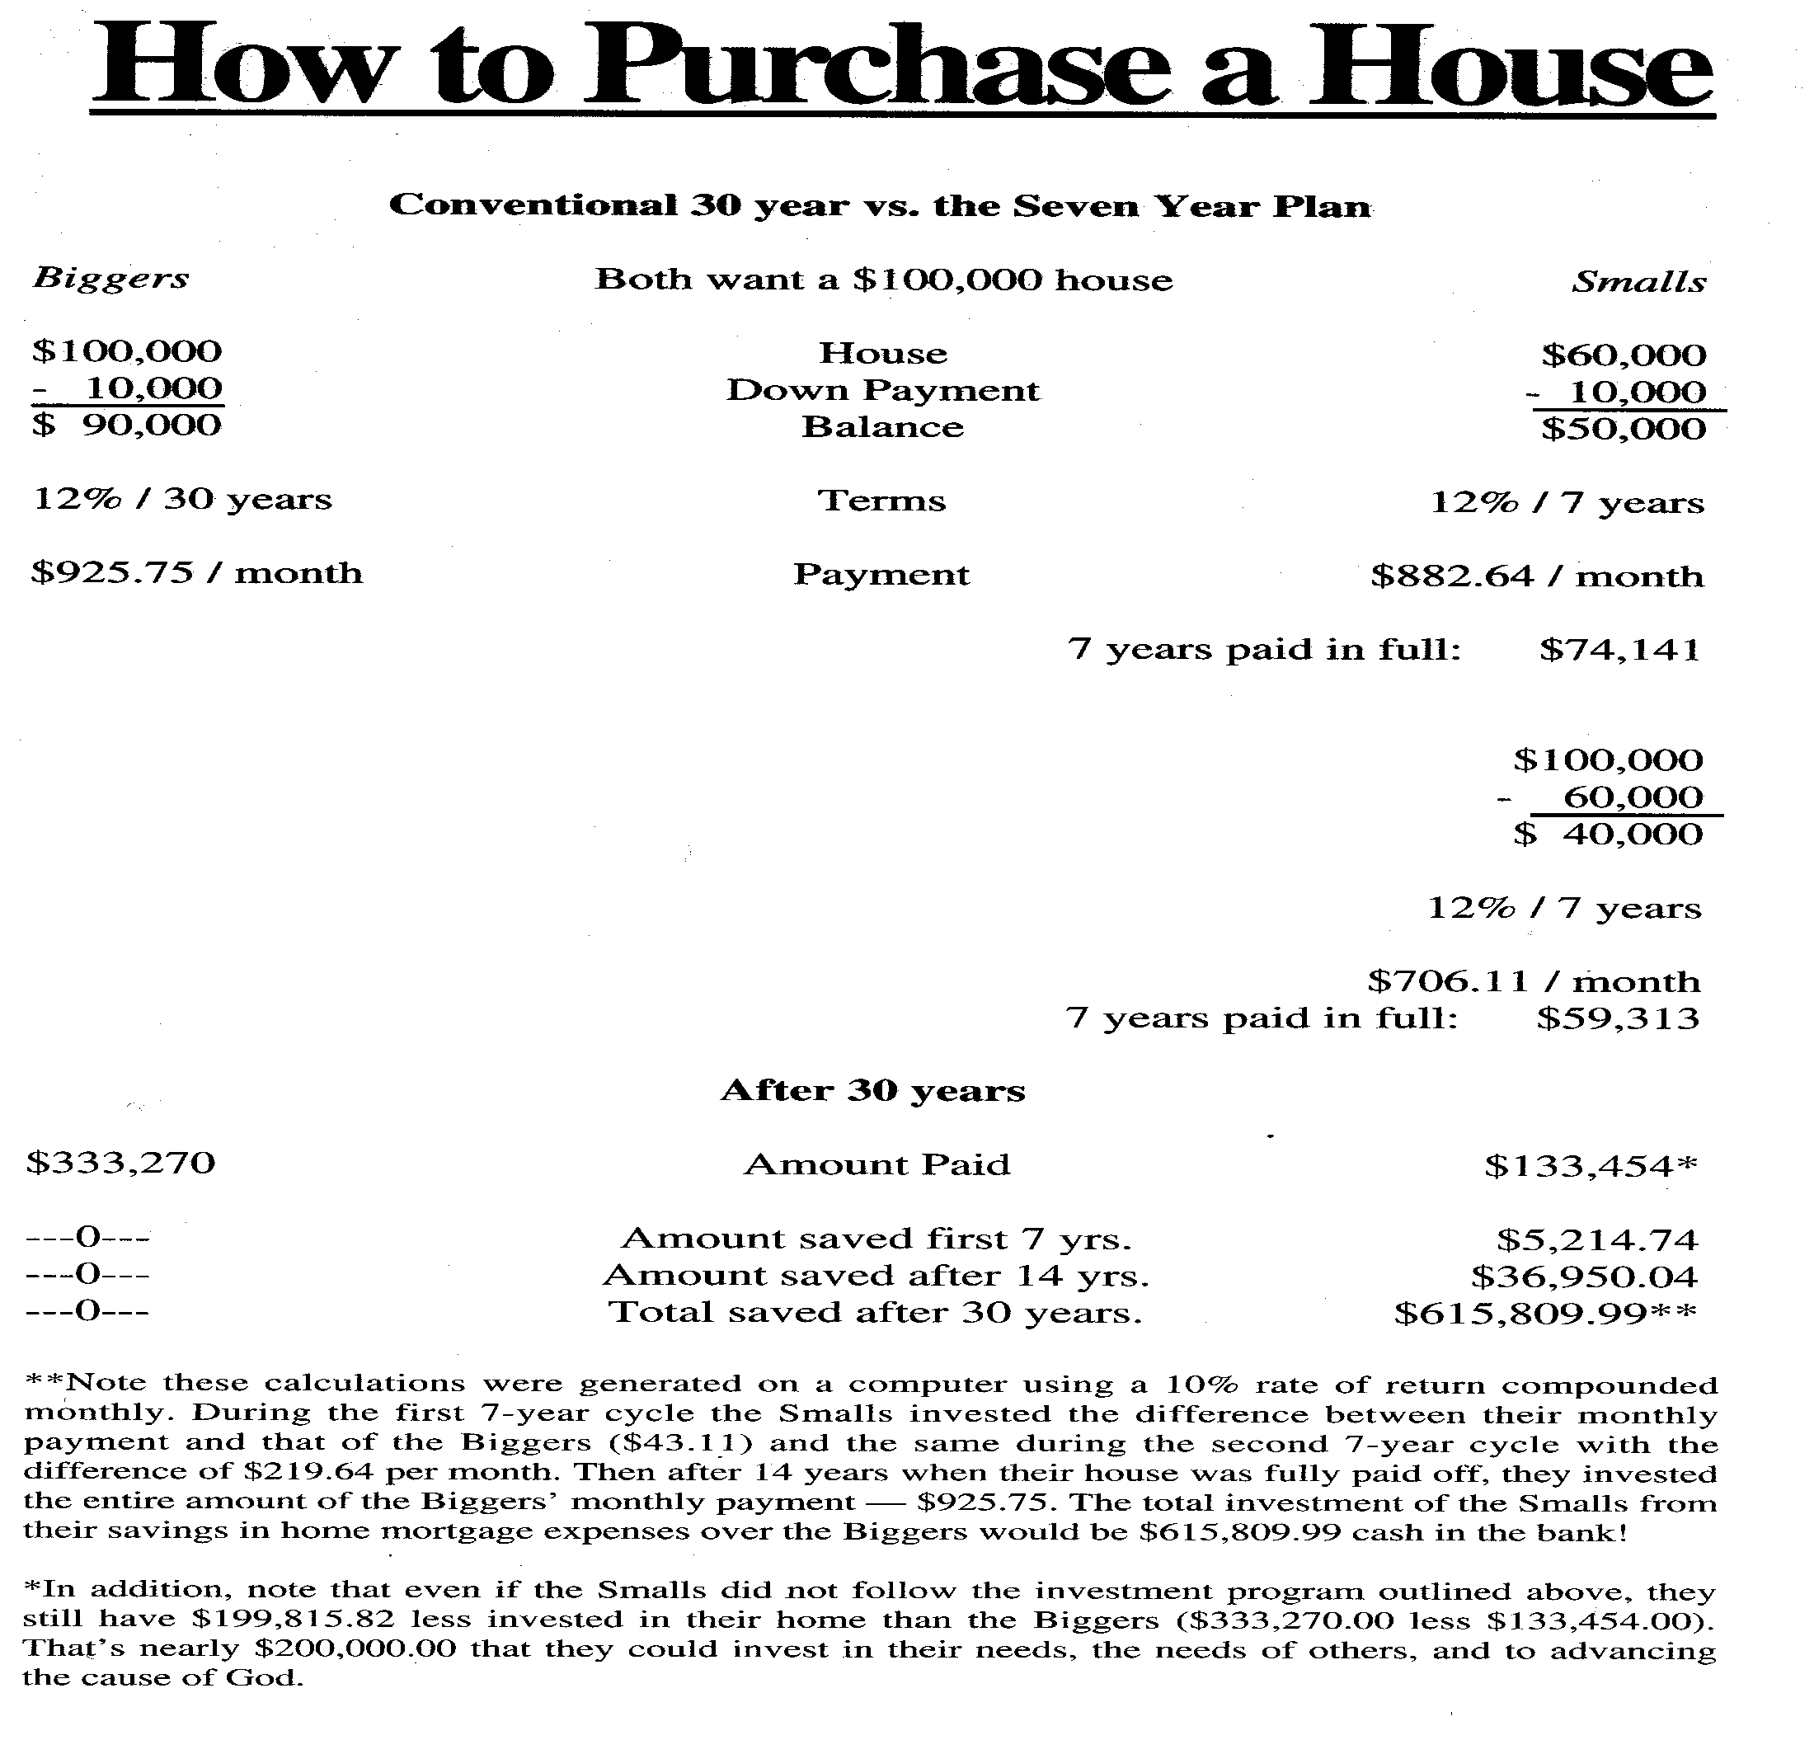
60%
1
2
1+2

