Slide 1
BORN FREE

Slide 2
With acknowledgement and honour to our Heavenly Father for the wisdom and insight granted to G. Edward Reid, retired Stewardship Ministries Director, North-American Division, whose series “Your Finances in Changing Times” as well as “It’s Your Money, Isn’t It?” laid the foundation for the “Money, Money, Money…!” seminar.

Slide 3
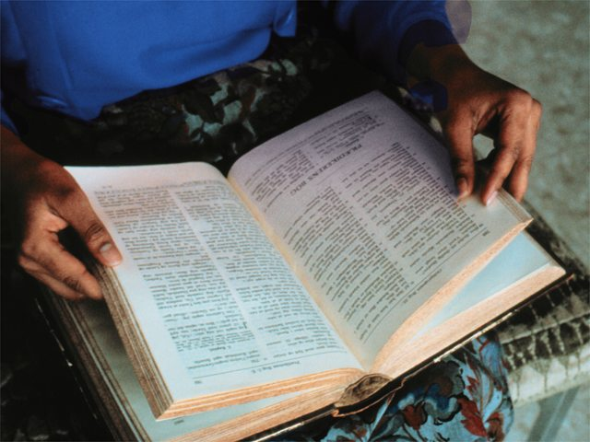
Does the Bible allow debt ? Yes / No

Slide 4
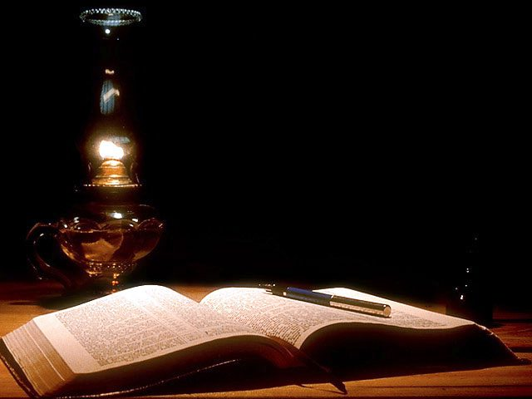
Deuteronomy 15:1,2
“At the end of every seven years you shall grant a release of debts. And this is the form of the release: Every creditor who has lent anything to his neighbor shall release it; he shall not require it of his neighbor or his brother, because it is called the Lord’s release.”

Slide 5
Leviticus 25:10 “And you shall consecrate the fiftieth year, and proclaim liberty throughout all the land to all its inhabitants. It shall be a Jubilee for you; and each of you shall return to his possession, and each of you shall return to his family.”

Slide 6
Leviticus 25:14,15 “And if you sell anything to your neighbor or buy from your neighbor's hand, you shall not oppress one another. According to the number of years after the Jubilee you shall buy from your neighbor, and according to the number of years of crops he shall sell to you.”

Slide 7
What is the ideal ?
Romans 13:8
“Owe no one anything except to love one another, for he who loves another has fulfilled the law.”

Slide 8
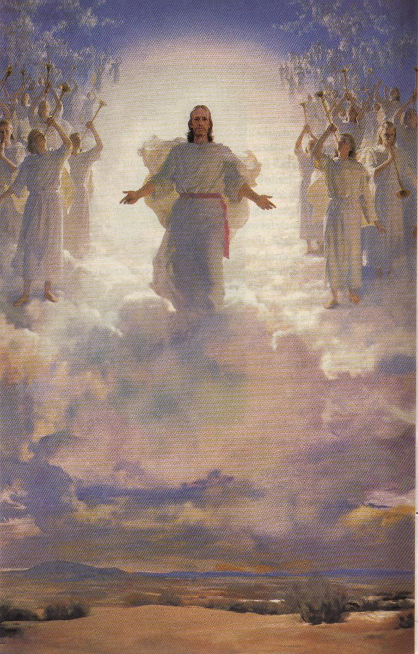
5 MR 255 “It should be our highest aim in life to get ready for heaven.”

Slide 9
The Dangers of Debt
Proverbs 22:7
“The rich rules over the poor, and the borrower is servant to the lender.”

Slide 10
Debt actually implies…
- That you are today spending money that you only expect to earn tomorrow [may be].
That you have to repay what you borrowed.

Slide 11
How do people get into debt ?
- Borrowing
- Credit spending
- Surety / Personal surety
- Window shopping

Slide 12
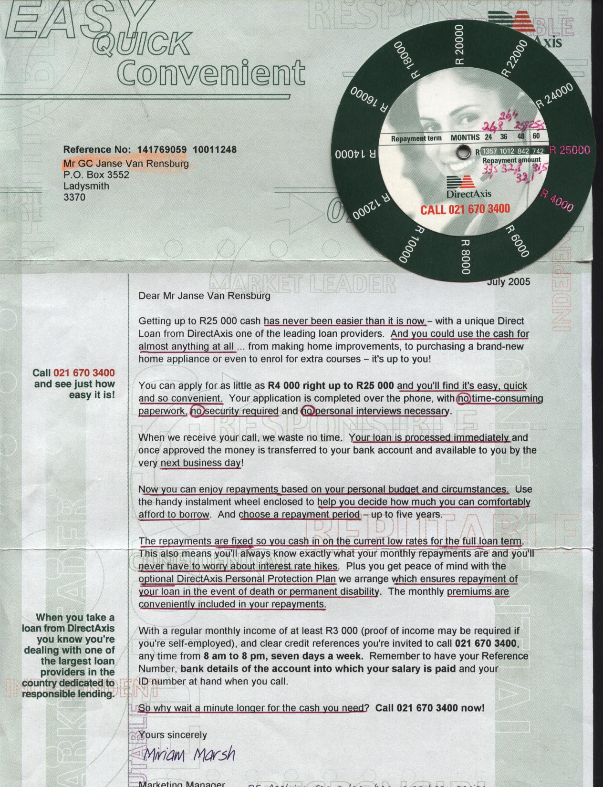

Slide 13
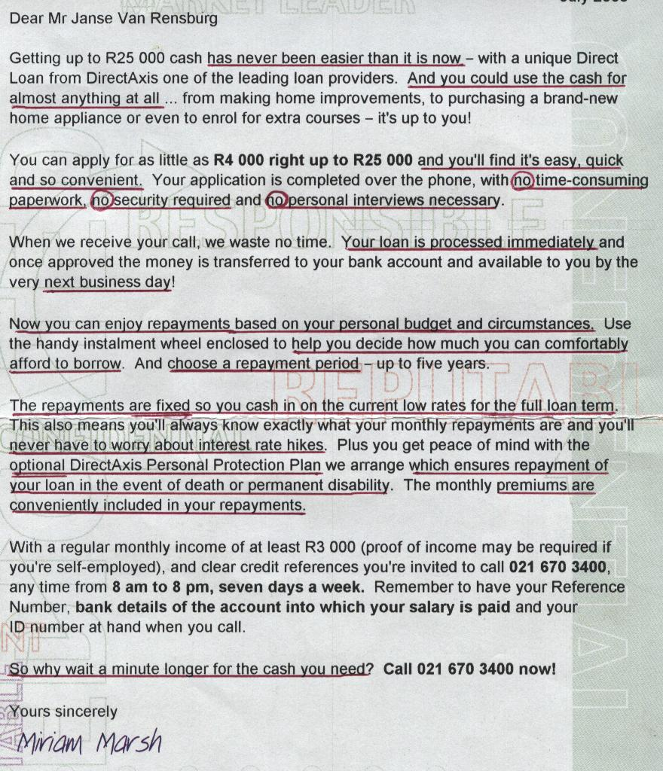

Slide 14
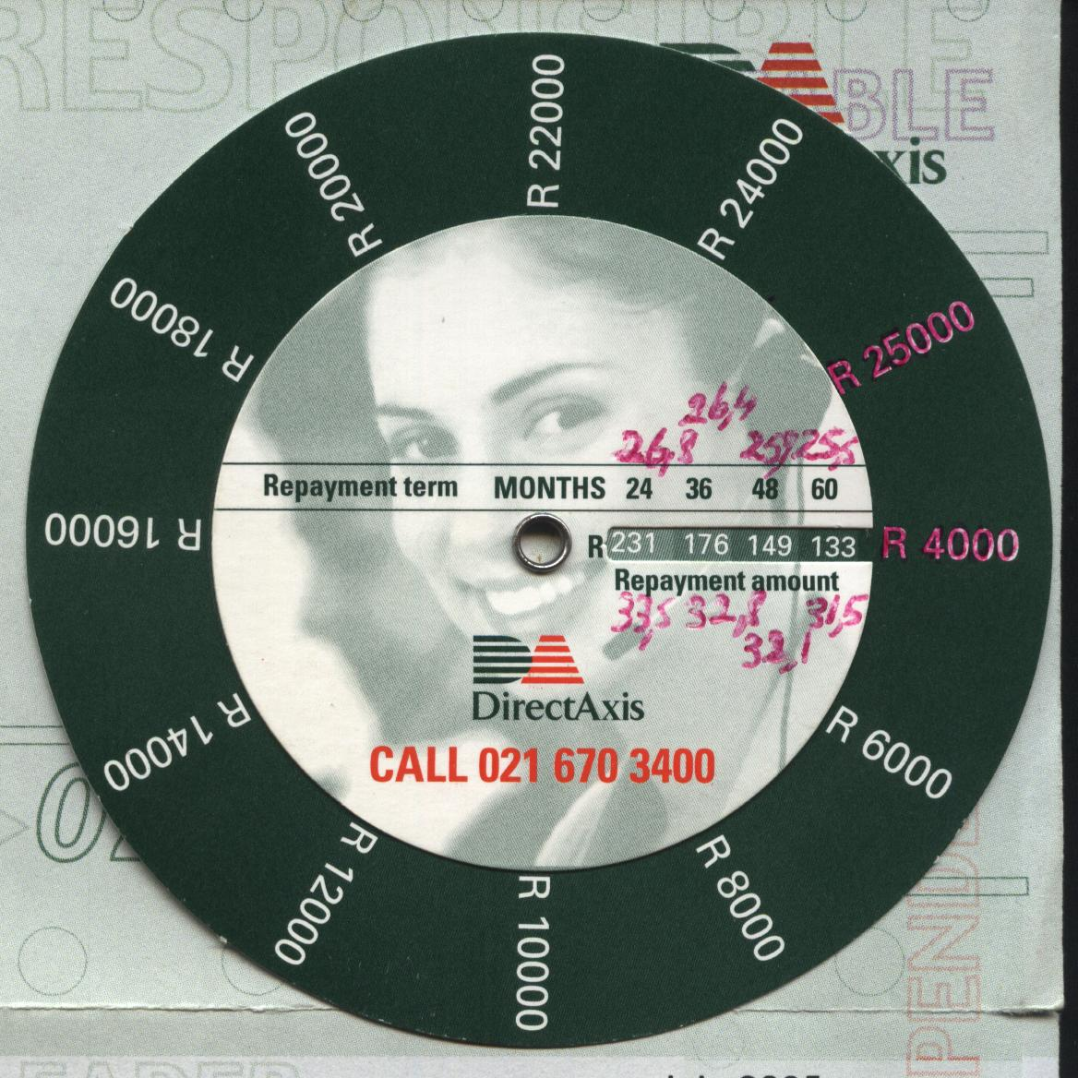
33,5%
Interest

Slide 15
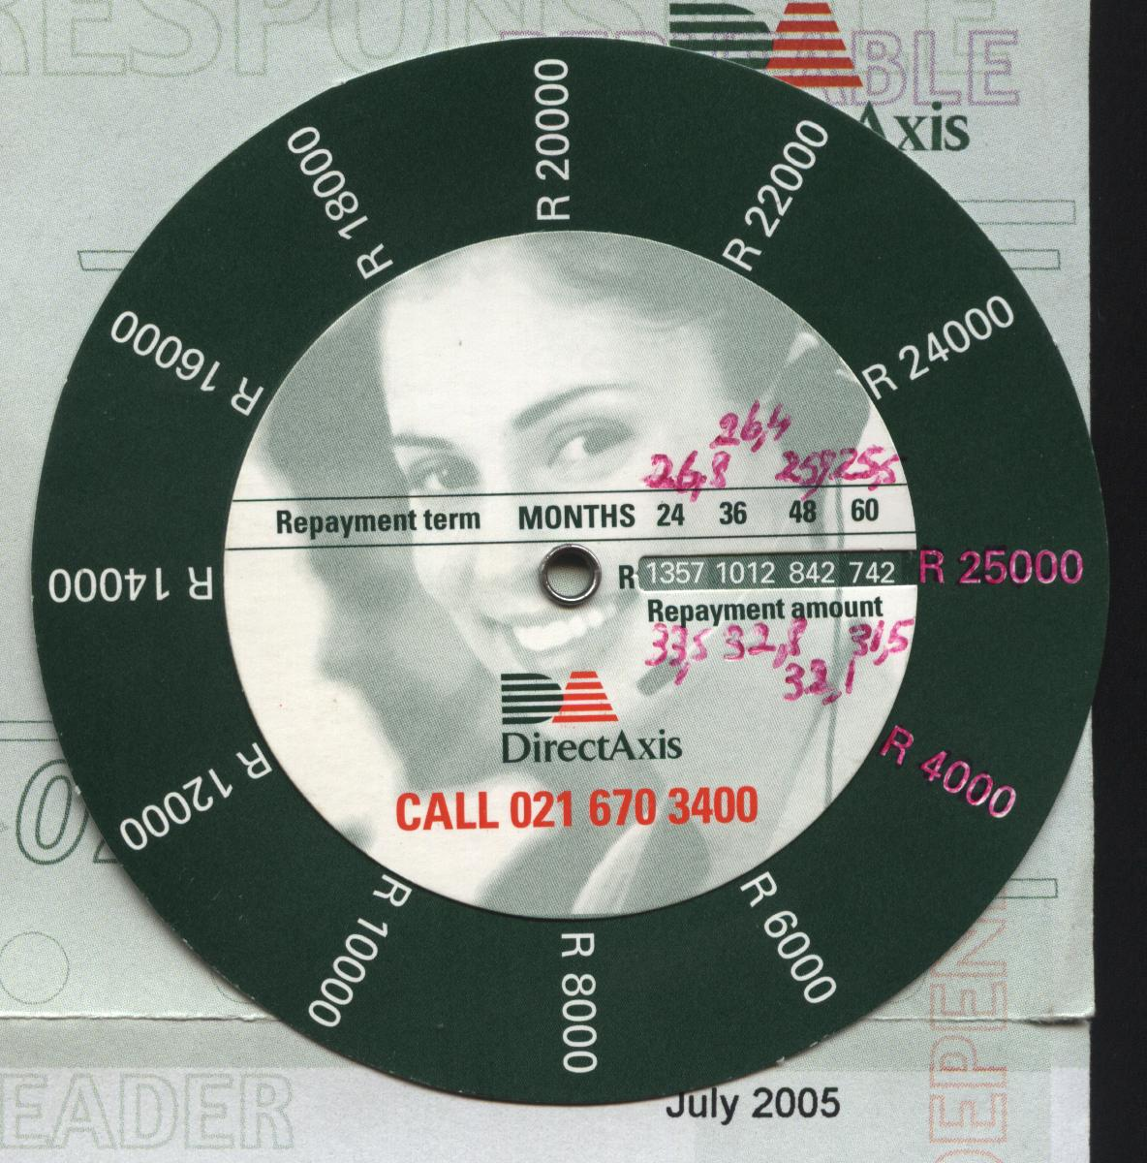
26,8%
Interest

Slide 16
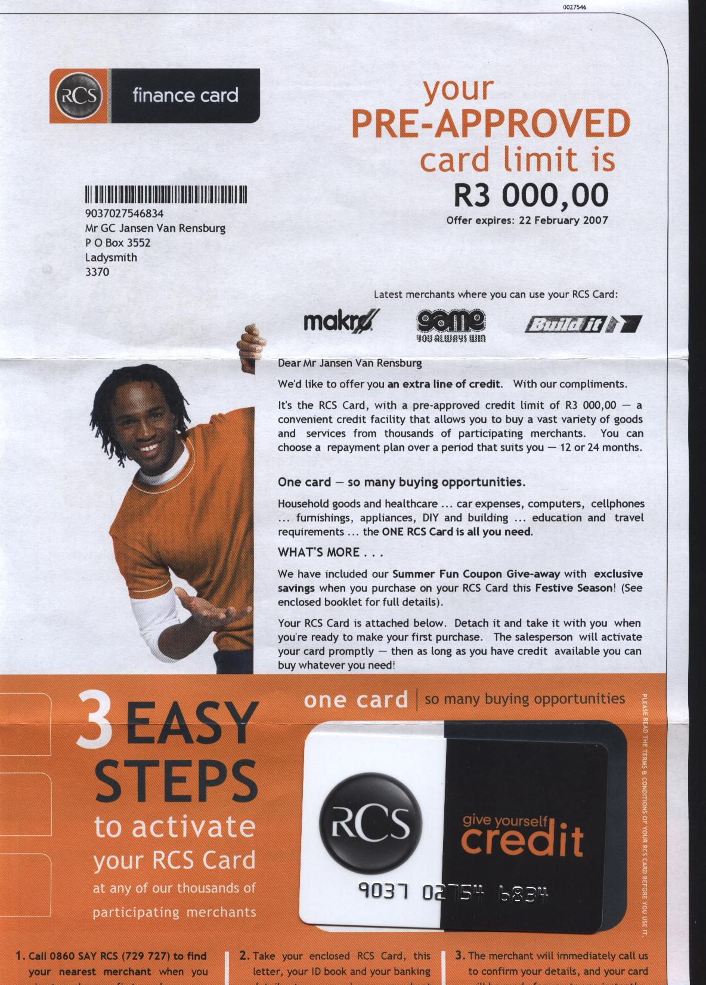

Slide 17
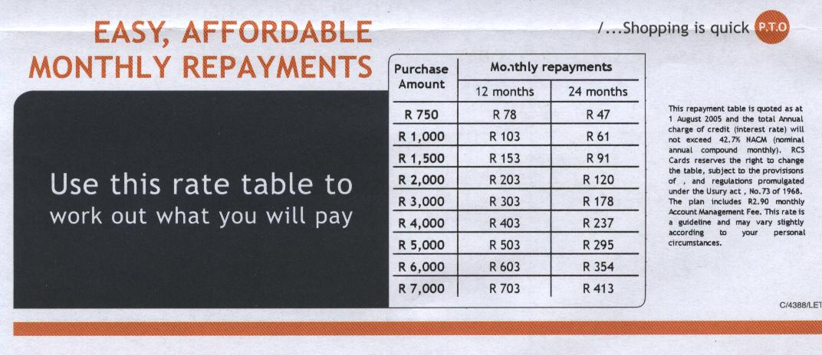

Slide 18
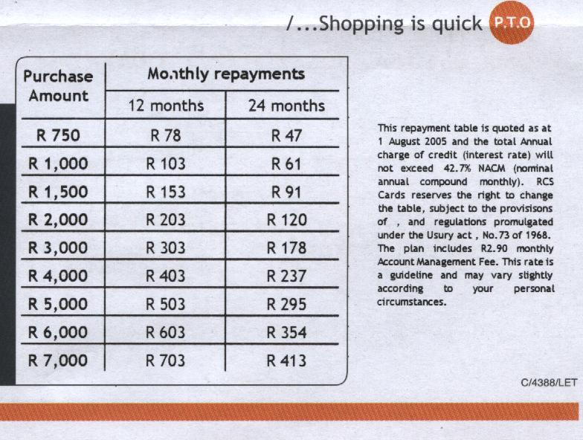
36%
Interest

Slide 19
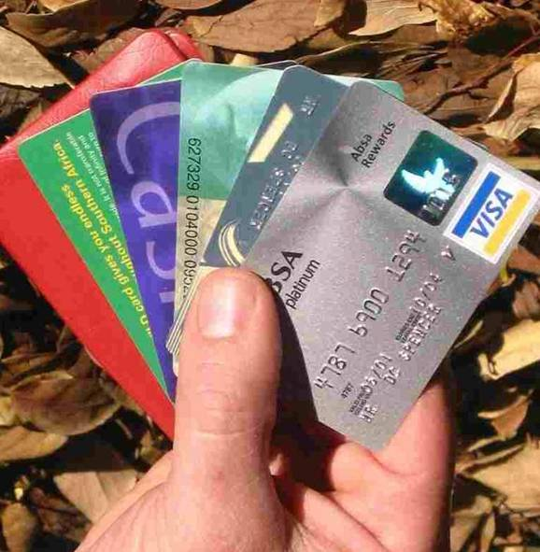

Slide 21
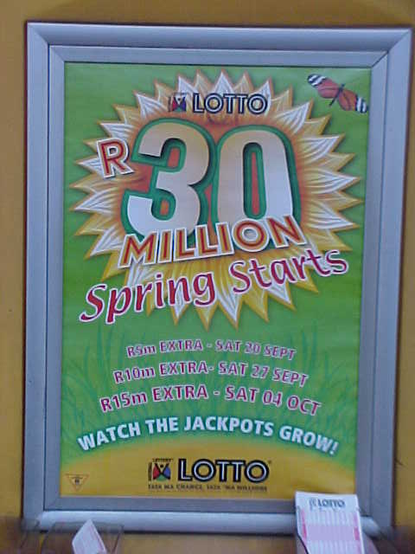

Slide 22
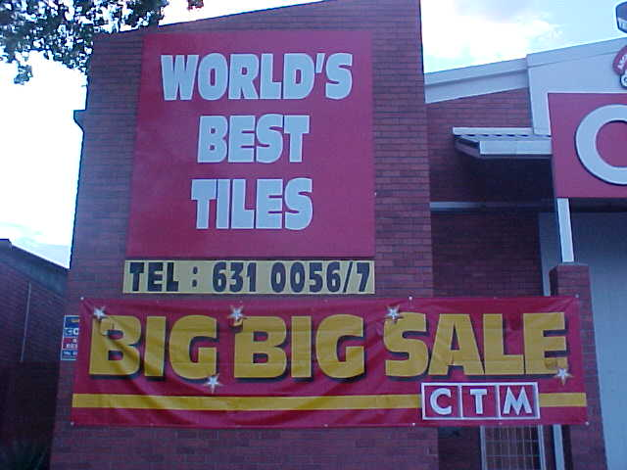

Slide 23
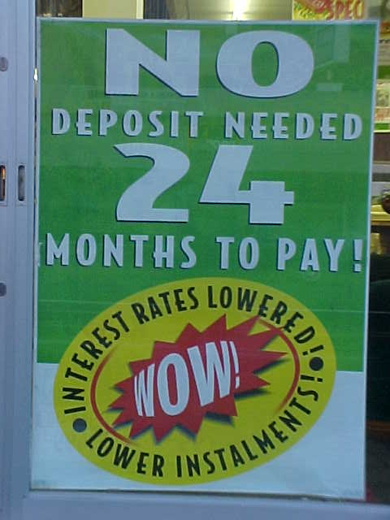

Slide 24
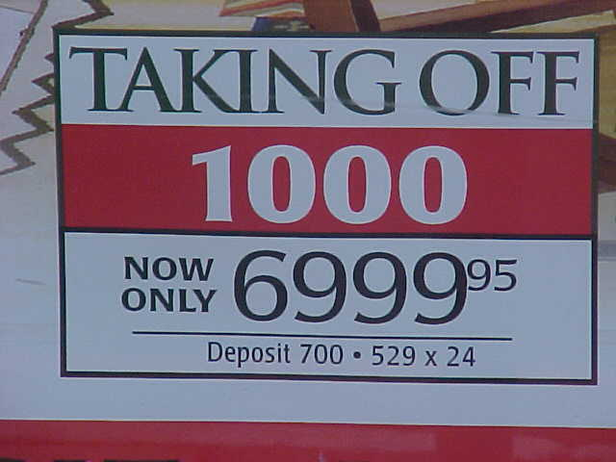

Slide 25
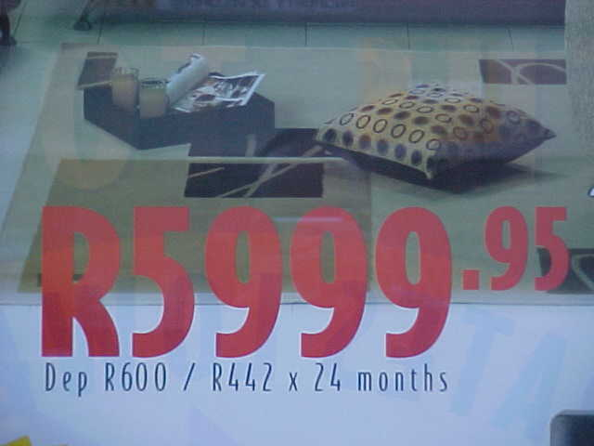

Slide 26
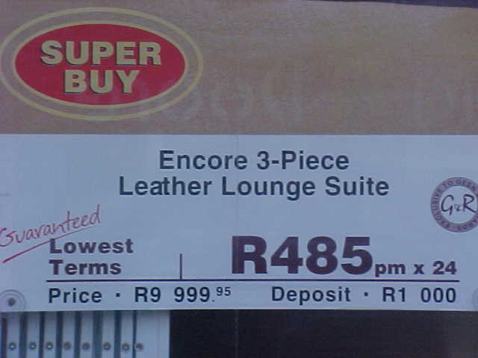

Slide 27
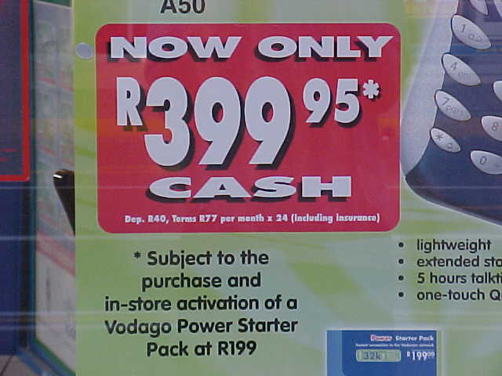

Slide 28
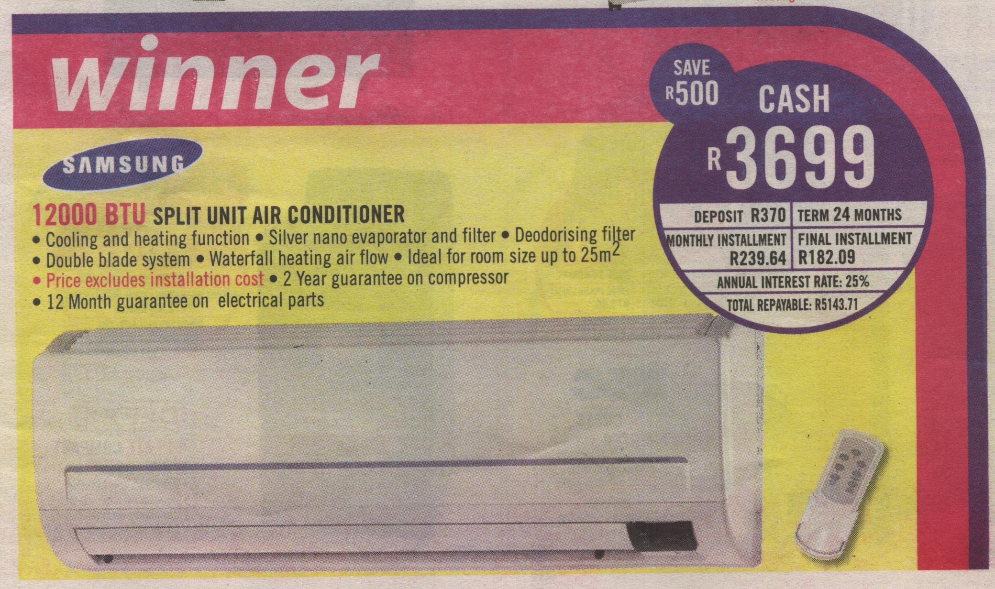
Application of new credit law as from 1 June 2007

Slide 29
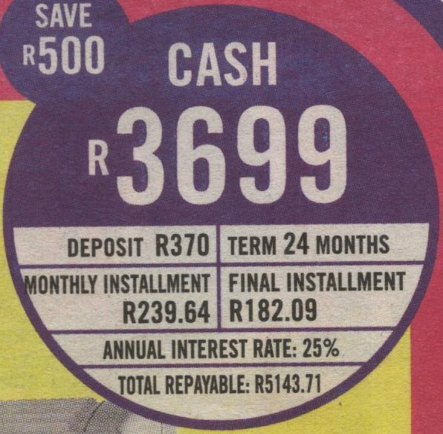

Slide 30
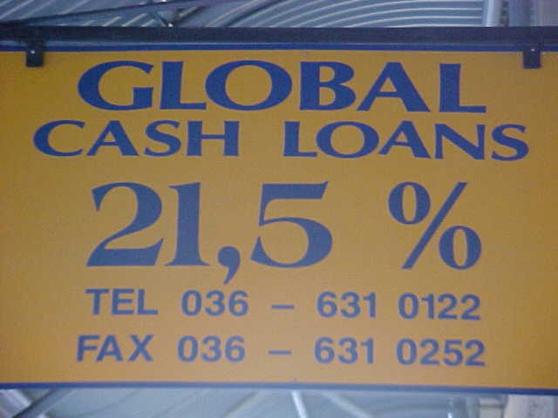

Slide 31
Types of debt
- Consumer debt
- Principle debt
- Surety

Slide 32
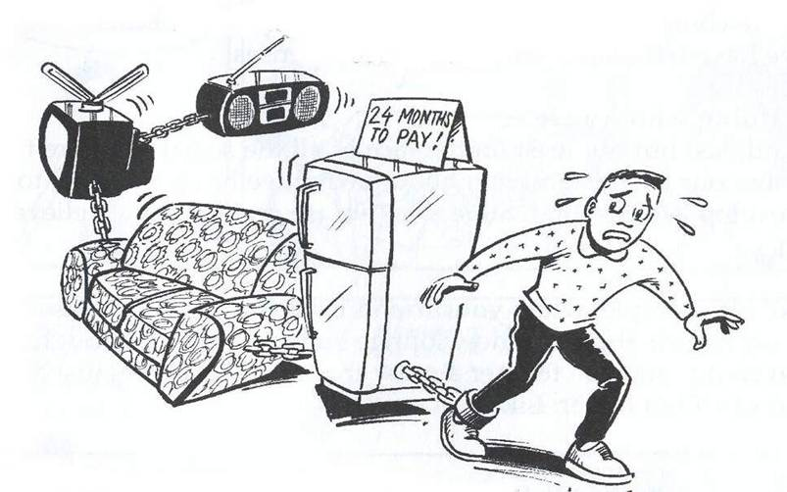
What is consumer debt?

Slide 33
Repayment of any debt consist of:
- Principle [capital]
- Interest
- Payment period

Slide 34
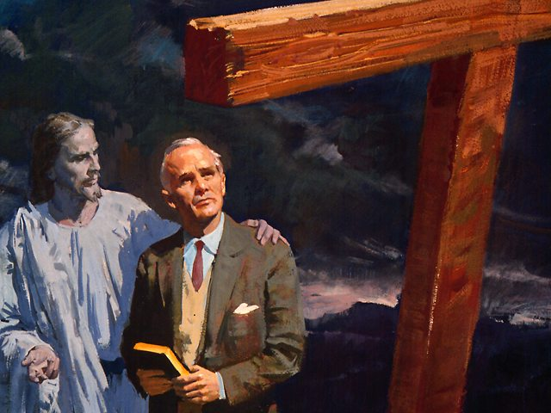
3 Steps for
TOTAL DEBT
ELIMINATION
(Pg.8-M)

Slide 35
BASIC PREMISE
This plan is based on the assumption that a commitment to faithful tithing has been established to access God’s promised wisdom and blessing.

Slide 36
STEP 1
Declare a moratorium on
additional debt
- No more credit spending.
- If you don’t borrow, you can’t
get into debt.
- If you don’t borrow more
money, you can’t get further
into debt.

Slide 37
STEP 2
- Covenant with God that from
this point on, as He blesses, you
will pay off your debts ASAP.
- Set a target date for being debt
free. As God blesses you, don’t
purchase more things, reduce
your debt…
- Make debt reduction your
highest financial priority.

Slide 38
STEP 3
- List all your debts from the
largest to the smallest in
descending order.
- Pay the minimum payment
due on each of your debts on
a monthly basis…

Slide 39
STEP 3 [continued]
- Do your best to double up or increase the payment on the debt on the bottom of the list.
You will be happily surprised to
see how quickly that smallest
debt will be eliminated
- Add the money from that debt to
the basic payment next to the
bottom on your list.

Slide 40
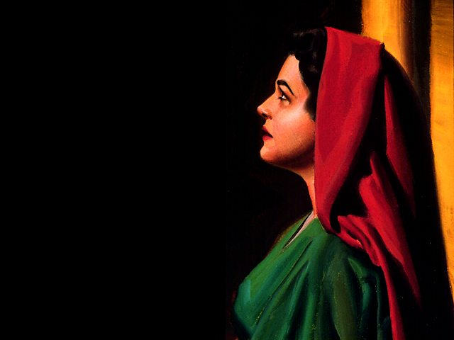
Count Your Blessings!
As you start from the bottom, you will have many occasions, close together in praising God for His blessings.

Slide 41
The Result !
When you reach your home mortgage debt, use the extra money from previous debts to add to your “principle payment.” You will reduce the length of your loan by several months or even years.

Slide 42
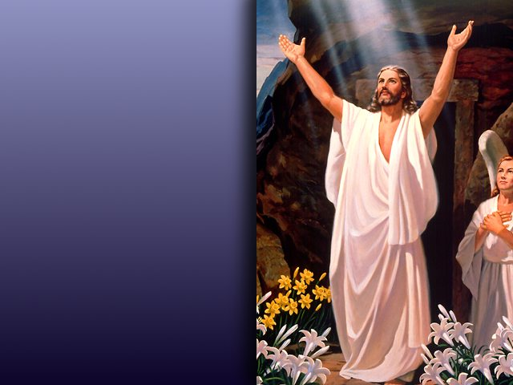
Freedom through Self-Denial (Pg.9-M)
CS.257
“Be determined never to incur another debt. Deny yourself a thousand things rather than run in debt. This has been the curse of your life, getting into debt. Avoid it as you would the smallpox…

Slide 43
CS 257 (continue)
…Make a solemn covenant with God that by His blessing you will pay your debts and then owe no man anything if you live on porridge and bread…

Slide 44
CS 257 (continue)
…It is so easy in preparing your table to throw out of your pocket twenty-five cents for extra’s. Take care of the pennies and the dollars will take care of themselves…

Slide 45
CS 257 (Continue)
…It is the mites here and the mites there that are spent for this, that and the other, that soon run up into dollars. Deny self at least while you are walled in with debts...

Slide 46
CS 257 (Continue)
…Do not falter, be discouraged, or turn back. Deny your taste, deny the indulgence of appetite, save your pence and pay your debts…

Slide 47
CS 257 (continue)
…Work them off as fast as possible. When you can stand forth a free man again, owing no man anything, you will have achieved a great victory.”
(Amen!)

Slide 48
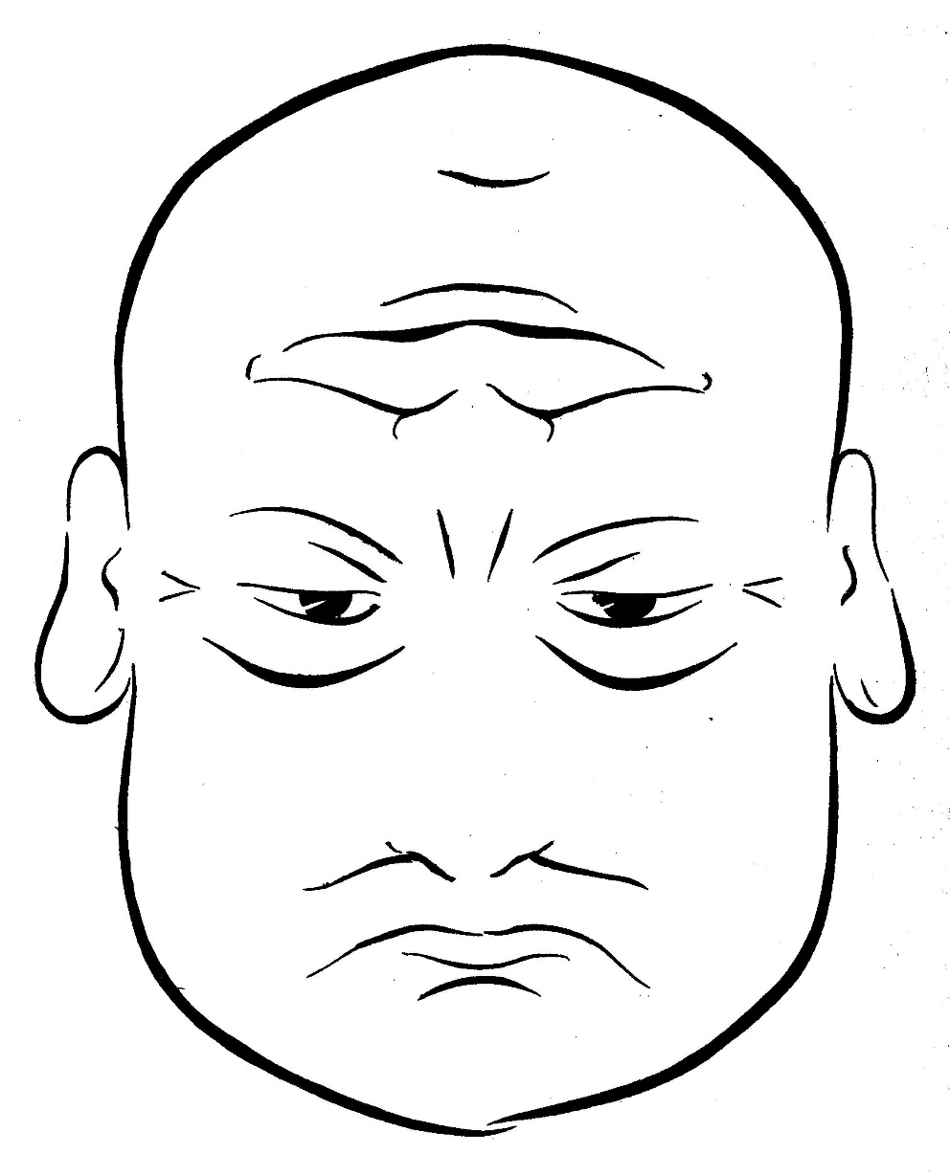
Mr. Worry Dontcare
“I’m free ! ! !”
“I’m in trouble !”

Slide 49
5 MR 255 “It should be our highest aim in life to get ready for heaven.”

Slide 50
THE BEGINNING …

Slide 51
POINTS TO CONSIDER (Pg.13-M)
1. Borrow as little as possible.
2. Make the payback term as short
as possible.
3. Have a fixed rate of interest.
4. Be sure there is no pre-payment
penalty.
5. Avoid personal surety.

Slide 52
POINTS TO CONSIDER
Pg.13-M (continue)
6. Shop for the money.
7. Do not purchase credit
life insurance.
8. Know what you are doing.

Slide 53
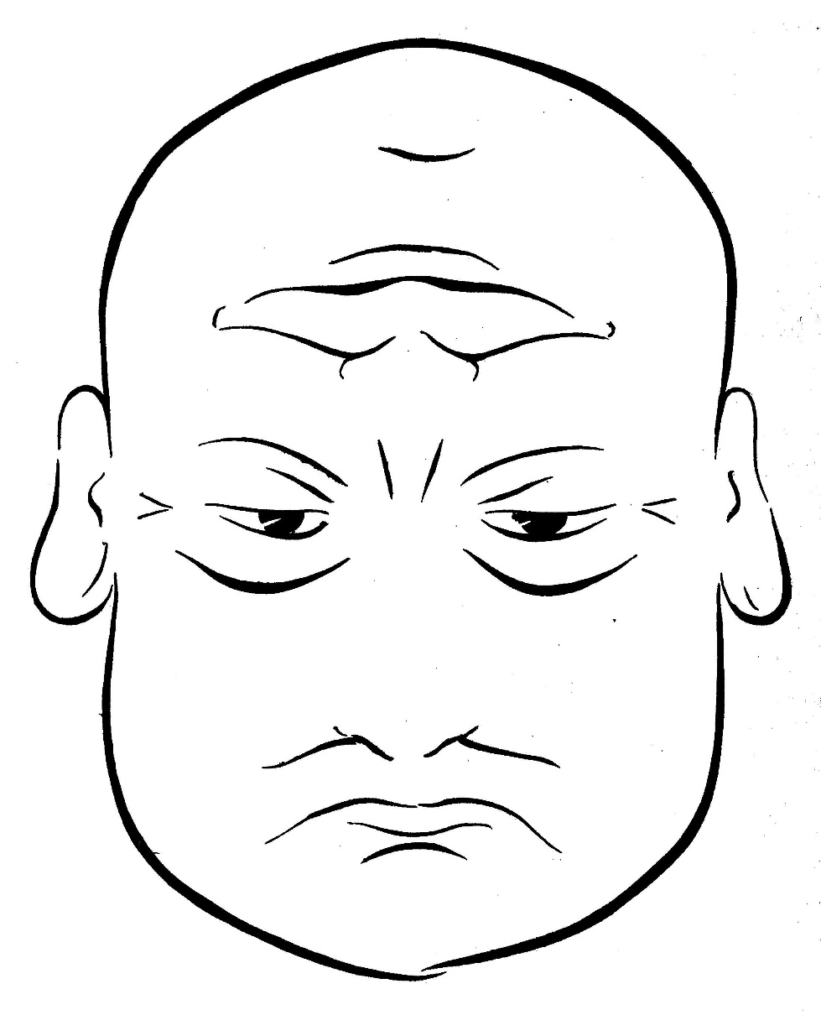
Mr. Worry Dontcare
“I’m in trouble ! ! !”

