Slide 1


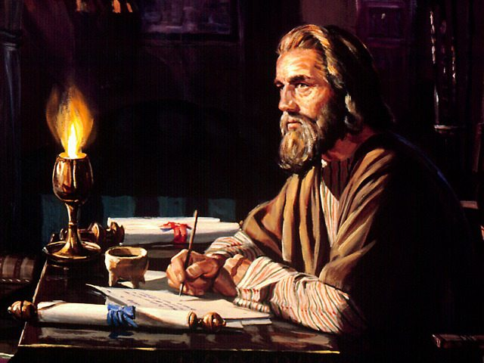
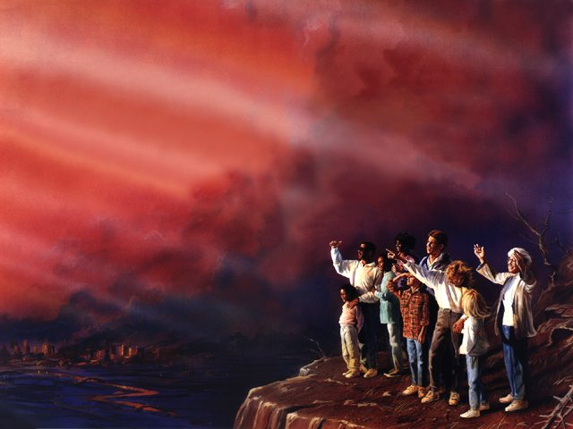
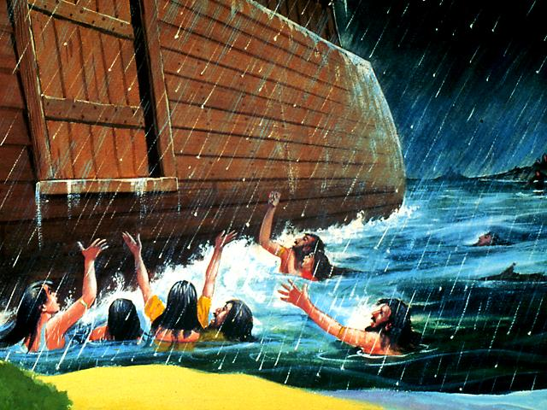
"Money, Money, Money..."
2
3
4
5
6
1
7
Saving Up for a Rainy Day !
Your Will, Your Crowning Act !
Home, sweet home !
The Endtime Adventist Family !
Satan's GOLDEN Chain
Well done, good and faithful servant !
BORN FREE!

Slide 2
With acknowledgement and honour to our Heavenly Father for the wisdom and insight granted to G. Edward Reid, former Stewardship Ministries Director, North-American Division, whose series “Your Finances in Changing Times” as well as “It’s Your Money, Isn’t It?” laid the foundation for the “Money, Money, Money…!” seminar.

Slide 3
Satan's
GOLDEN
Chain

Slide 4

1 Timothy 6:10
“For the love of money is a root of all kinds of evil, for which some have strayed from the faith in their greediness, and pierced themselves through with many sorrows.”

Slide 5
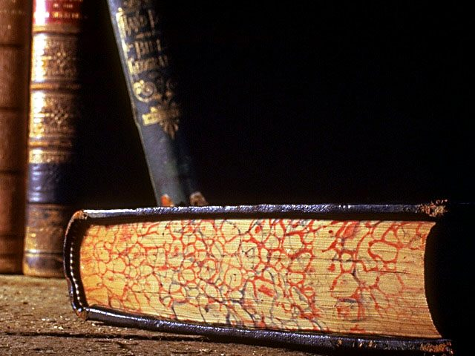
Steps to Christ p.44 “The love of money, the desire for wealth, is the golden chain that binds (men) to Satan.”

Slide 6
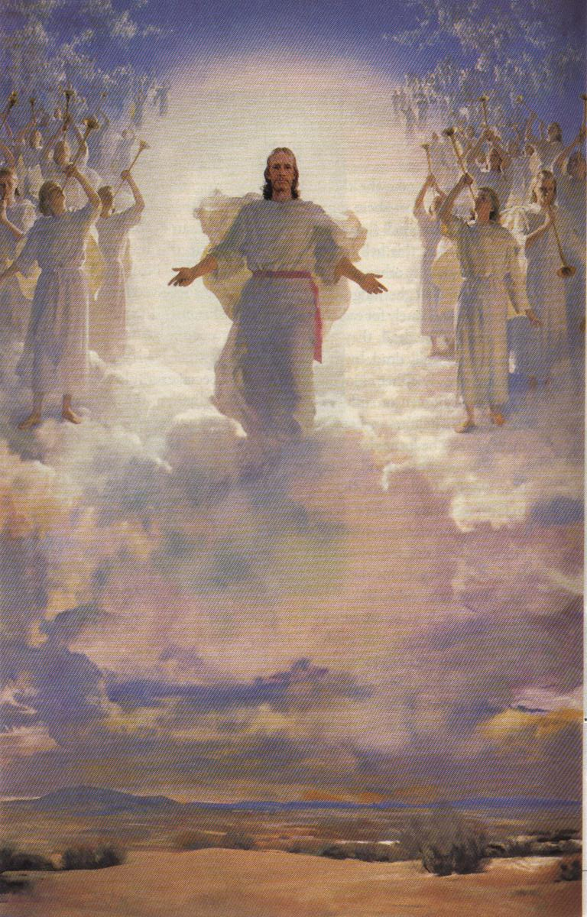
5 MR 255 “It should be our highest aim in life to get ready for heaven.”

Slide 7

THE BIBLE and MONEY
- 2/3 of Jesus’ parables deals with
money / possessions
- 2000 references on money found in
the Bible
- 500 reference on faith found in the
Bible
- All 15 Kingdom parables deals with
money / possessions

Slide 8
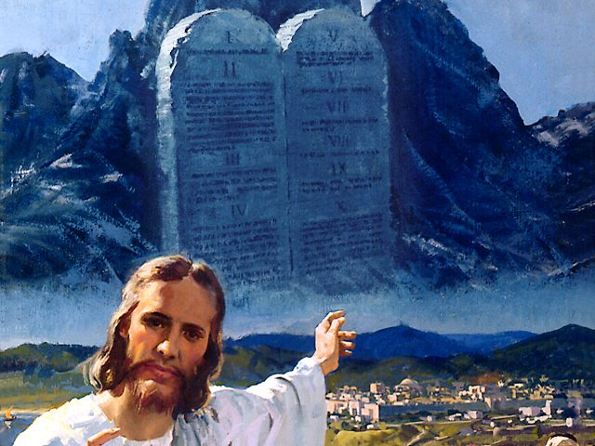
The Camp of the Israelites
and
The Camp of the Philistines

Slide 9
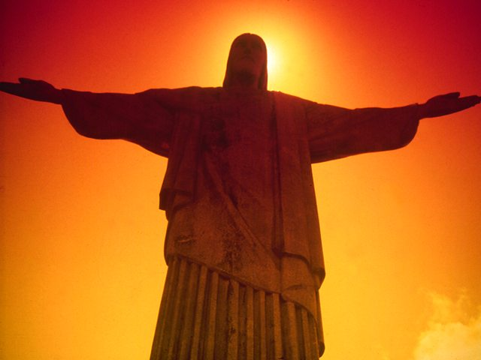
John 17:15-17
“I do not pray that You should take them out of the world, but that You should keep them from the evil one. They are not of the world, just as I am not of the world. Sanctify them by Your truth. Your word is truth.”

Slide 10

Love not the world !
What does the world offer us ?

Slide 11

World Economic Conditions
2 Timothy 3:1-5
“But know this that in the last days perilous times will come: for men will be lovers of themselves, lovers of money, boasters, proud…”

Slide 12
Escalating Bankruptcies
James 5:3,4 “Your gold and silver are corroded,… You have heaped up treasure in the last days. Indeed the wages of the laborers who mowed your fields, which you kept back by fraud, cry out…”

Slide 13
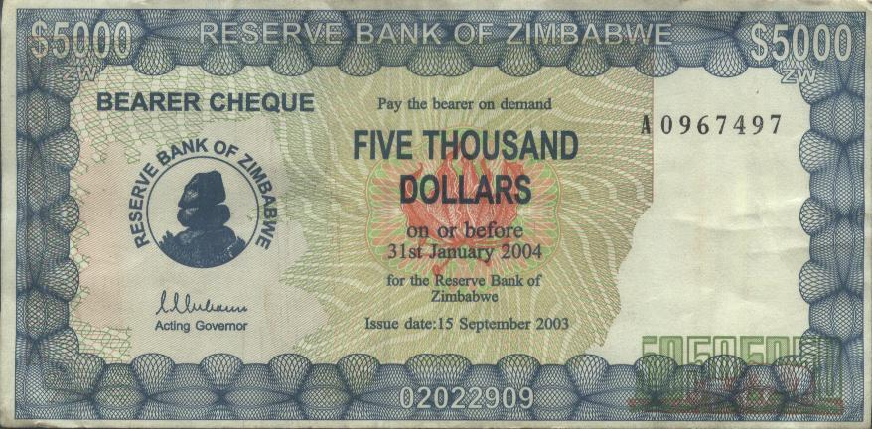
?

Slide 14
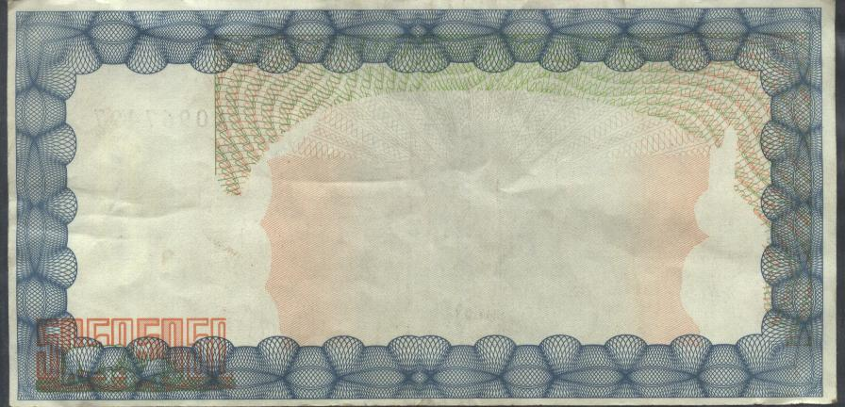
?

Slide 15
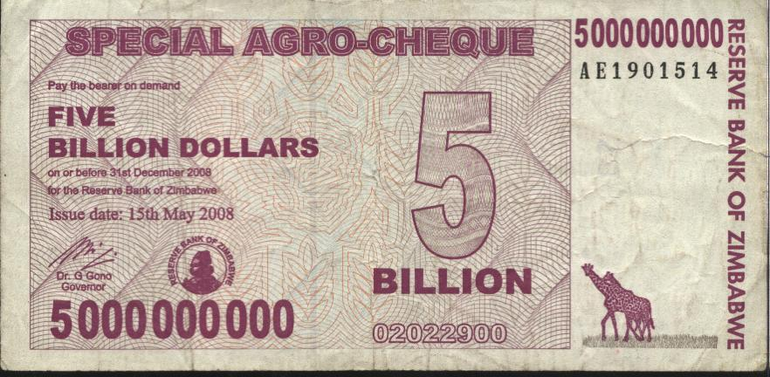
?

Slide 16
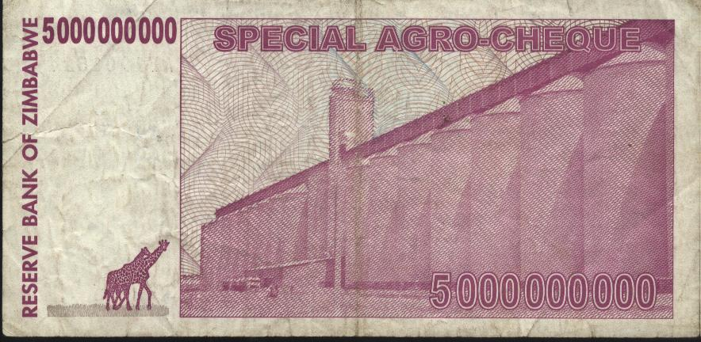
?

Slide 17
Testimonies vol. 9 p13
“There are not many, even among educators and statesmen, who comprehend the causes that underlie the present state of society…

Slide 18
9T 13 (Continue)
…Those who hold the reins of government are not able to solve the problem of moral corruption, poverty, pauperism, and increasing crime…

Slide 19
9T 13 (Continue)
…They are struggling in vain to place business operations on a more secure basis. If men would give more heed to the teaching of God’s word, they would find a solution of the problems that perplex them.”

Slide 20
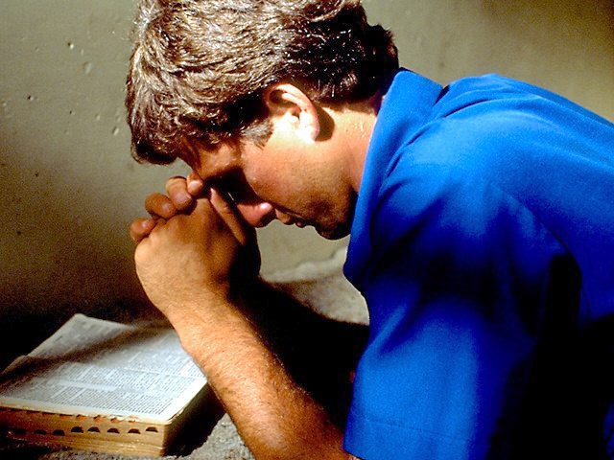
Where should I invest my money ?

Slide 21
Testimonies Vol. 6, p.448
“There are only two places in the world where we can deposit our treasures - in God’s storehouse or in Satan’s, and all that is not devoted to Christ’s service is counted on Satan’s side and goes to strengthen his cause.”

Slide 22
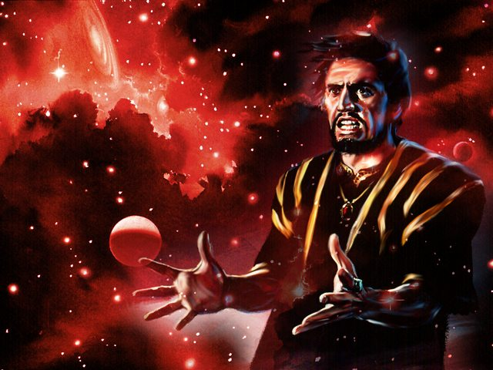
(The Devil’s Workers Meeting) Testimonies to Ministers, p 473,474
“Go make the possessors of lands and money drunk with the cares of this life. Present the world before them in its most attractive light, that they may lay up their treasure here and fix their affections upon earthly things…

Slide 23
TM.473-4 (Continued…)
…We must do our utmost to prevent those who labour in God’s cause from obtaining means to use against us. Keep the money in our ranks. The more means they obtain, the more they will injure our kingdom by taking from us our subjects…

Slide 24
TM.473-474 (Continued)
…Make them care more for money than for the up building of Christ’s kingdom and the spread of the truths we hate, and we need not fear their influence; for we know that every selfish, covetous person will fall under our power, and will finally be separated from God’s people.”

Slide 25
SATAN’S STRATEGY
The Target- Owners and Possessors
The Aim- Shift Focus: Invest in the World
The Method- Prevent Funds From Leaking
The Danger- The Three Angel’s Message
The Result- Eternal Separation

Slide 26
Christ Object Lessons p.351 “Money has great value because it can do great good…But money is of no more value than sand, only as it is put to use
- In providing for the necessities of life,
- In blessing others,
- And advancing the cause of Christ.”

Slide 27

Testimonies Vol.3 p.387
“Practical benevolence will give spiritual life to thousands of nominal professors of the truth. It will transform them from selfish, covetous worshipers of mammon to earnest, faithful co-workers with Christ in the salvation of sinners.”

Slide 28

Christ Object Lessons p.351
“Some think that only a portion of their means is the Lord’s. When they have set apart a portion for religious and charitable purposes, they regard the remainder as their own, to be used as they see fit. But in this they mistake. All we possess is the Lord’s and we are accountable to Him for the use we make of it.”

Slide 29
Bible Characters and money
- Remember Lot’s wife- Gen.13
- Achan- Joshua 7
- Gehazi- 2 Kings 5
- The yuppie- Matt. 19:16-22
- Ananias & Sapphira- Acts 4,5
- Judas Iscariot- Matt. 27:3-5
- Abraham: father of the faithful Gen.12-15
- Moses: greater riches- Heb.11:24-26
- Zacchaeus: the tax collector- Luke 19

Slide 30
5 MR 255 “It should be our highest aim in life to get ready for heaven.”

Slide 31
What is
the real issue
before us ?
Selfishness
vs
Sacrifice

Slide 32
The End

Slide 33
With acknowledgement and honour to our Heavenly Father for the wisdom and insight granted to G. Edward Reid, former Stewardship Ministries Director, North-American Division, whose series “Your Finances in Changing Times” as well as “It’s Your Money, Isn’t It?” laid the foundation for the “Money, Money, Money…!” seminar.

Slide 34
?

